Slide 1
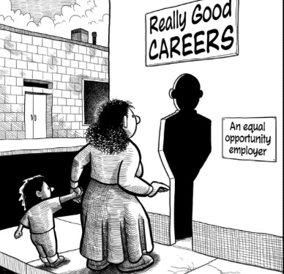
What do you understand by this cartoon?

Slide 2
Think about it….
What does gender mean to you?
Your task: On the flip chart paper, write down all of the words that you associate with the words ‘Gender’, ‘Male’ and ‘Female’

Slide 3
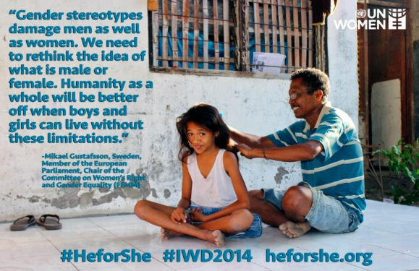
Gender stereotypes affect Men and Women

Slide 4
What is gender?
SEX | GENDER
Biological | Socially-constructed
Born with | Not born with
Cannot be changed | Can be changed

Slide 5
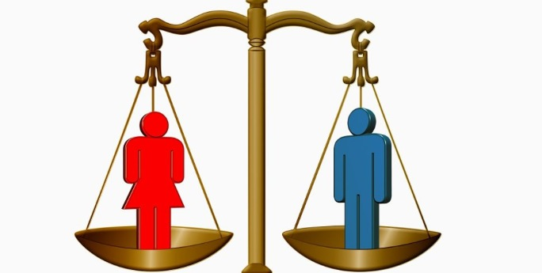
How can we promote gender equality?
Think about it….
Your task: in you groups, come up with 5 ideas/strategies which could help promote and achieve gender equality
Time 10 minutes

Slide 6
Gender and poverty
What is the link?

Slide 7

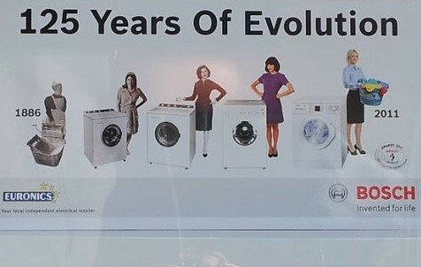


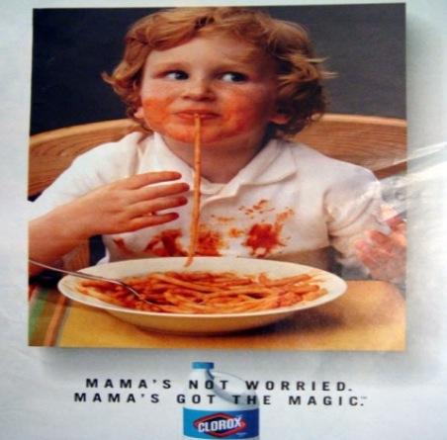
Gender stereotypes in the media

Slide 8
How do gender stereotypes affect men and women?

Slide 9
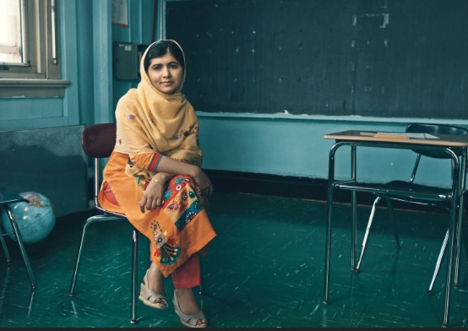
Who is Malala Yousafzai? Why do you think she was nominated for the Nobel Peace Prize?
“Girls must be told at an early age that they have the potential to become influential leaders before they fall victim to their own self-doubt.”

Slide 10
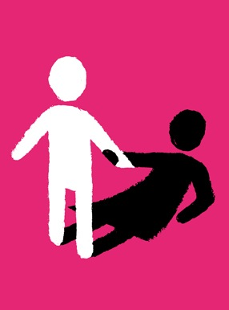

What do these images say to you?

Slide 11
Some facts:
Women earn only 10% of the world’s income and yet carry out two-thirds of the world’s unpaid work
On average women earn three-quarters of men’s earnings for the same work or work of an equal value
In the developing world, women are still responsible for between 60% and 80% of food production but have limited control over the land and other assets.

Slide 12
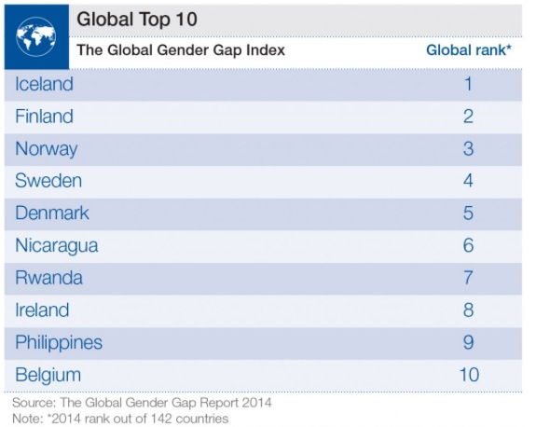

Slide 13
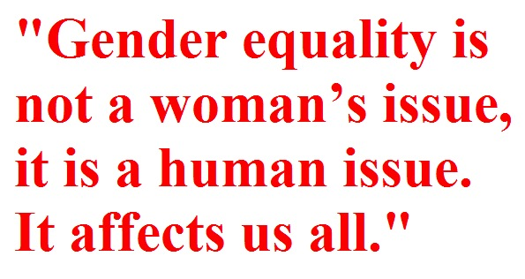

Slide 14


