Slide 1


Energy
WWGS Thematic Online Training Series
LIZZY NOONE, DUBLIN
AISHLING MCGRATH, GALWAY
Notes:
Welcome
- Introduce ourselves
Type in your name and the name of your school in the chat! Also change your name on your Zoom to your first name
Invite people to use the chat

Slide 2

Hopes & Fears
- What do you HOPE to get out of todays session?
- Any FEAR about todays session?

Slide 3
Housekeeping
To mute and un-mute
Turn your camera on
Please use the chat function

Slide 4

Session Plan
An Introduction to Energy - Kate Ruddock
Schools Experience of Exploring Sustainability as a Justice Issue – Louise Nolan, CBS North Brunswick Street
Break & Reflection
Energy: from Knowledge to Action
WWGS 6 Step Programme
Reflection and Next Steps
Notes:
Todays session will be broken into 3 key areas:
Read through slide

Slide 5
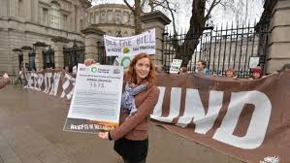
An Introduction to Taking Action on Energy
Kate Ruddock

Slide 6
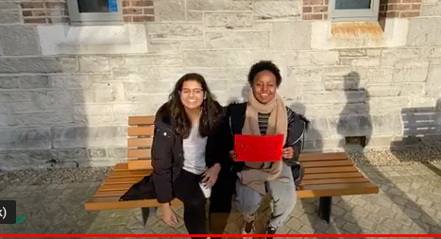
https://www.youtube.com/watch?app=desktop&feature=youtu.be&v=V1BN7yyXGus

Slide 7
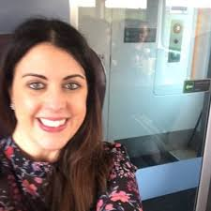
TEACHER INPUT
Louise Nolan, CBS North Brunswick St, Dublin 7

Slide 8
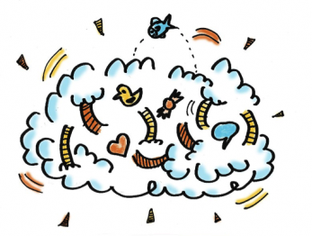
Reflection
Reflect on what you’ve heard this morning..
Consider:
- What are your initial thoughts/ feelings
- Your approach to exploring this theme with students

Slide 9
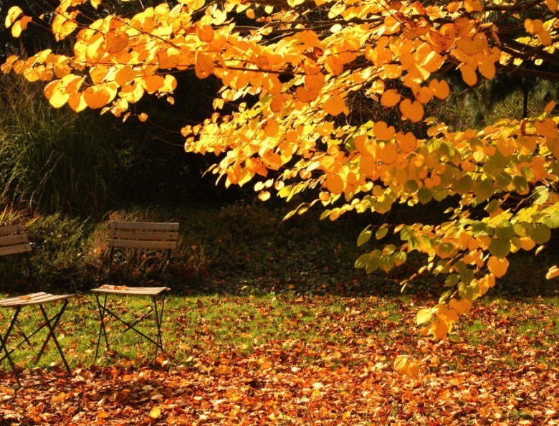


Slide 10
Reflection in Pairs
Share your reflections on:
- Your initial thoughts/ feelings
- Your approach to exploring this theme with students
- How does this relate to your subject?

Slide 11
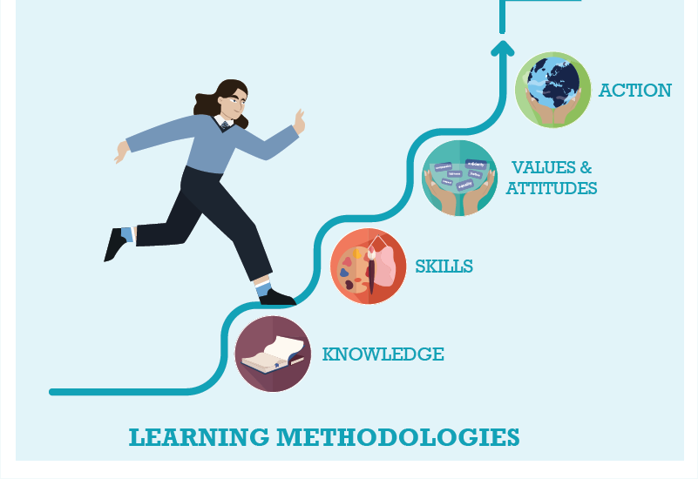



WWGS: 6 Step Programme
Degrowth and Sustainability as a justice issue: from Knowledge to Action
Page
22

Slide 12

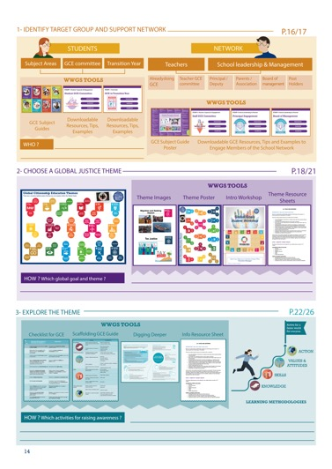
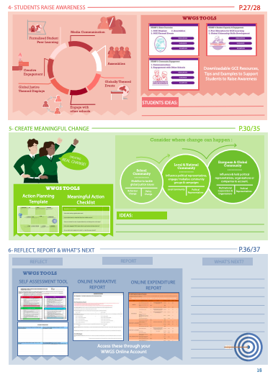
Page
14-15
Notes:
Briefly talk through the 6 steps

Slide 13
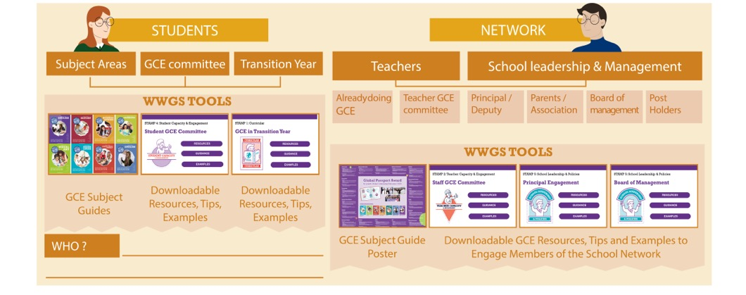
Pages
18-19
STEP 1:
IDENTIFY TARGET GROUP AND SUPPORT NETWORK
Notes:
Ask everyone to reflect on the student group they intend to work with and who in the school they can engage as a support network. Remind them that it’s not all about TY!

Slide 14

TASK:
Consider:
What opportunities are there to explore
Justice issues around degrowth in your subject area(s)?

Slide 15

http://www.worldwiseschools.ie/6-step-programme/
Pages
18-21
STEP 2:
CHOOSE A GLOBAL JUSTICE THEME
Notes:
Introduce the step and the tools available – invite them to use their phone to view the tools on their 6 step programme

Slide 16
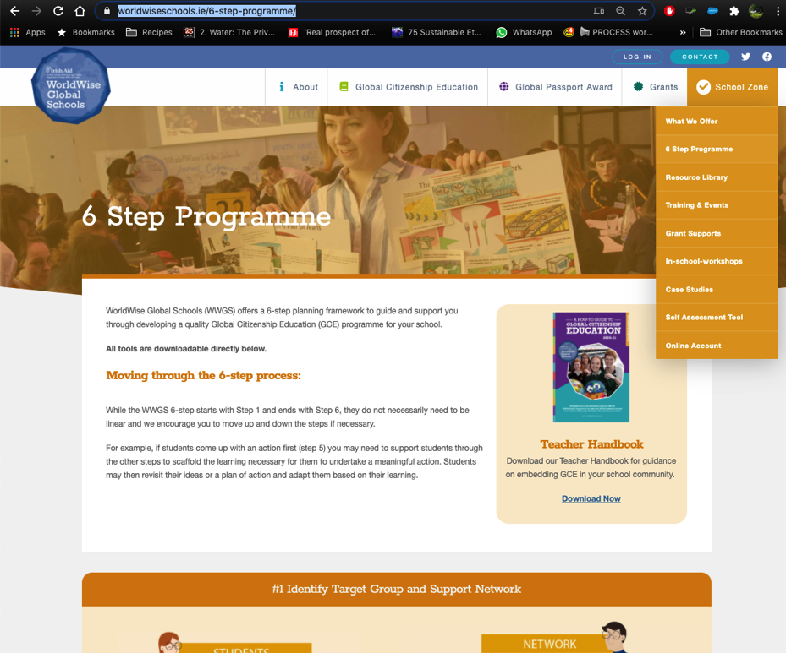

Slide 17

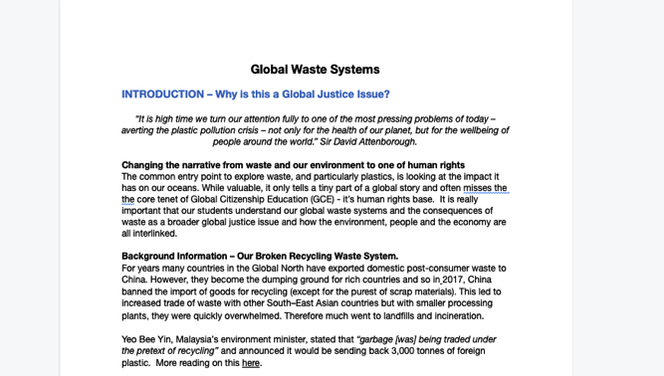
1. Hover over the symbol and a drop down menu appears!
2. Click on the theme and the resource sheet will pop up!
Notes:
Intro to thematic information sheets

Slide 18
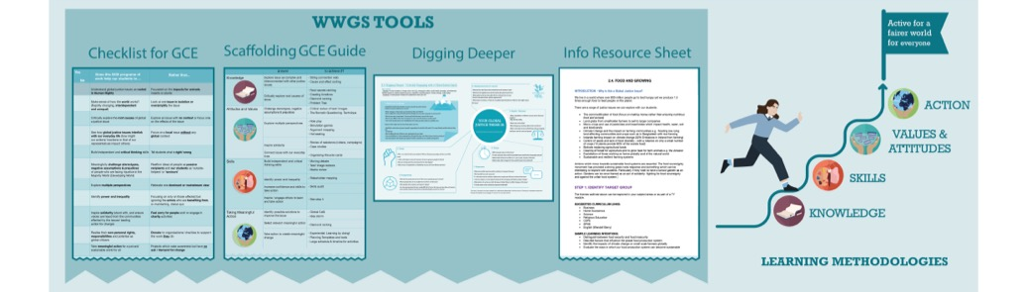
Pages
22-26
STEP 3:
EXPLORE THE THEME
Notes:
Be sure to change to your own date here!!

Slide 19
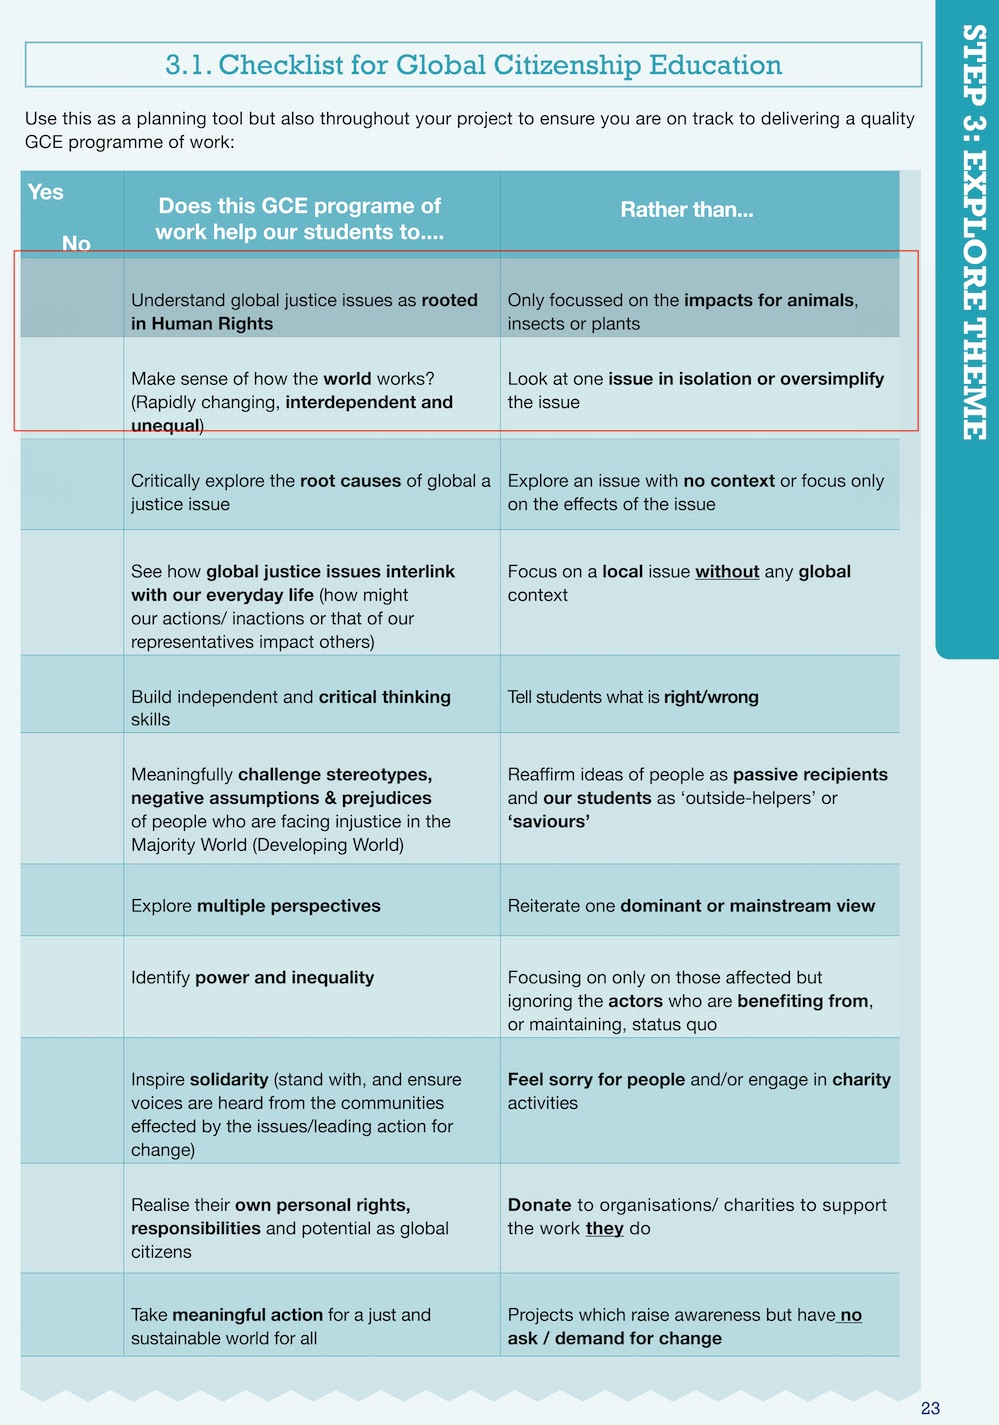

Slide 20
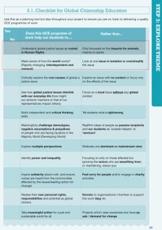
Task
Instructions
Review the two points on the GCE checklist which have been framed in red
What practical things can you do to ensure that your take a GCE approach to waste in the classroom?
(ensure it falls into the left column and not the right?)
Notes:
Room 1: https://docs.google.com/document/d/1ADSyfeoNwfrDDegX8E_FhGlOnjgYYM7CuKnYW5mhv7g/edit?usp=sharing
Room 2:
https://docs.google.com/document/d/1GFRoNr_DzpuzIVtSATNCvYrNNgG5kDTwZKcrn3hX8to/edit?usp=sharing
Room 3
https://docs.google.com/document/d/1v2aWuQhkaG3XTZlR24cu63LkKnSu_45V1nEHTTcnPoo/edit?usp=sharing
Room 4
https://docs.google.com/document/d/1B8L4PpZGmOZsfR0OuFbJ5J6d41v9w5jQui0UU2w6wEw/edit?usp=sharing
Room 5
https://docs.google.com/document/d/1u9pBYugUSs0JP5a5hQ2cHqTDEfWxKx1eP8xGm83Rc40/edit?usp=sharing

Slide 21





STEP 3: EXPLORE THE THEME
TEACHING AND LEARNING MATERIALS: Information websites:

Slide 22



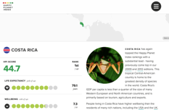
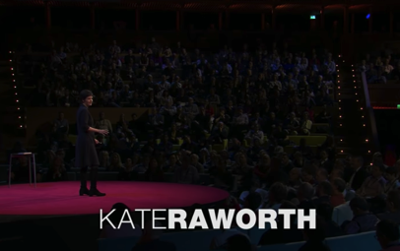
STEP 3: EXPLORE THE THEME
TEACHING AND LEARNING MATERIALS:

Slide 23
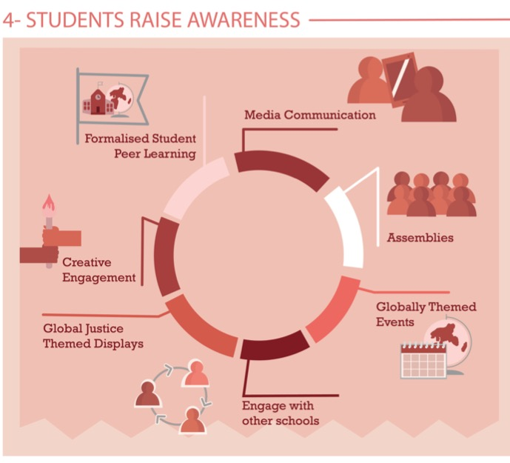
Share Learning
Pages
28-29
Notes:
Media Communication
Assemblies – Intercom
Themed Events –
Global Justice themed displays
Creative engagement
Formalised peer learning

Slide 24
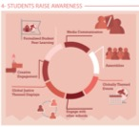
Energy is needed for so much and we use too much-we need to raise
awareness of our need to slow down production and consumption!
Celebrate UN days of action:
-International Mother Earth Dsy 22nd of April
-Buy Nothing Day (On Black Friday!)
Learn and create awareness campaign – Share what you've learned about energy and sustainability so your whole school will learn how important it is
Do an online workshop on energy – share your learning with other students & showcase your work
Have a Crap-free Christmas!

Slide 25
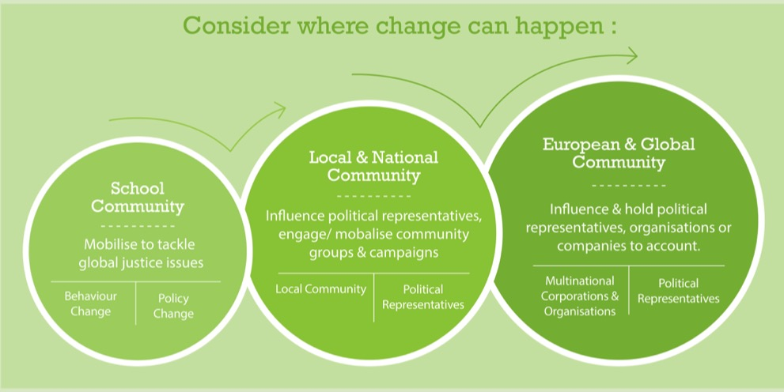
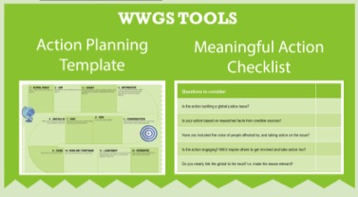
Page
30-35
STEP 5: TAKING MEANINGFUL ACTION
Aims to create Actual Change

Slide 26
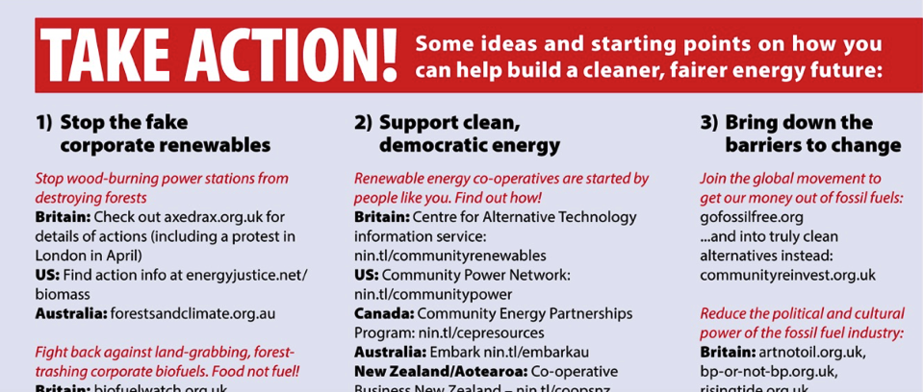


Slide 27

STEP 5: TAKING MEANINGFUL ACTION
Ideas for School Community Actions:
Conduct an energy audit in the school and act on it!
-Discuss and Debate energy-it’s not as simple as switching to renewables!
Ideas for Local and National Community Actions:
-Participate in or organise events, activities, discussions on the issues of energy
-Showcase actions and organisations/ community initiatives. Stream an event online!
Talk with your local leaders and government to support community initiatives and local businesses about energy usage and the possibility of community energy.

Slide 28
How to build a cleaner, fairer energy
future:
Stop the fake corporate renewables!
-wood burning power stations destroying forests
-Fight back against land-grabbiing corporate bio-fuels-Food not fuel
-Stop megadams-The Borneo Project Stop the Dams!
2. Support clean democratic energy
-renewable energy co-operatives-check out https://communitypower.ie
-gain the skills to build your own-Technology class project?
-Support campaigns for taking back energy into democratic and community control-Stop Climate Chaos
3. Bring down the barriers to change
-Support DeGrowth, Doughnut Economics, Circular Economy
-Divestment of fossil fuels
-Reduce the power of the fossil fuel industry

Slide 29
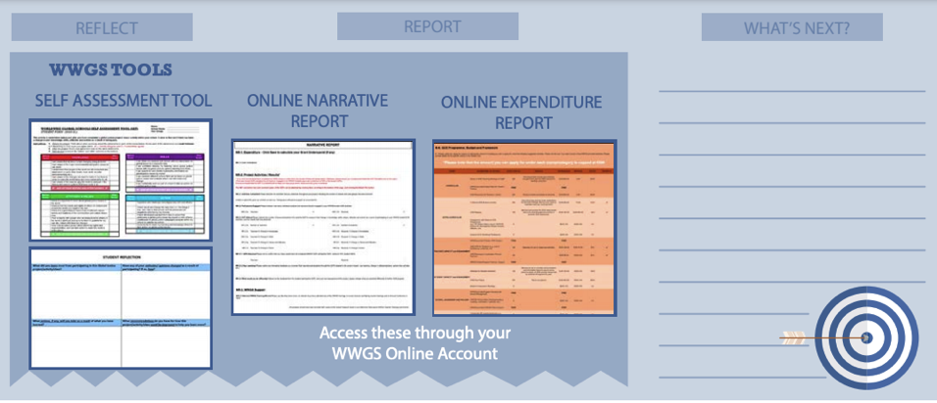
STEP 6:
REFLECT, REPORT AND WHAT’S NEXT?
Pages
36-41

Slide 30
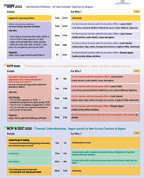
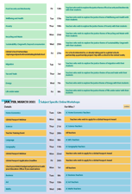
Upcoming Dates
Pages
4-6
Thematic Training Sessions
November
- Anti-Racism: - RECORDED
- Fast Fashion: RECORDED
- Food Security & Biodiversity: RECORDED
- Poverty: RECORDED
- Recycling & Waste: RECORDED
- Sustainability/ Degrowth: Recorded
December
- Migration: Tues 1st-Recorded
- Tax & Trade: Now!
- Energy: Mon 7th
- Life Under Water: Wed 9th
- Wellbeing & Health: Fri 11th
Global Passport Award
Webinar - January
Subject Specific Workshops
Jan- March 2020
Notes:
In terms of the breakdown of trainings, outline the 5 types of training
Purple – starter trainings – (today) for new schools and teachers new to GCE (perhaps their school has been involved longer)
Pink – WWGS approach and adapting to covid-19 – for ALL schools and teachers. Even for schools who have been involved for a while. Updated theory and practice
Green – Thematic areas
Blue – subject specific
Yellow – standard WWGS trainings and events. And deadlines.

Slide 31
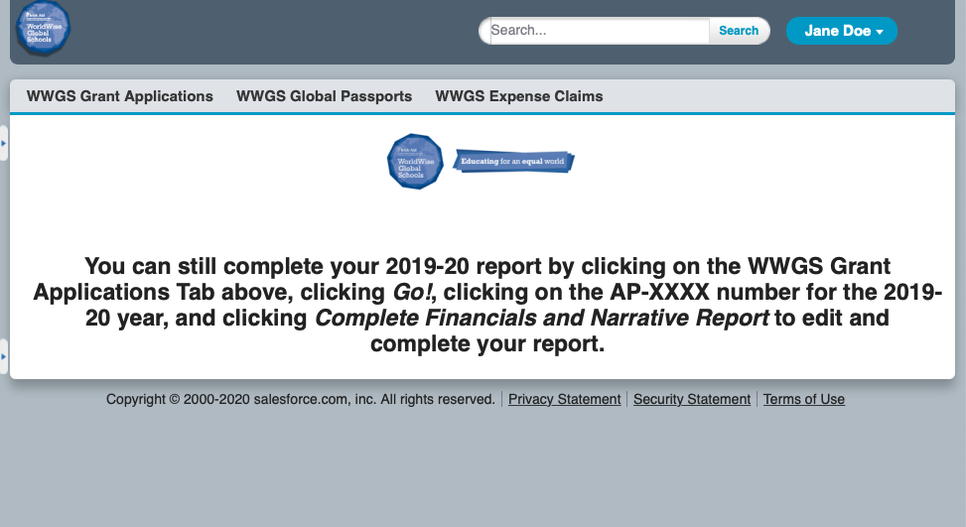
Or, if you think you will have an underspend, use your grant

Slide 32
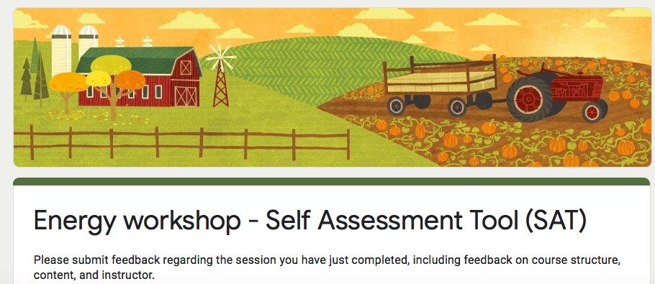
Evaluation for Today
https://forms.gle/hpgGYH8wCYEZZmmg6
Notes:
https://forms.gle/hpgGYH8wCYEZZmmg6

Slide 33
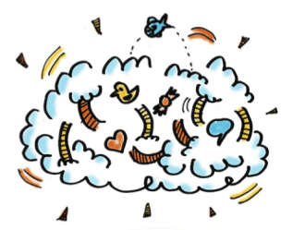
- What are the steps are you going to take next?
- What supports do you need?
Reflection & What Next?

Slide 34




Lizzy.noone@worldwiseschools.ie
086 8720879

