Slide 1
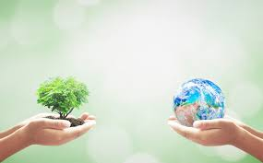
Sustainability
What does this word mean?

Slide 2
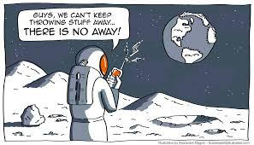
Sustainability
It is how we meet the needs of the present without the ability of future generations to meet their own needs.
Comment on meaning of the cartoon?

Slide 3
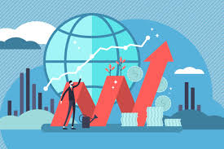
Economy
What does ‘Economy’ mean?

Slide 4
Economy
‘Aggregate of monetized activities done by people’ by David Pilling ‘The Growth Delusion’
GDP= invented by politicians around World War 1 to see how much the British government had to spend on the war.
Gross domestic product (GDP) is the standard measure of the value added created through the production of goods and services in a country during a certain period. As such, it also measures the income earned from that production, or the total amount spent on final goods and services (less imports).

Slide 5
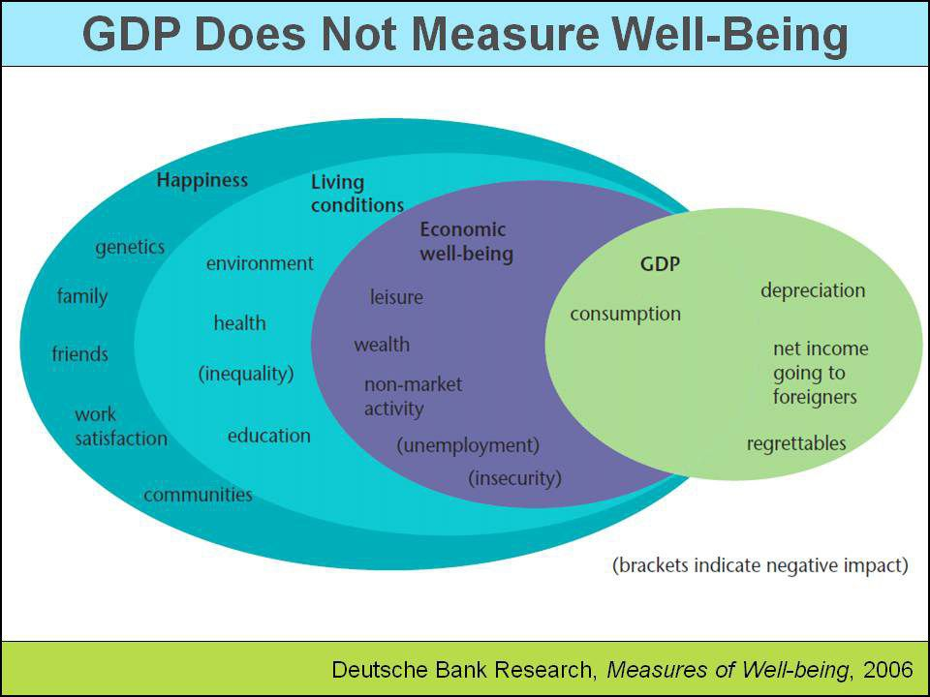
GDP does not measure the following….

Slide 6
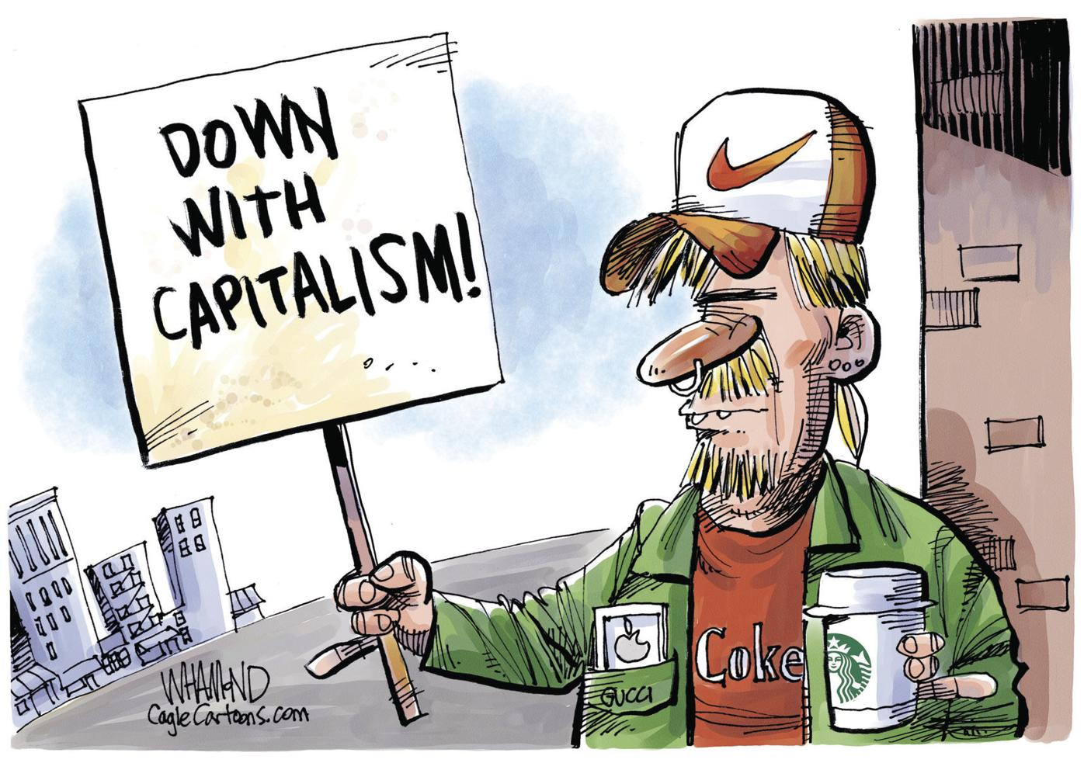
Capitalism
What is your understanding of it?

Slide 7
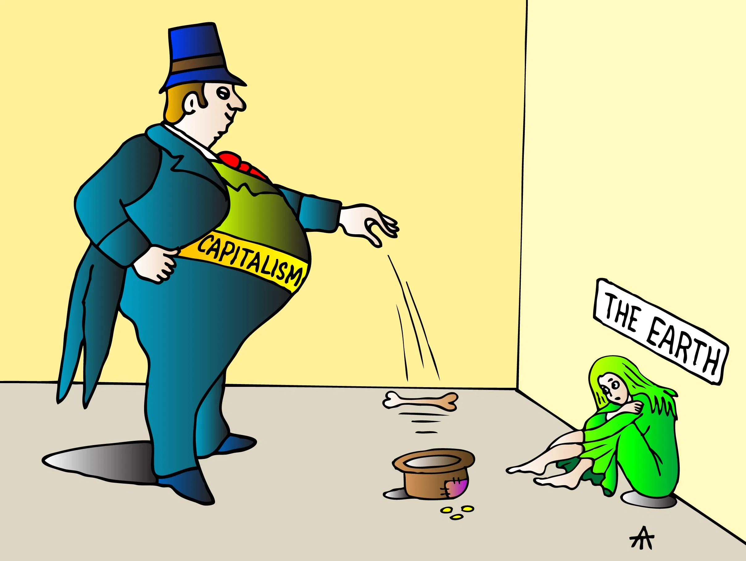
Capitalism
Capitalism is the driving forces for economic expansion lie in the urge of capital to accumulate…
Comment on this cartoon….

Slide 8
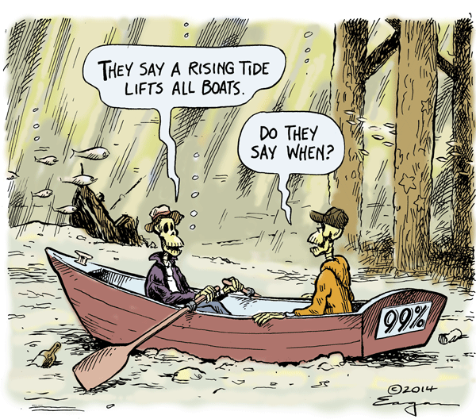
What do you think this means?

Slide 9
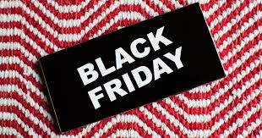
Black Friday: what is it and how does it impact planet?

Slide 10
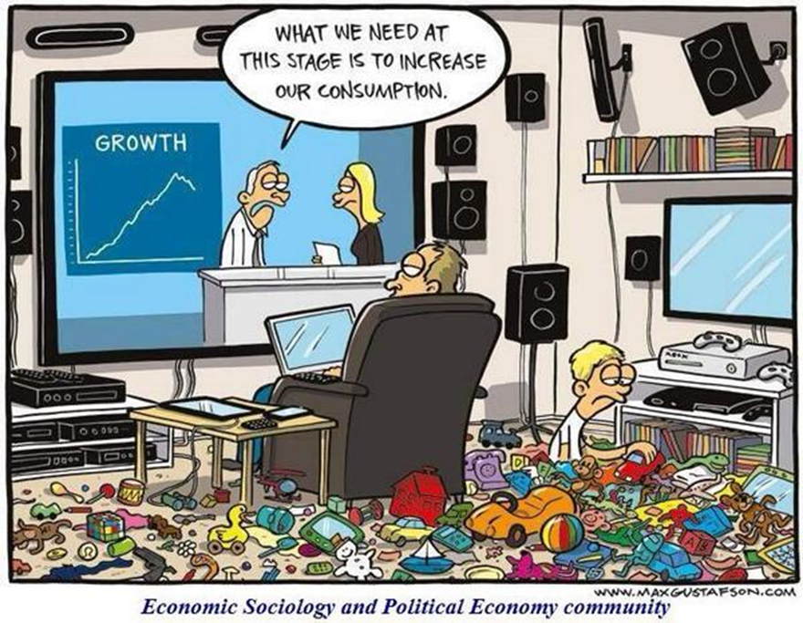
Where we are at the moment as humans..

Slide 11
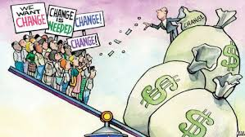
Putting it all together…
GDP will be high (looks good) if top wealthiest people making more money but most people are not.

Slide 12

Degrowth
This is a different way of running the economy….
At the moment…

Slide 13

Degrowth
A planned reduction of total energy and material use to bring the economy in line with planetary boundaries, while improving people’s lives by distributing income and resources fairly.

Slide 14
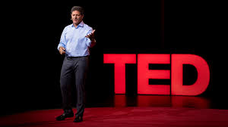
The Dirty Secret of capitalism (TED Talk)
https://www.ted.com/talks/nick_hanauer_the_dirty_secret_of_capitalism_and_a_new_way_forward?language=en
16 mins

Slide 15
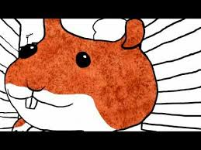
The impossible Hamster=neoliberal theory
https://www.youtube.com/watch?v=bqz3R1NpXzM

Slide 16
Who/What is doing the damage?
Discuss..

Slide 17
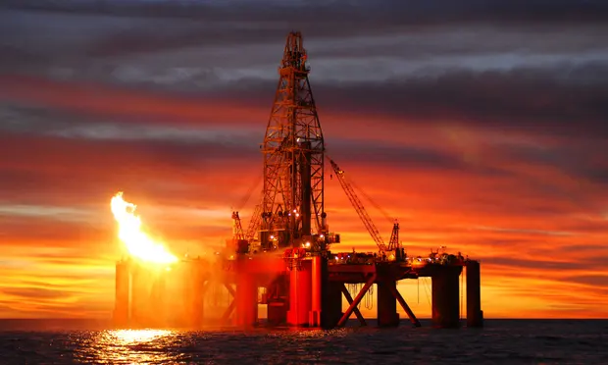
Top 100 companies creating 71% of the world’s emissions
https://www.theguardian.com/sustainable-business/2017/jul/10/100-fossil-fuel-companies-investors-responsible-

Slide 18

What is solution?
Discuss……

Slide 19
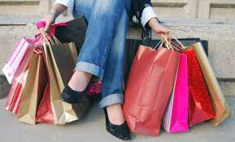
What do we need to do?
Have to have sufficiency….
Not enough to make energy more efficient.
We need to reduce our consumption…

Slide 20
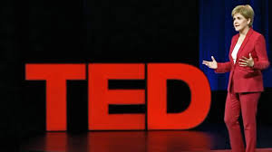
Why governments need to focus on wellbeing not just capitalist ideals:
https://www.ted.com/talks/nicola_sturgeon_why_governments_should_prioritize_well_being?language=en
Nicola Sturgeon is First Minister of Scotland

Slide 21
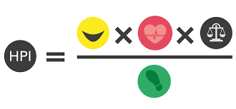
Instead of focussing on GDP
Gross National Happiness
Happy Planet Index
Repair café
4Dayweek.ie
Buenvivir
Genuine happiness indicator
(Take one and research in class on your phone)

Slide 22
Activities
Draw or write what a flourishing community looks like
Moving debate
What contributes to wellbeing but is not monetized.
What could an alternative model of living look like?
Repair workshop
Donut economic map
Chart overshoot days for last 20 years

Slide 23
Resources:
https://350.org/
https://doughnuteconomics.org/
http://virtual.foei.org/trainings/

