Slide 1
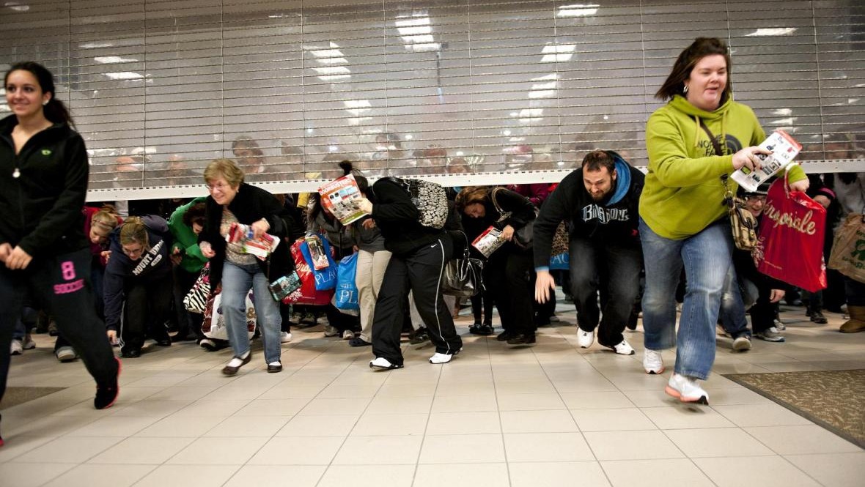
DeGrowth/Beyond Consumerism
WorldWise Global Schools Teacher Training 25/11/2020
Meaghan Carmody
meaghancarmody@gmail.com

Slide 2

What we’ll cover
Learning Objectives / Goals
Rough plan or agenda
Common understanding of core concepts
Context, or relevance of the question of degrowth
Key elements of a growth-based economy
Key elements of a post-growth or degrowth oriented economy
Examples of degrowth in action
Suggested activities
Recap

Slide 3
Goals
By the end of my input, you will:
Gain an deeper understanding of the systemic nature of the prevailing economic order and dominant paradigm
Be introduced to narratives around economic growth which undergird environmental destruction
Know some examples of degrowth in action
Have some ideas of activities you can carry out with your students to help them question the dominant economic model
Leave with some resources to help you dig deeper into these concepts

Slide 4

What does sustainability mean?!
Unmute yourselves and share!

Slide 5
‘Sustainable Development’
The emergence of the concept of sustainable development is a defining feature of the 1980s
Believed that economic growth could finally be integrated with the environment
International Union for Conservation of Nature and Natural Resources (ICUN) published the World Conservation Strategy with the co-operation of the United National Environment Programme (UNEP) and the World Wildlife Fund (WWF)
First strategic international undertaking to place the concept of sustainable development on the agenda

Slide 6
1980 World Conservation Strategy
“Humanity’s relationship with the biosphere (the thin covering of the planet that contains and sustains life) will continue to deteriorate until a new international order is achieved, a new environmental ethic is adopted, human populations stabilised, and sustainable modes of development become the rule rather than the exception... For development to be sustainable it must take account of social and ecological factors, as well as economic ones; of the living and non-living resource base; and of the long term as well as short term advantages and disadvantages of alternative actions.” (IUCN, 1980, Section1)

Slide 7
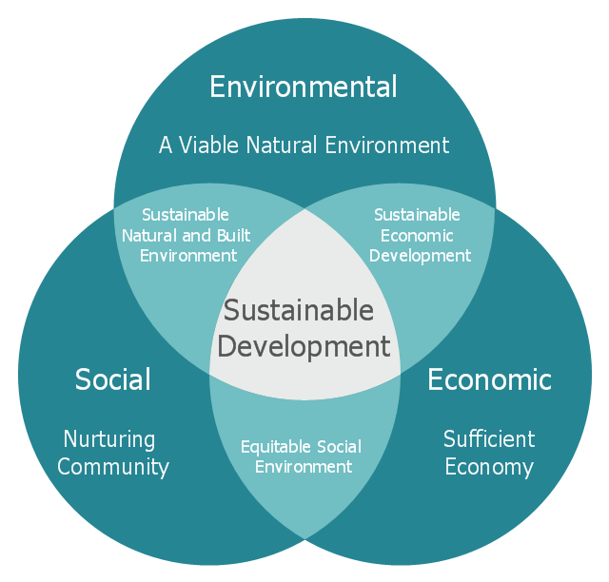

Slide 8
1987 World Commission on Environment and Development
  Sustainable development = progress that:
  “meets the needs of the present without compromising the ability of future generations to meet their own needs.” (Our Common Future, p.43)

Slide 9

Let’s return to our definition of sustainability…are we achieving sustainable development?

Slide 10
Can we have it all – profit plus planet?
“meets the needs of the present without compromising the ability of future generations to meet their own needs.” (Our Common Future, p.43)

Slide 11
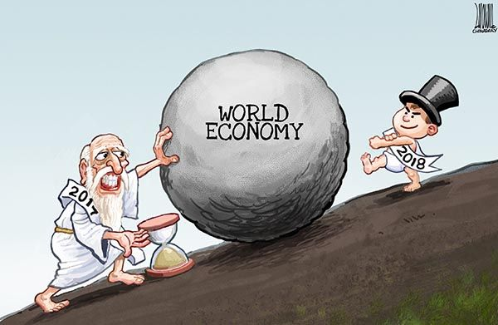
What is the ‘economy?’
Type in chat box

Slide 12
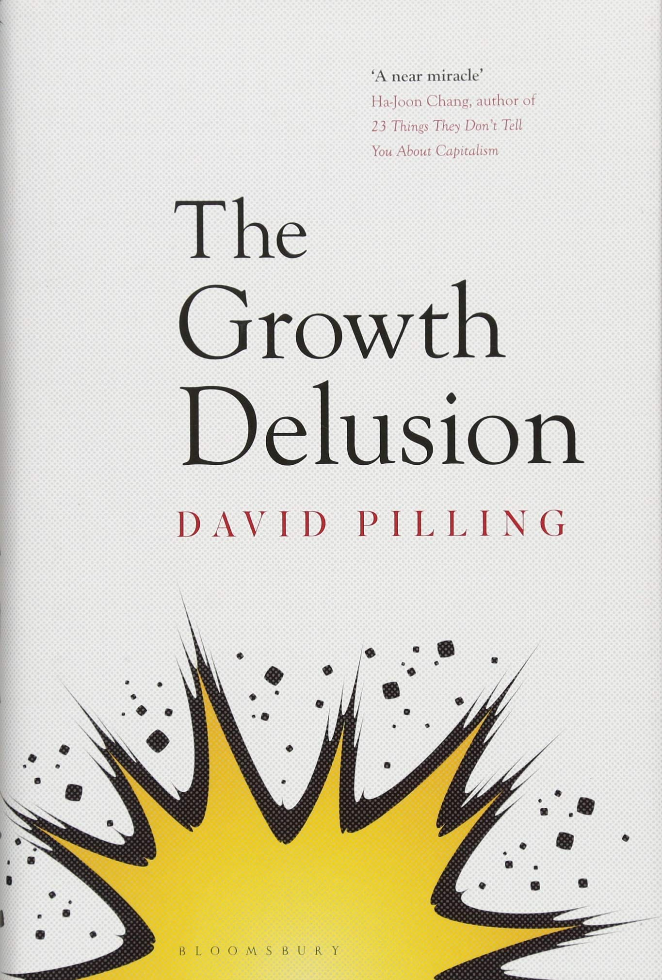
The Economy
Aggregate of monetized activities done by people

Slide 13
Economic Growth and the Dominant Organizing Principle of the Economy
According to Pirani (2018, p.2), the driving forces for economic expansion lie in the constant urge of capital to accumulate.
Capitalism survives by over-accumulating capital and finding new frontiers in which to put it.
It needs to eliminate all spatial barriers and can only do this through the production of fixed space via long-term infrastructural projects - it thus requires dispossession of territory for ‘spatial fixes’ (Harvey, 2008).

Slide 14
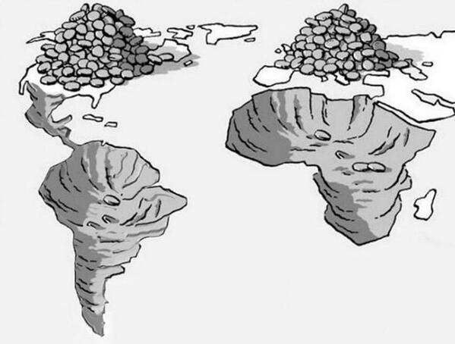
Capital Accumulation & Spatial Fixes

Slide 15
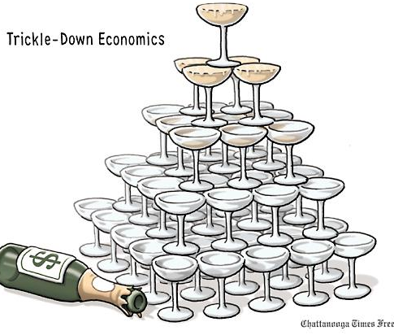
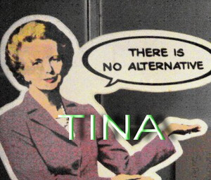
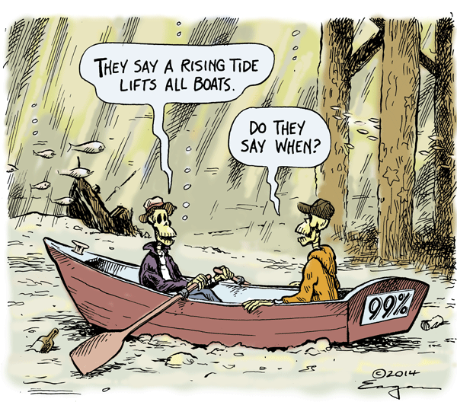
Neoliberalism
Neoliberal globalization is the production of space for capital fixation.
What’s more, it is based on the transnationalization of corporations from many origins. Economies are ‘transnationalized’ in an effort to generate profit margins for investors.

Slide 16
‘Common Sense’ –an ideological battle ground
Critical theory “does not take institutions and social and power relations for granted but calls them into question by concerning itself with their origins and whether they might be in the process of changing” (Robert Cox, 1995).
‘Common sense’ is defined as an ideological construction in which the interests of the dominant class are represented as the general interests of all (Rupert, 2003, p. 192), while the social and moral claims of working people and the poor are reduced to the pleadings of ‘special interests’ which much be resisted in order to ensure the smooth continuation of capital accumulation.

Slide 17

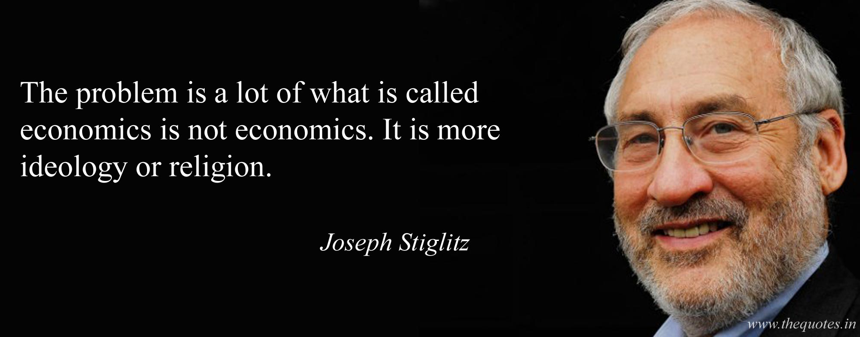
Paradigm Maintenance
Establishing consent = gaining power

Slide 18
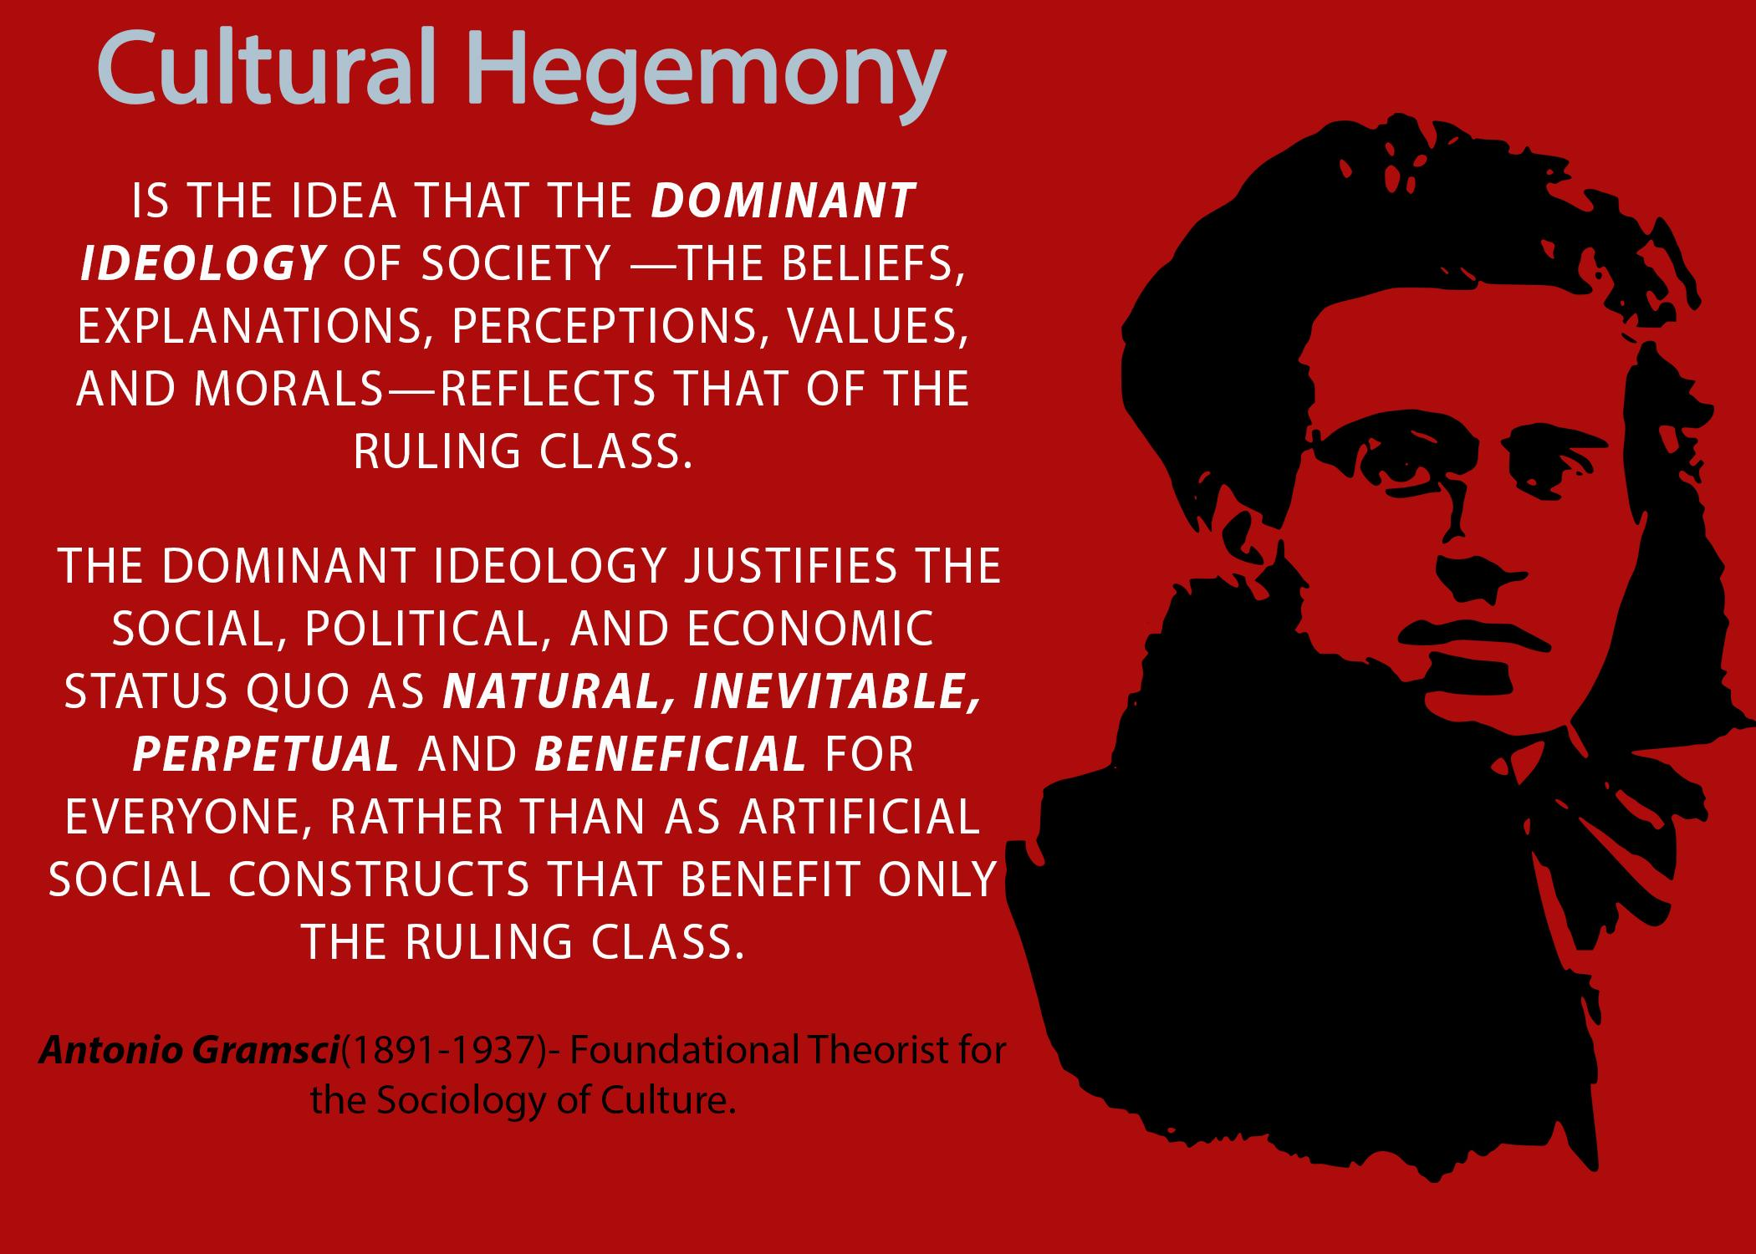
Cultural Hegemony
A Gramscian understanding of hegemony takes it to mean both coercion and consent are wielded to control the private sphere, which reinforces control in the public sphere.
It promotes authority based on “intellectual and moral leadership” rather than pure domination (Gramsci, 1971 as cited in Mueller, 2011).

Slide 19
Critical Pedagogy as an attempt to deconstruct neoliberal ‘common sense’
Requirements:
Critical consciousness
A desire to question prevailing norms
A desire to shatter ways of thinking that legitimate forms of social and political control.

Slide 20
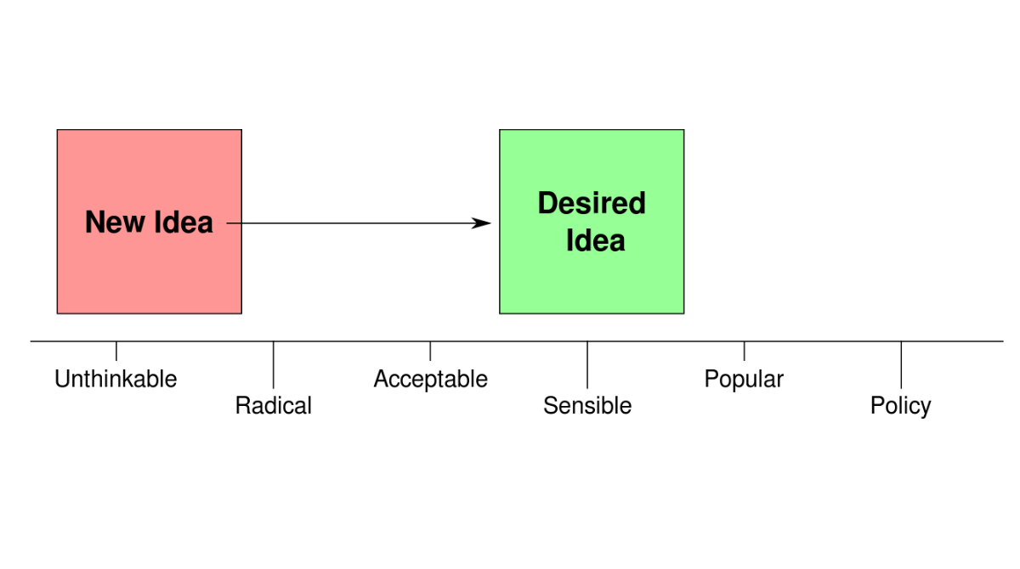
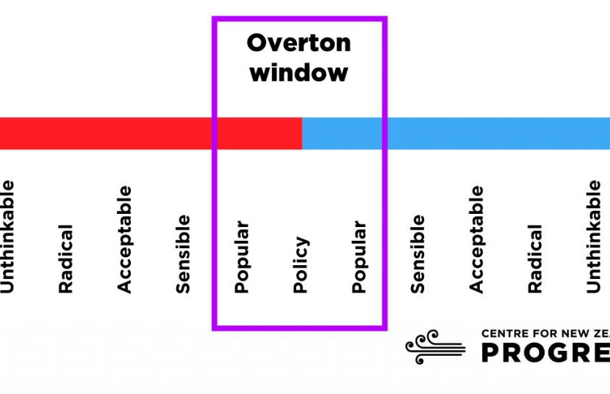
The Overton window is the range of policies politically acceptable to the mainstream population at a given time. The window frames the range of policies that a politician can recommend without appearing too extreme to gain or keep public office given the climate of public opinion at that time.

Slide 21
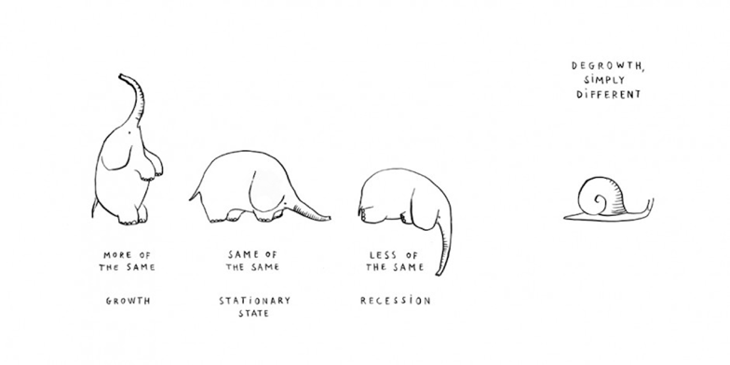

Degrowth
Notes:
Misleading as it’s not just growth in reverse
It is a paradigm shift

Slide 22
Back to caves?
Not ‘growth in reverse’!

Slide 23
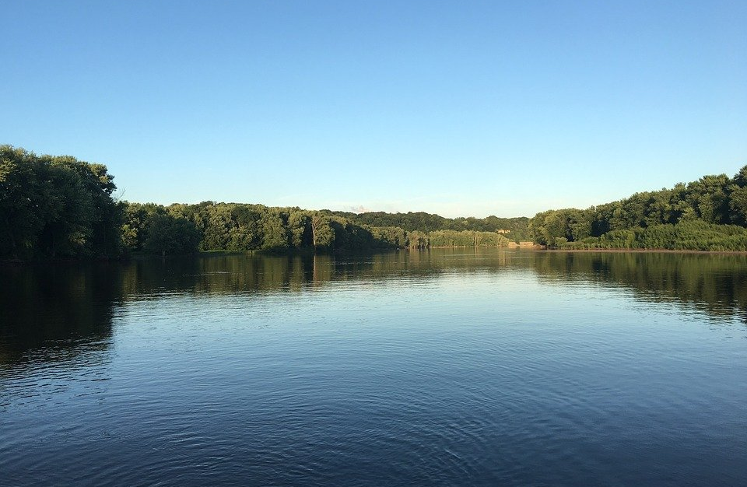
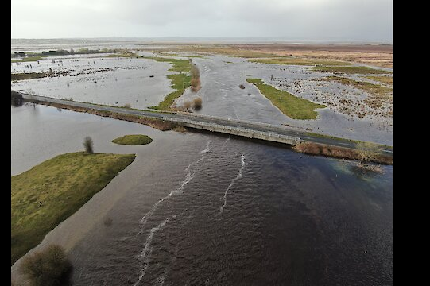
A river returns to its normal flow
Notes:
English speakers sometimes find the word ‘degrowth’ problematic and it can lead to misunderstandings. Reading just the word, it has a negative, and for some, a non-ecological connotation. But the origin of the term is anything but that. It is to be found in Latin languages, where “la décroissance” in French or “la decrescita” in Italian refer to a river going back to its normal flow after a disastrous flood.

Slide 24
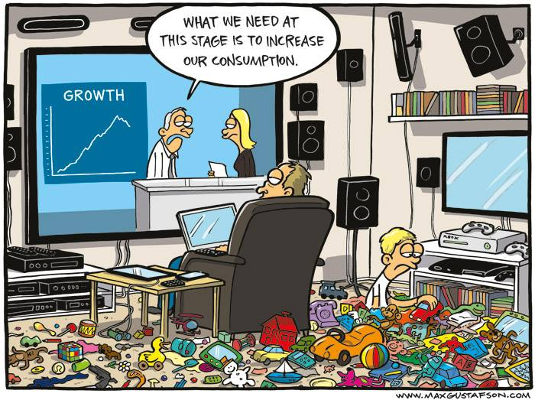

Slide 25
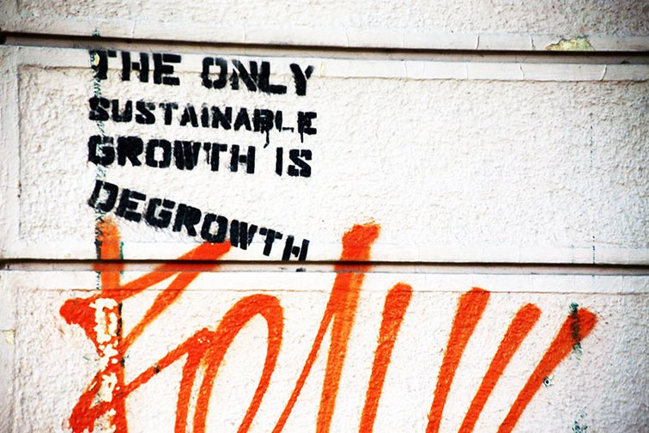
Alternative terms used
Degrowth
Décroissance
Post-growth
Sufficiency

Slide 26
Context & Relevance
Over the last 30 years, in the USA alone, the top one percent has grown 21 trillion dollars richer while the bottom 50 percent have grown 900 billion dollars poorer, a pattern of widening inequality that has largely repeated itself across the world.

Slide 27
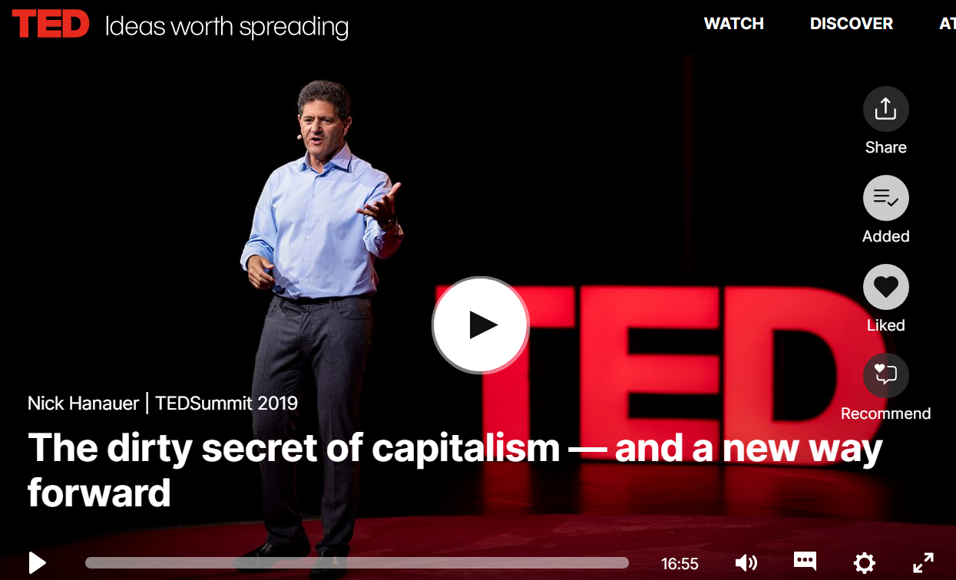
People. Reciprocity. Cooperation.
What we now know is that the economics that made me so rich isn't just wrong, it's backwards, because it turns out it isn't capital that creates economic growth, it's people; and it isn't self-interest that promotes the public good, it's reciprocity; and it isn't competition that produces our prosperity, it's cooperation. What we can now see is that an economics that is neither just nor inclusive can never sustain the high levels of social cooperation necessary to enable a modern society to thrive.

Slide 28
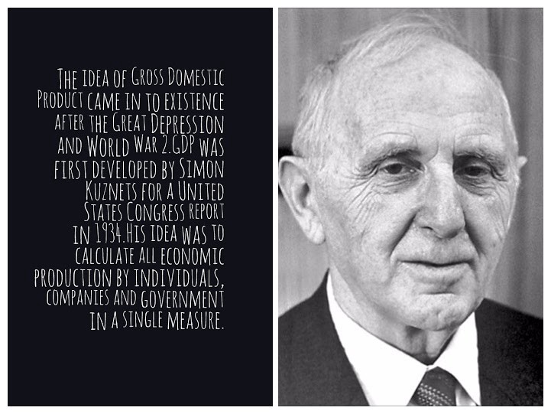
Where did the idea of GDP come from?

Slide 29
GDP
= A gross tally of products and services bought and sold, with no distinctions between transactions that add to well-being, and those that diminish it.
GDP assumes that every monetary transaction adds to well-being, by definition.
GDP treats crime and natural disasters as economic gain.
  GDP increases with polluting activities and then again with clean-ups.
GDP ignores the non-market economy of household and community.
GDP takes no account of income distribution (average does not equal typical!)
  Presents this enormous gain at the top as a bounty to all.

Slide 31
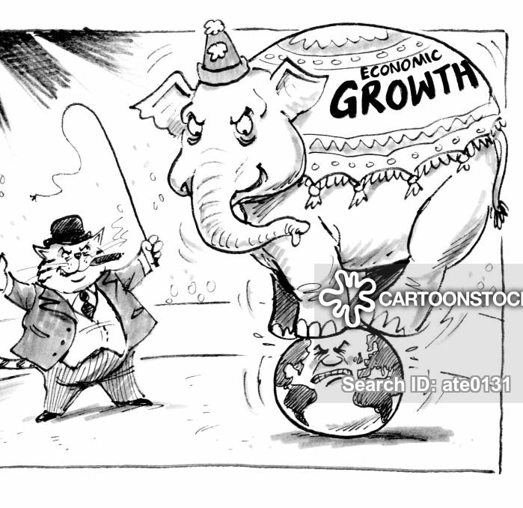
GDP & Environment
1992 report of the Council on Environmental Quality. "Accounting systems used to estimate GDP" the report said, "do not reflect depletion or degradation of the natural resources used to produce goods and services." (1992 Council on Environmental Quality)
→ Portrays ecological breakdown as economic gain.

Slide 32
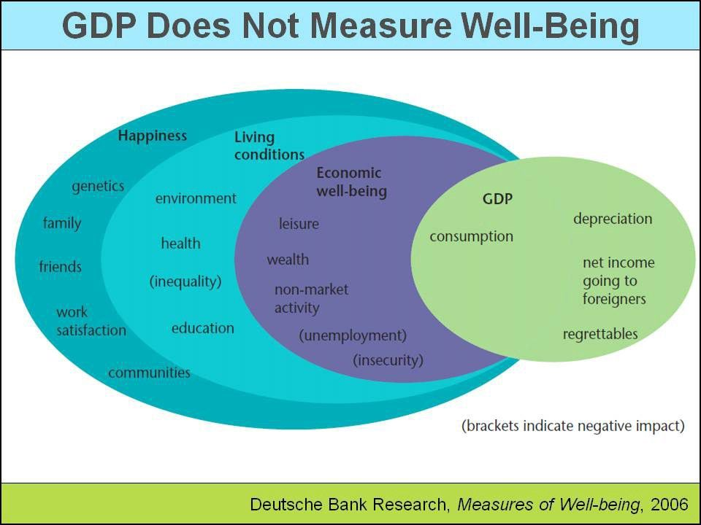
Do we measure what matters?

Slide 33
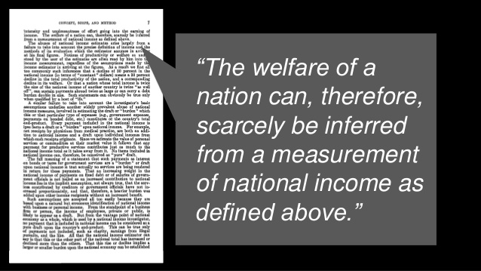
Notes:
Simon Kuznets

Slide 34
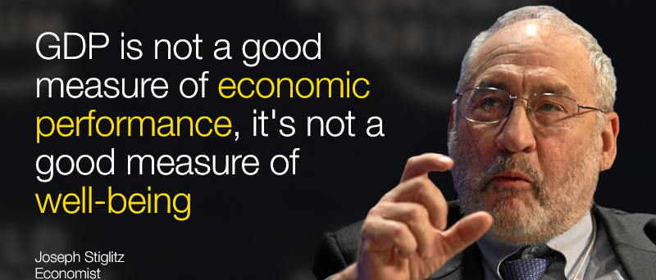
GDP
Joseph E. Stiglitz, a Nobel laureate in economics and University Professor at Columbia University, is Chief Economist at the Roosevelt Institute and a former senior vice president and chief economist of the World Bank. His most recent book is People, Power, and Profits: Progressive Capitalism for an Age of Discontent.

Slide 35
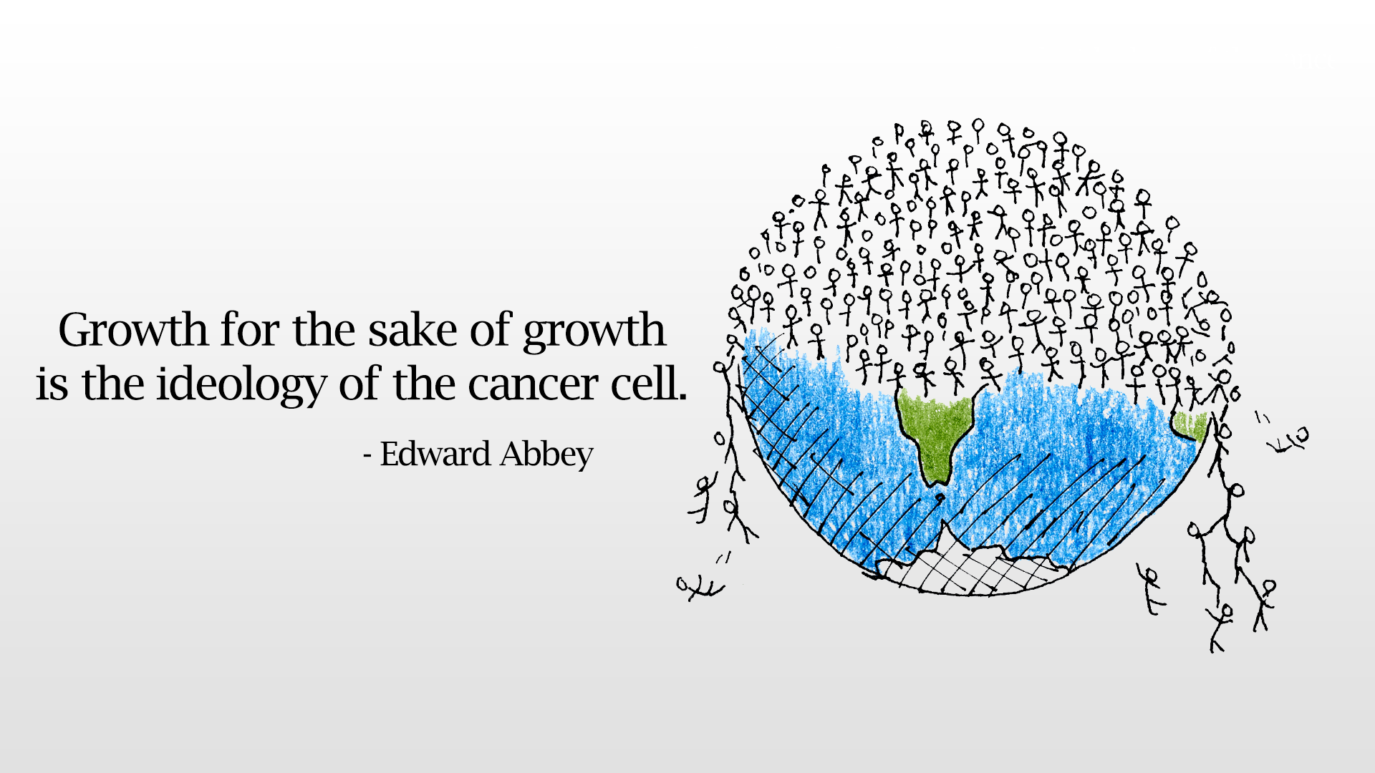
Key principles of a growth-based economy
Prevailing logic of forever-higher-faster-further-more
3% a year
Exponential
Constant growth on a finite planet
Notes:
Or a virus

Slide 36
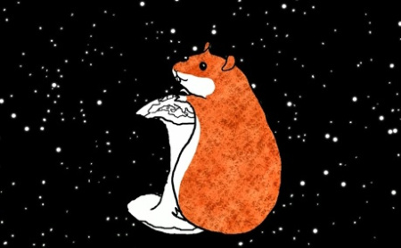
The Impossible Hamster

Slide 37
Changing how we think
Neoliberal economic theory has sold itself to you as unchangeable natural law, when in fact it's social norms and constructed narratives based on pseudoscience. If we truly want a more equitable, more prosperous and more sustainable economy, if we want high-functioning democracies and civil society, we must have a new economics. (Hanauer, 2019).

Slide 39
Who is to blame?
Extractivism has been a mechanism of colonial and neo-colonial plunder and appropriation. This extractivism was forged in the exploitation of the raw materials essential for the industrial development and prosperity of the global North (Acosta, 2013, p.63)
Neoliberal globalisation is based on the globalisation of capitalist relations. Actors at each level of agency (global, national, regional and local) are facilitated to interact with each other. Capital is a dominant social relation, meaning that it possesses a dominant social role impacting how agents interact with one another.
After World War II there was significant restructuring of the global economy, the so called "neoliberal turn" (Harvey, 2005). Within this era emerged a new form of subordination—economic, political, and cultural—of the state to the dynamic of transnational capital.
The production of scale associated with the neoliberal turn has profoundly disrupted the previously existing hierarchies between global and national levels in favour of a subordination of the national to the global. Transnational corporations have become dominant actors, displacing nation-states as leaders in processes of capital accumulation.

Slide 40
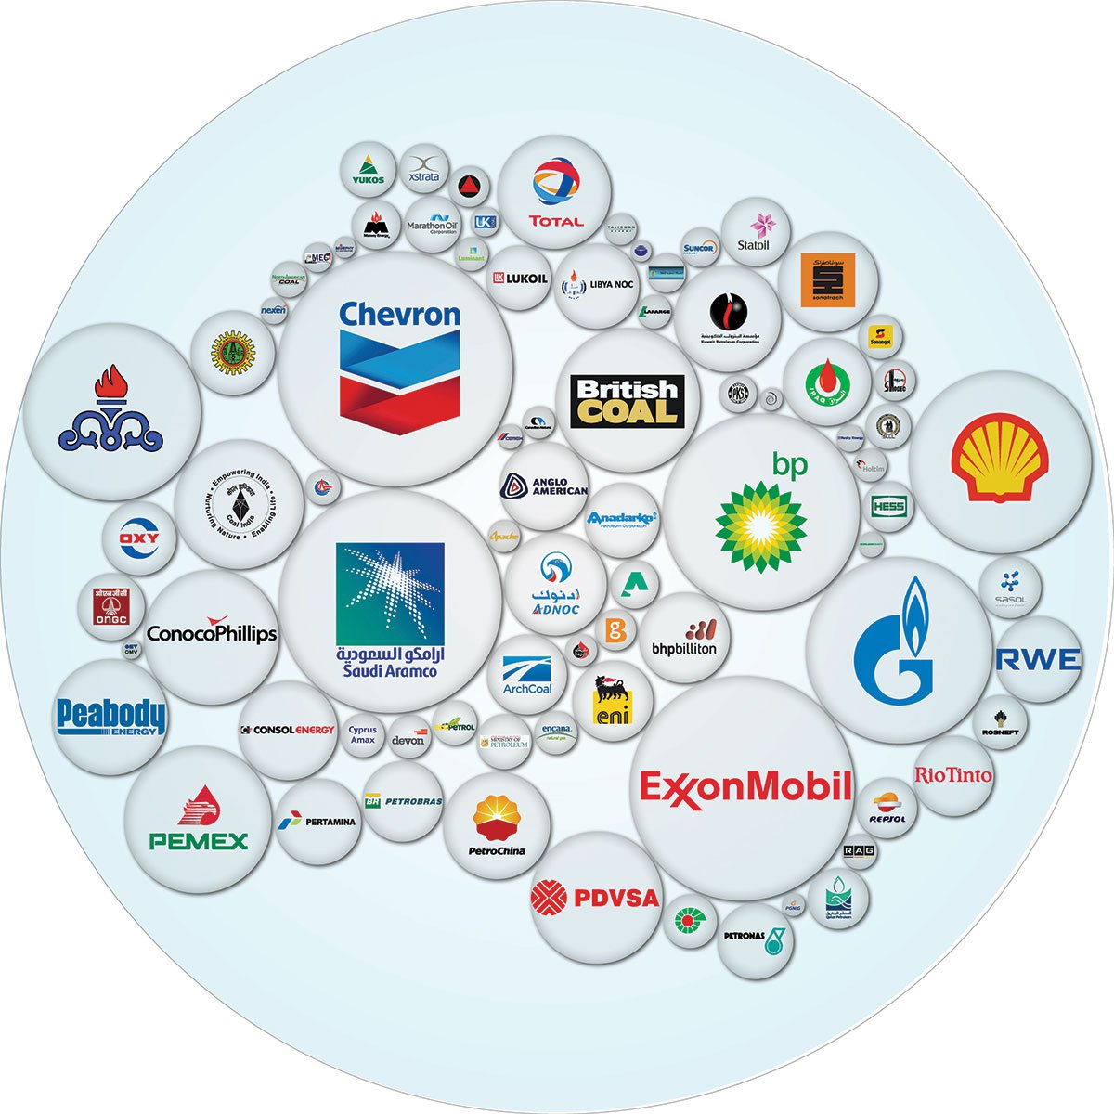
Notes:
The climate crisis of the 21st century has been caused largely by just 90 companies, which between them produced nearly two-thirds of the greenhouse gas emissions generated since the dawning of the industrial age, new research suggests.
The companies range from investor-owned firms – household names such as Chevron, Exxon and BP – to state-owned and government-run firms.
The analysis, which was welcomed by the former vice-president Al Gore as a "crucial step forward" found that the vast majority of the firms were in the business of producing oil, gas or coal, found the analysis, which has been published in the journal Climatic Change.
"There are thousands of oil, gas and coal producers in the world," climate researcher and author Richard Heede at the Climate Accountability Institute in Colorado said. "But the decision makers, the CEOs, or the ministers of coal and oil if you narrow it down to just one person, they could all fit on a Greyhound bus or two."
Half of the estimated emissions were produced just in the past 25 years – well past the date when governments and corporations became aware that rising greenhouse gas emissions from the burning of coal and oil were causing dangerous climate change.
All but seven of the 90 were energy companies producing oil, gas and coal. The remaining seven were cement manufacturers.
.

Slide 41
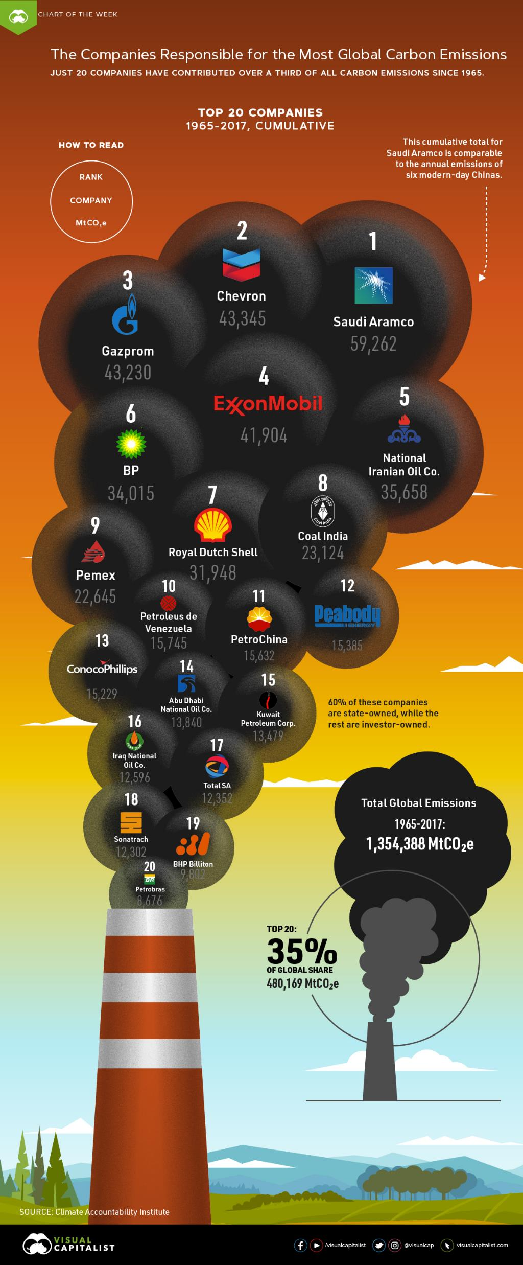
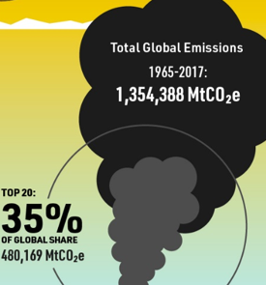
Notes:
https://www.visualcapitalist.com/companies-carbon-emissions/

Slide 42
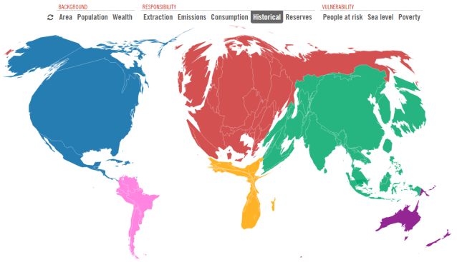
What does this image represent?
Territory sizes show CO₂ emissions from energy use 1850–2011
Notes:
Country sizes show CO₂ emissions from energy use 1850–2011. These historical (or 'cumulative') emissions remain relevant because CO₂ can remain in the air for centuries. Europe and the US dominate, having released around half the CO₂ ever emitted.
Ask them to discuss why this has happened?
http://www.carbonmap.org/#Historical
Climate change as a political issue – what does this represent? It represents the historical responsibility the countries of the world have for the climate change we are experiencing.
Questions: Which countries are the most polluting?
Which countries do you think are suffering the most from the impacts of climate change?

Slide 43
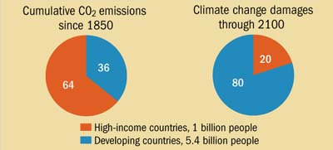
Notes:
Source: IMF

Slide 45
Key elements of Degrowth
Conviviality
Dematerialisation
Simplicity
Degrowth: A vocabulary for a new era

Slide 46
Degrowth
A planned reduction of total energy and material use to bring the economy in line with planetary boundaries, while improving people’s lives by distributing income and resources more fairly.

Slide 47
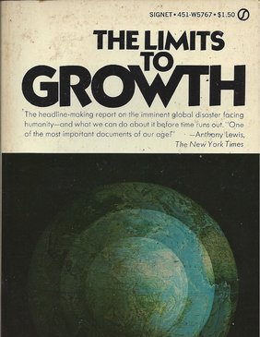
Limits to Growth
Notes:
Also in the 1970s, seminal research took place that is still relevant today. This research was led by Donella Meadows (MIT) and attempted to model consumption and production patterns and extrapolate future scenarios. It received masses of publicity and pitched the economists against the environmentalists, the pro-growth lobby against the steady-state or zero-growth exponents.
This was also the beginnings of a stand-off between northern and southern hemisphere countries that we are still seeing played out in international conferences today.
The perceived choice between environmental protection and economic growth generated distrust and disharmony. It was a very adversarial time. All this set against the backdrop of the OPEC oil crisis of the decade starting in 1973.

Slide 48

1970’s Limits to Growth Debate
Club of Rome Report in 1972, came to two main conclusions:
(i) If the present trends in growth of population, industrialisation, pollution, food production and resource depletion continued unchanged, the limits to growth on this planet would be reached within the next 100 years (2072)
(ii) It is possible to alter these growth trends and to establish a condition of ecological and economic stability that is sustainable for the future. (Meadows et al, 1989).

Slide 49
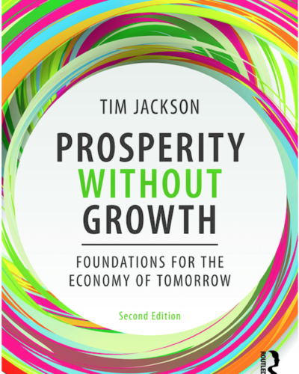
Prosperity without Growth – Economics for a Finite Planet by Tim Jackson
It was first published as a report to the UK government in 2009 and rapidly became a landmark in the sustainability debate, translated into 17 foreign languages. Tim’s piercing challenge to conventional economics openly questioned the most highly prized goal of politicians and economists alike: the continued pursuit of exponential economic growth. Its findings provoked controversy, inspired debate and led to a new wave of research building on its arguments and conclusions.
Notes:
Prosperity Without Growth is a book by author and economist Tim Jackson. It was originally released as a report by the Sustainable Development Commission. The study rapidly became the most downloaded report in the Commission's nine-year history when it was published in 2009. Wikipedia

Slide 50
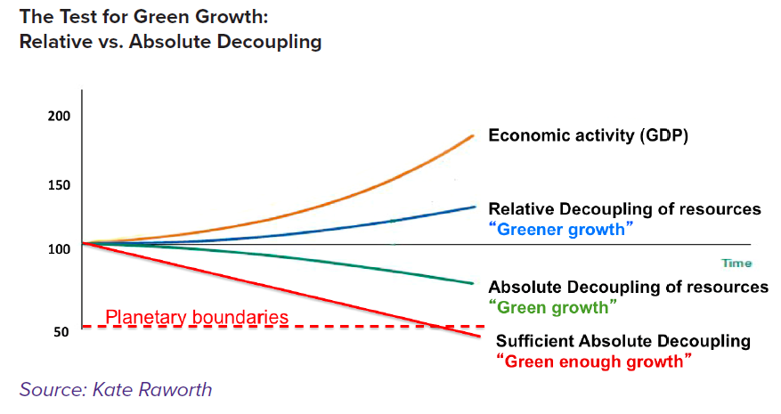

Slide 51
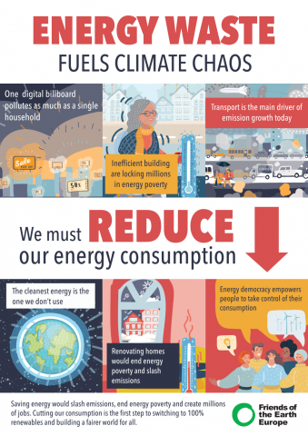
Efficiency v. absolute decoupling
Notes:
http://foeeurope.org/europe-throwing-energy-out-window-060220

Slide 52

Alternatives & Stories

Slide 53
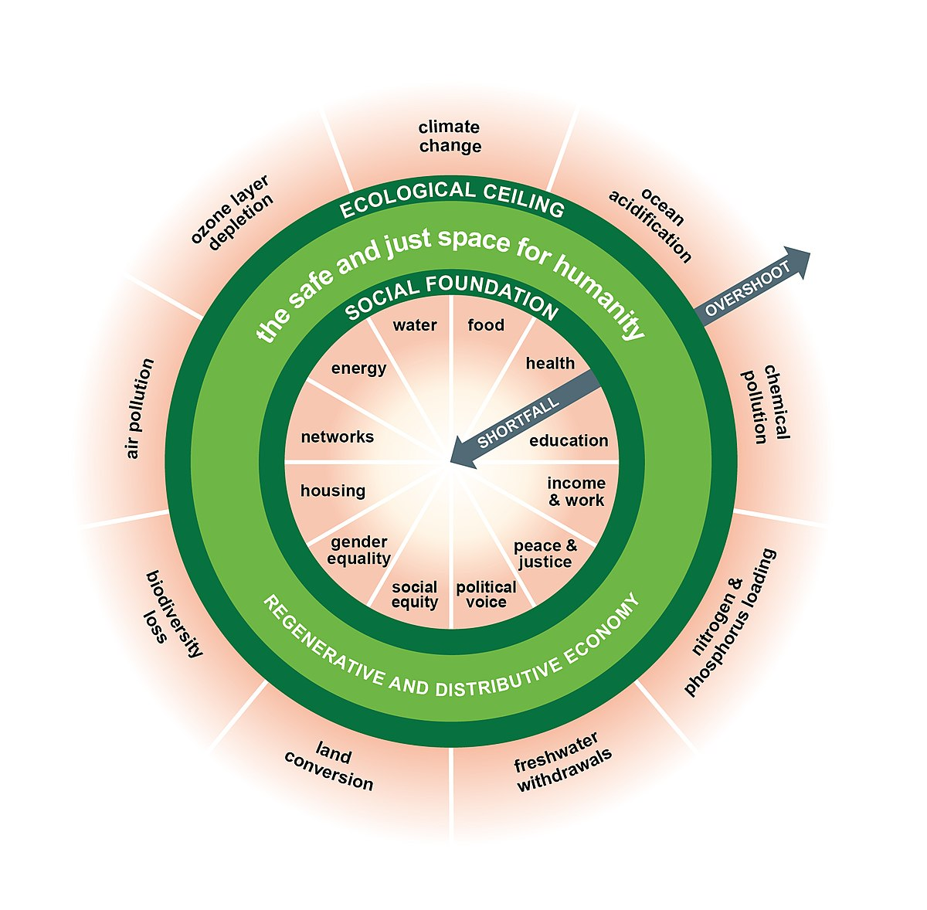
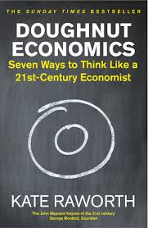

Slide 54
Genuine Progress Indicator
The GPI takes into account more than twenty aspects of our economic lives that the GDP ignores. It includes estimates of the economic contribution of numerous social and environmental factors which the GDP dismisses with an implicit and arbitrary value of zero. It also differentiates between economic transactions that add to well-being and those which diminish it. The GPI then integrates these factors into a composite measure so that the benefits of economic activity can be weighed against the costs.
Notes:
While per capita GDP has more than doubled from 1950 to present, the GPI shows a very different picture. It increased during the 1950s and 1960s, but has declined by roughly 45% since 1970. Further, the rate of decline in per capita GPI has increased from an average of 1% in the 1970s to 2% in the 1980s to 6% so far in the 1990s. This wide and growing divergence between the GDP and GPI is a warning that the economy is stuck on a path that imposes large -- and as yet unreckoned -- costs onto the present and the future.
The GPI starts with the same personal consumption data the GDP is based on, but then makes some crucial distinctions. It adjusts for certain factors (such as income distribution), adds certain others (such as the value of household work and volunteer work), and subtracts yet others (such as the costs of crime and pollution). Because the GDP and the GPI are both measured in monetary terms, they can be compared on the same scale.

Slide 55
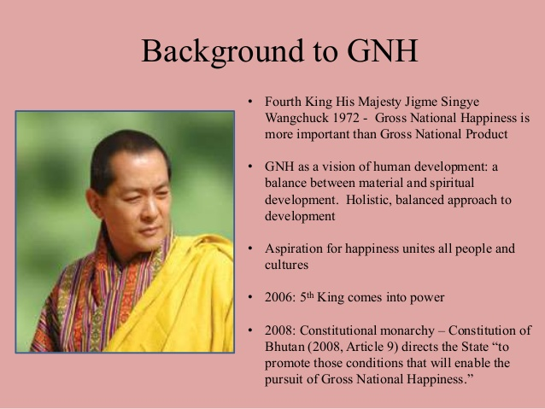
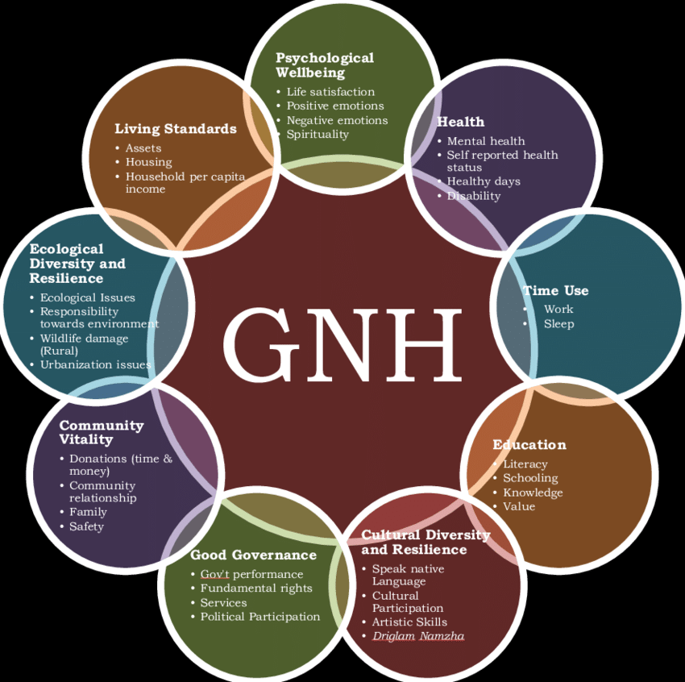
Notes:
https://www.researchgate.net/figure/The-9-domains-and-33-indicators-of-the-GNH-Index-Source-Ura-et-al-2012a_fig1_305764333

Slide 56
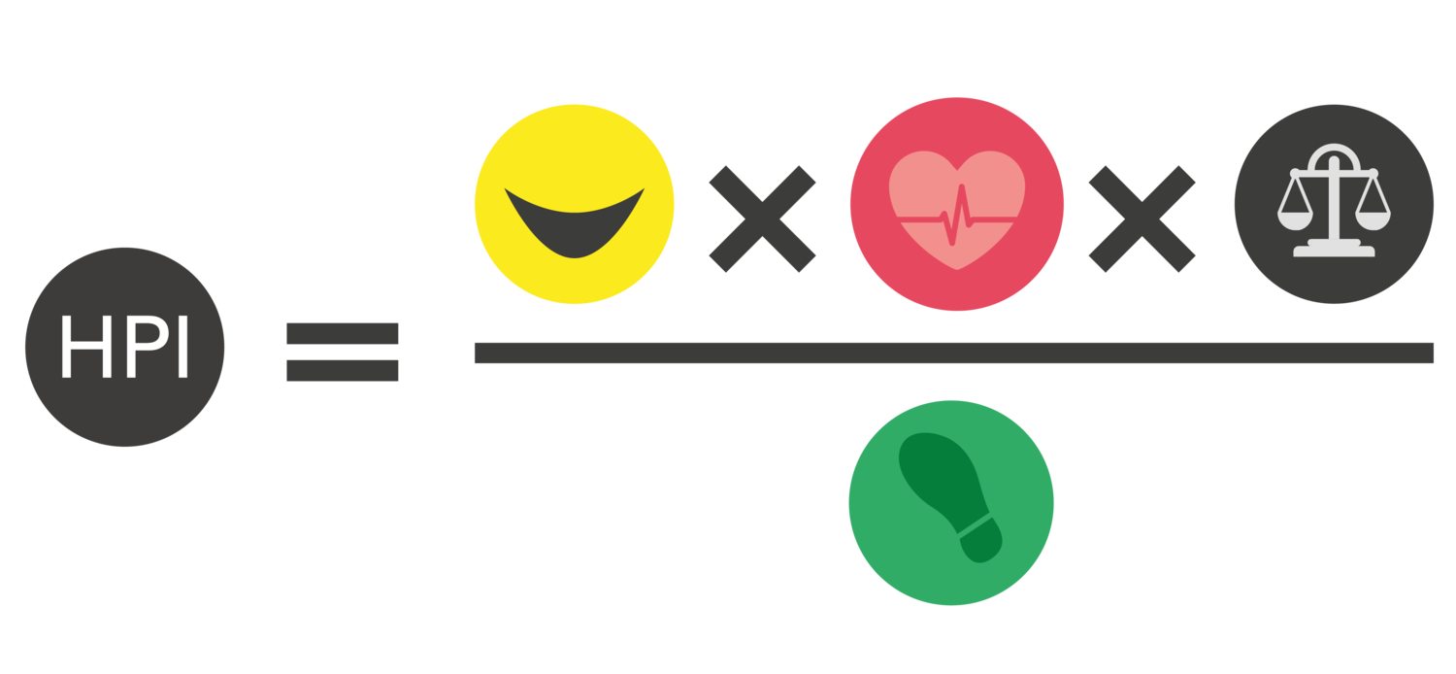
Happy Planet Index
The Happy Planet Index measures what matters: sustainable wellbeing for all. It tells us how well nations are doing at achieving long, happy, sustainable lives.
Notes:
Wellbeing: How satisfied the residents of each country say they feel with life overall, on a scale from zero to ten, based on data collected as part of the Gallup World Poll.
Life expectancy: The average number of years a person is expected to live in each country based on data collected by the United Nations.
Inequality of outcomes: The inequalities between people within a country, in terms of how long they live, and how happy they feel, based on the distribution in each country’s life expectancy and wellbeing data. Inequality of outcomes is expressed as a percentage.
Ecological Footprint: The average impact that each resident of a country places on the environment, based on data prepared by the Global Footprint Network. Ecological Footprint is expressed using a standardized unit: global hectares (gha) per person.

Slide 57

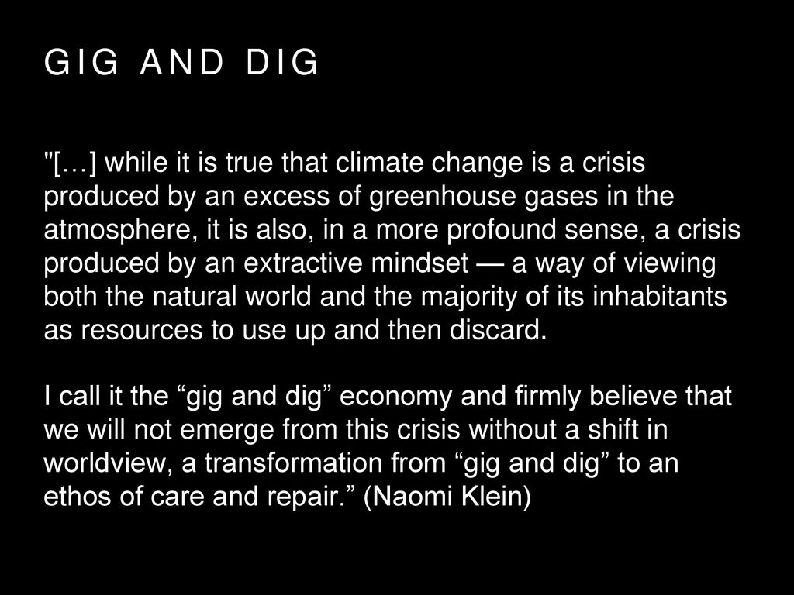

Slide 58


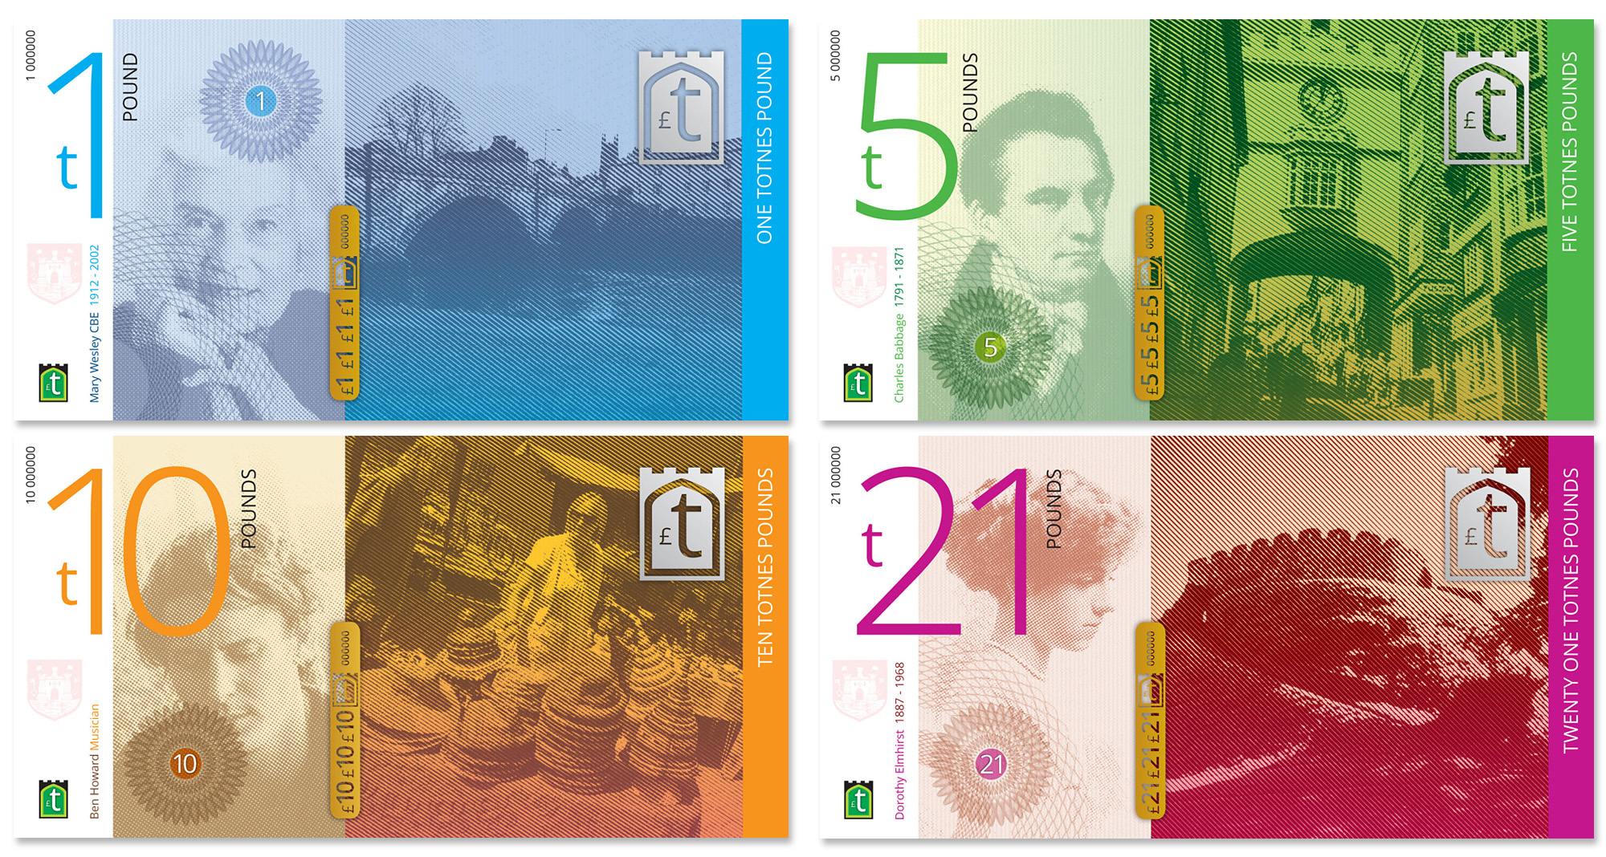

Alternatives
Repair cafés https://www.changex.org/ie/repaircafe/locations
Alternative currencies
‘Buen vivir’ – see Bolivia and Ecuador
‘Happy Planet Index’
‘Genuine Progress Indicator’
‘Gross National Happiness’
Basic income
4-day week
Notes:
If we reduce working hours we can redistribute necessary labour without any loss of total jobs
To make up for lost hours, we can introduce a living-wage law, or roll out a universal basic income. And we can provide retraining programmes to make sure workers can move painlessly from dirty industries to cleaner ones (after all, some industries will still need to grow in a degrowth scenario).

Slide 59
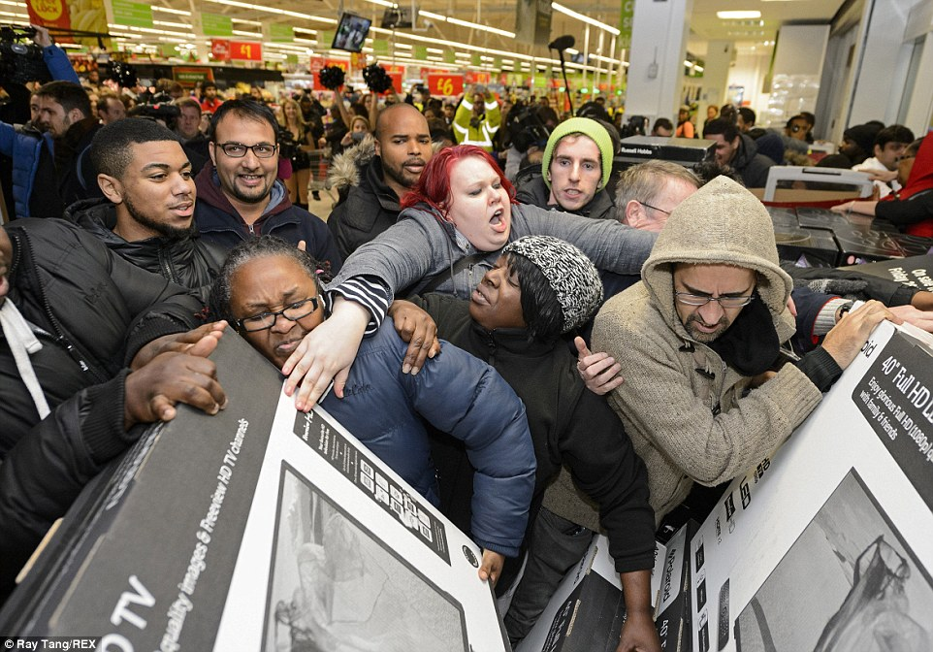

It's a story about us, people, being persuaded to spend money we don't have on things we don't need to create impressions that won't last on people we don't care about.

Slide 60
Suggested activities
Art/English
  Draw/write what a flourishing community looks like. What are the things that tell us we are flourishing?
  Moving debates
History & Geography
  What contributes to well-being but is not monetized?
  What are major changes in the last 500 years? *GDP was only invented in the mid 1900s
Science / research
  Ask them what an alternative model could look like?
  Research pros and cons of basic income
Kinesthetic
  Obstacle course - are all sustainable activities available to all people?
  Repair workshop in school
Home
  Alternatives to Black Friday – make Black Friday Green Friday.
Art
  https://sustainabilityillustrated.com/en/2019/03/26/economy-growth-indefinitely-cartoon/
  Doughnut economics - mapping
Maths
  Chart Earth overshoot days for the last 20 years
  Relative v. absolute decoupling project
Notes:
Not all sustainable options for action are equally available to all people, as
the societal and infrastructural environment is an important factor in determining
who is able to do what. For example, living in the country
without connection to public transport or access to organic food is an
obstacle to sustainable living.
Housework
Care work
Volunteering

Slide 61
Ecological ceiling
Social foundation

Slide 62
Recap of key points
Changing our thinking
  Sustainability has lost its meaning
  Extractivism and a neoliberal economic model based on capital accumulation and the need for constant economic growth is to blame
  ‘Common Sense’
  We are living under a specific paradigm which can be changed
  This is not ‘natural’
GDP and economic growth
  There are limits to growth
  Absolute v. relative decoupling
  Importance of sufficiency over efficiency
Alternatives
  Measure what matters

Slide 63
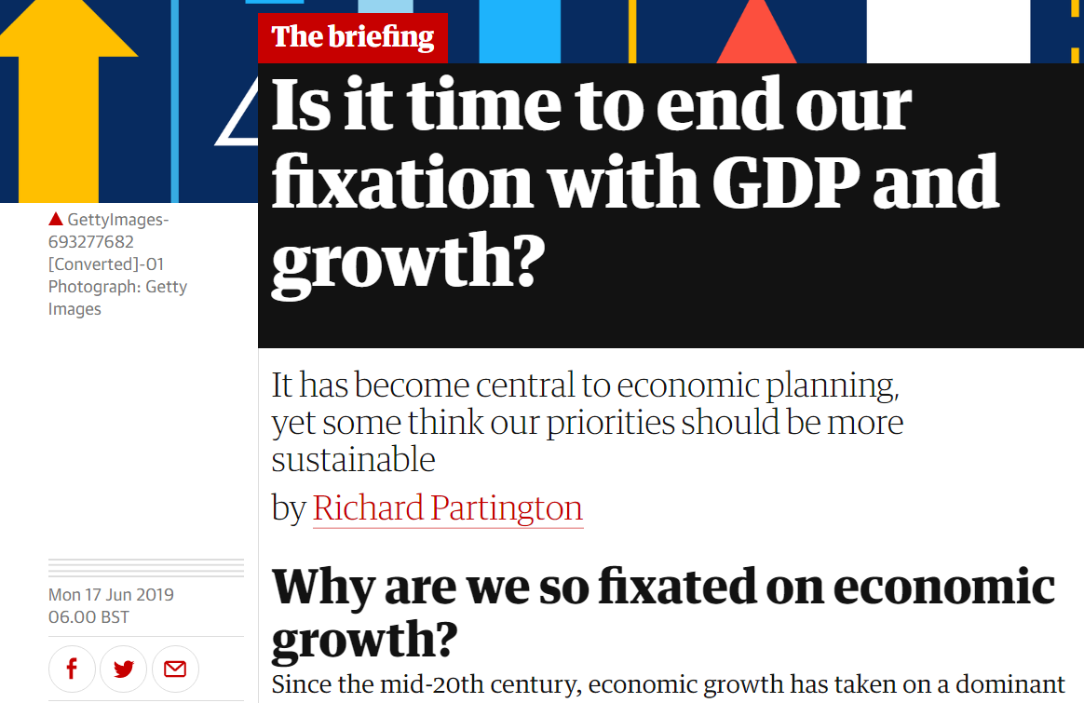
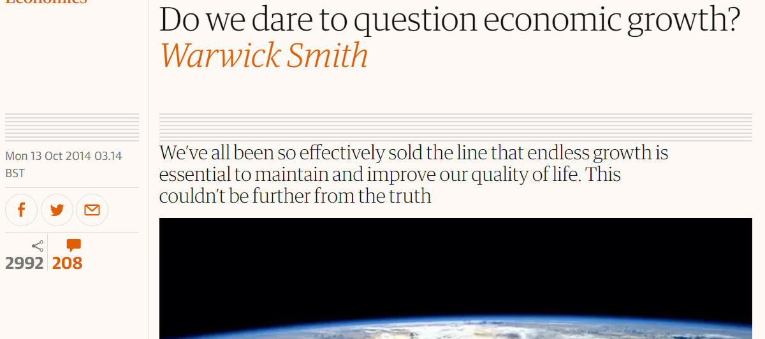
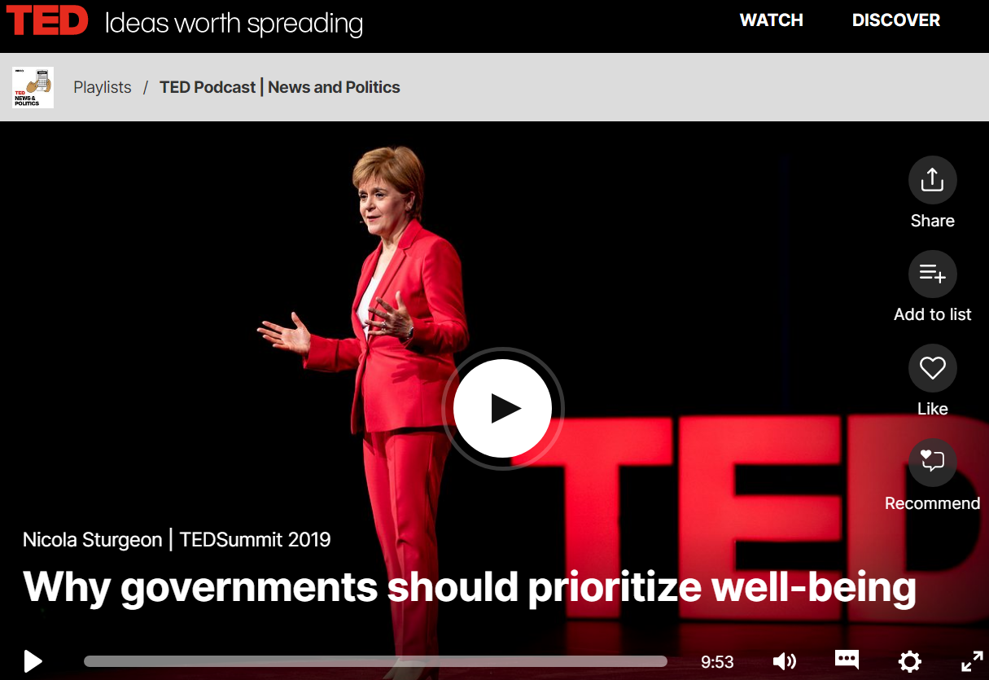
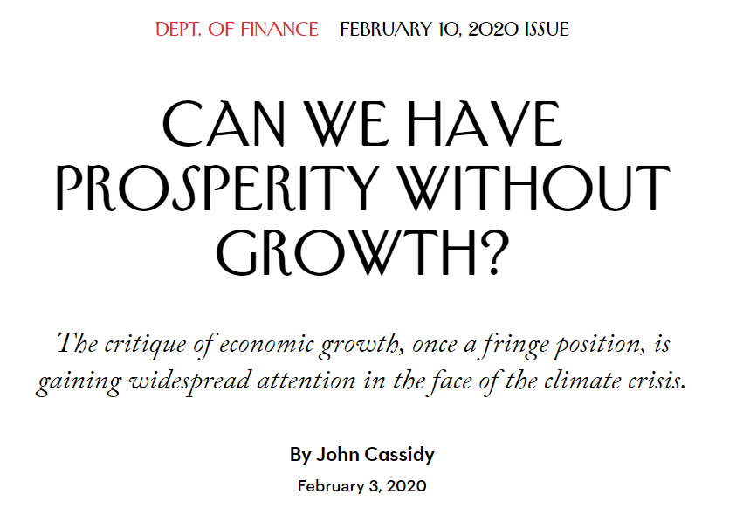
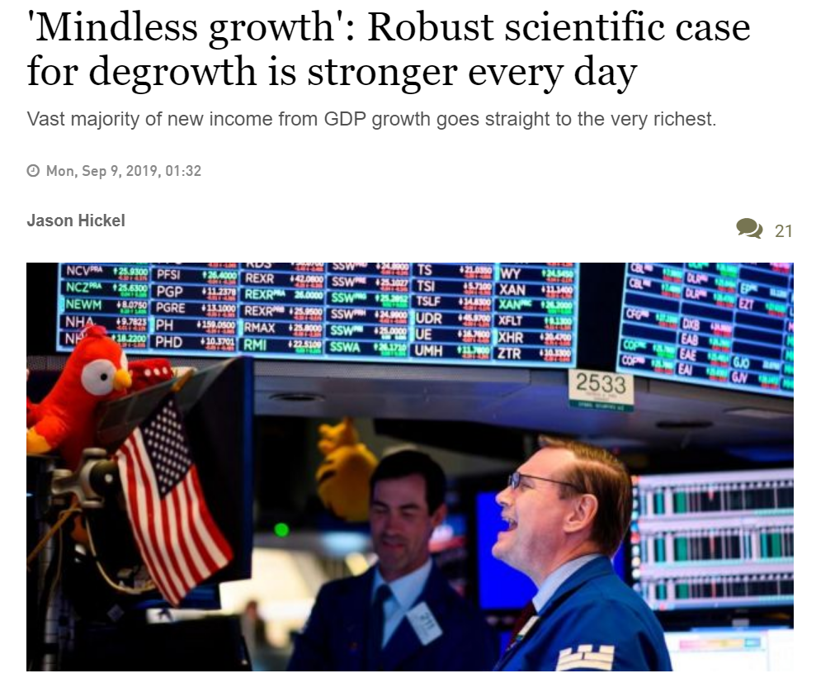
Notes:
https://www.irishtimes.com/opinion/mindless-growth-robust-scientific-case-for-degrowth-is-stronger-every-day-1.4011495

Slide 65
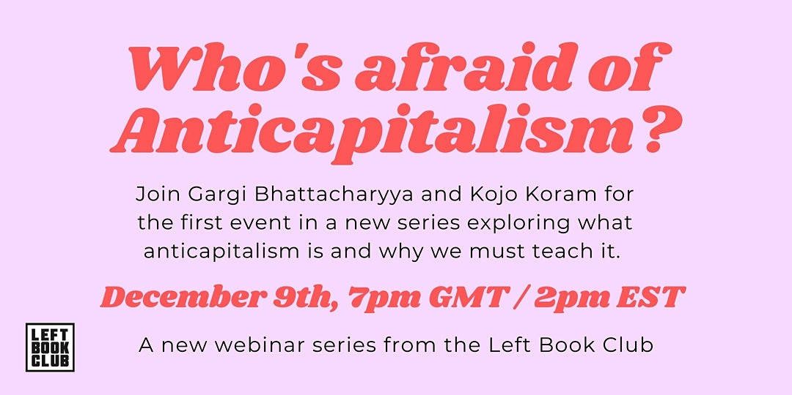
In case you’re interested…
Notes:
https://www.eventbrite.co.uk/e/series-intro-whos-afraid-of-anti-capitalism-tickets-129723752235

Slide 66
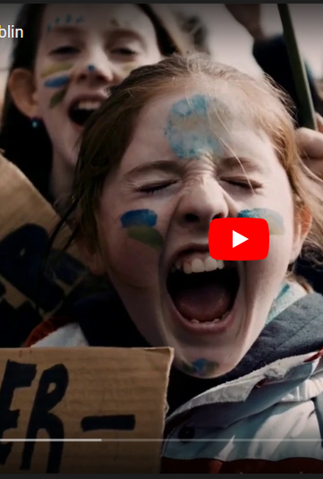
Power of youth
The focus of attention is leading a sufficient life at the personal level, because young environmentalists feel a great need for direct effectiveness. Anyone who is able to change their own eating habits, travel, or consumer behaviour to be more environmentally friendly and sustainable, immediately learns that some things can be changed in the here and now, even if their true effectiveness is often left unclear.
Young people appear to have lost confidence in rapid, effective change at the political level, and adopting a sustainable lifestyle enables them to recapture part of their own effectiveness.

Slide 67
Key resources
https://gnhusa.org/gross-national-happiness/
https://www.ted.com/talks/tim_jackson_an_economic_reality_check/transcript?language=en
https://www.youtube.com/watch?v=Rhcrbcg8HBw
The dirty secret of capitalism -- and a new way forward | Nick Hanauer
https://neweconomics.org/
https://neweconomyorganisers.org/resources/
https://www.irishtimes.com/opinion/mindless-growth-robust-scientific-case-for-degrowth-is-stronger-every-day-1.4011495
A Message from the Future with Alexandria Ocasio Cortez
https://doughnuteconomics.org/discover-the-community
http://virtual.foei.org/trainings/
https://www.foe.ie/blog/2020/10/23/explore-our-climate-justice-read-and-watch-list/
https://www.kateraworth.com/doughnut/

Slide 68
Thank you!
WorldWise Global Schools Teacher Training 25/11/2020
Meaghan Carmody
meaghancarmody@gmail.com

