Slide 1


Degrowth & Sustainability
WWGS Thematic Online Training Series
SINÉAD HAYES, DUBLIN
LIZZY NOONE, DUBLIN
Notes:
Welcome
- Introduce ourselves
Type in your name and the name of your school in the chat! Also change your name on your Zoom to your first name
Invite people to use the chat

Slide 2

Hopes & Fears
- What do you HOPE to get out of todays session?
- Any FEAR about todays session?

Slide 3
Housekeeping
To mute and un-mute
Turn your camera on
Please use the chat function

Slide 4

Session Plan
An Introduction to Degrowth, Sustainability and Beyond Consumerism - Meaghan Carmody
Schools Experience of Exploring Sustainability as a Justice Issue – Mike Kiernan, Bremore Educate Together Secondary School, Dublin
Break & Reflection
Degrowth and Sustainability: from Knowledge to Action
WWGS 6 Step Programme
Reflection and Next Steps
Notes:
Todays session will be broken into 3 key areas:
Read through slide

Slide 5
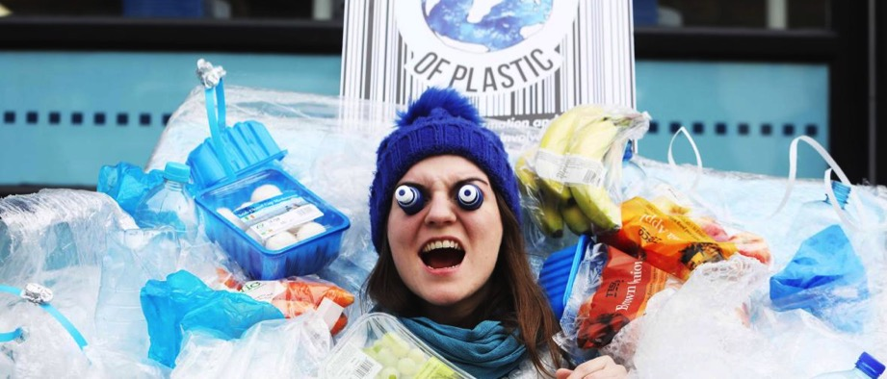
An Introduction to Degrowth, Sustainability and Beyond Consumerism
Meaghan Carmody

Slide 6

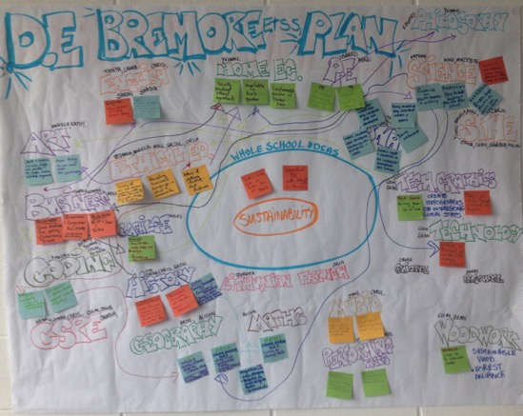
TEACHER INPUT
Mike Kiernan, Bremore Educate Together Secondary School, Dublin

Slide 7
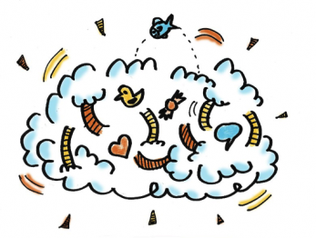
Reflection
Reflect on what you’ve heard this morning..
Consider:
- What are your initial thoughts/ feelings
- Your approach to exploring this theme with students

Slide 8
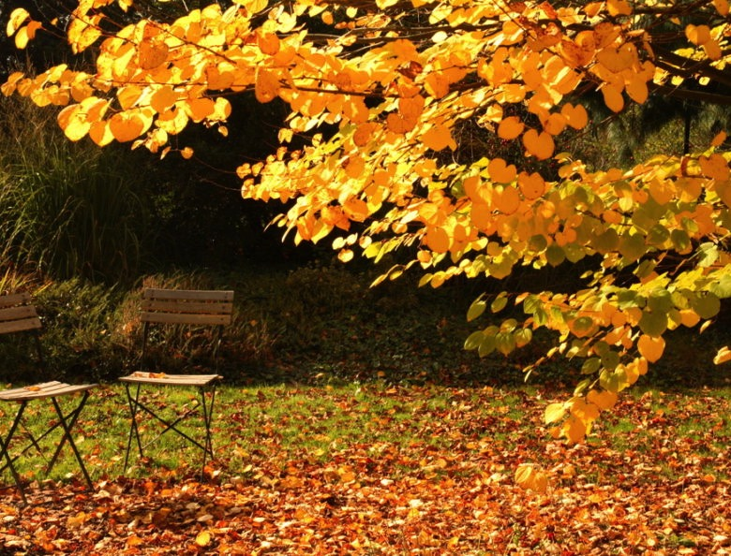


Slide 9
Reflection in Pairs
Share your reflections on:
- Your initial thoughts/ feelings
- Your approach to exploring this theme with students
- How does this relate to your subject?

Slide 10
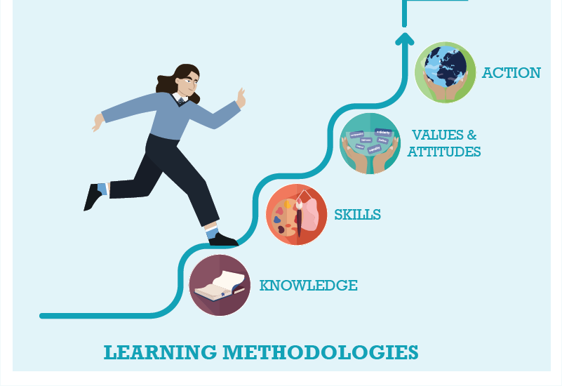



WWGS: 6 Step Programme
Degrowth and Sustainability as a justice issue: from Knowledge to Action
Page
22

Slide 11

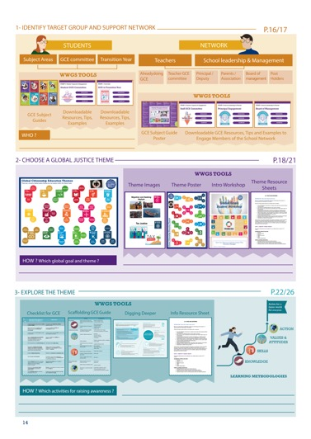
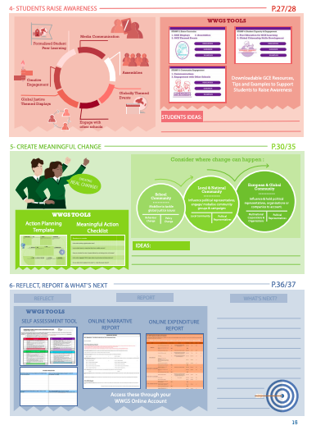
Page
14-15
Notes:
Briefly talk through the 6 steps

Slide 12
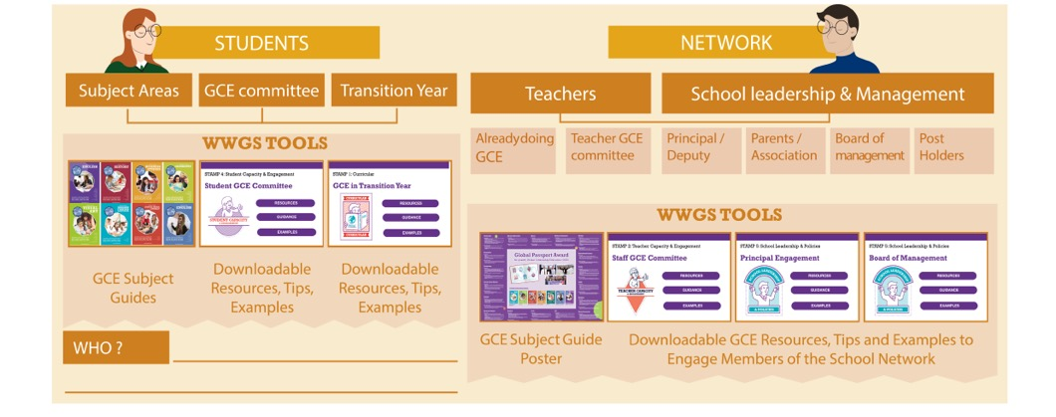
Pages
18-19
STEP 1:
IDENTIFY TARGET GROUP AND SUPPORT NETWORK
Notes:
Ask everyone to reflect on the student group they intend to work with and who in the school they can engage as a support network. Remind them that it’s not all about TY!

Slide 13

TASK:
Consider:
What opportunities are there to explore
Justice issues around degrowth in your subject area(s)?

Slide 14

http://www.worldwiseschools.ie/6-step-programme/
Pages
18-21
STEP 2:
CHOOSE A GLOBAL JUSTICE THEME
Notes:
Introduce the step and the tools available – invite them to use their phone to view the tools on their 6 step programme

Slide 15
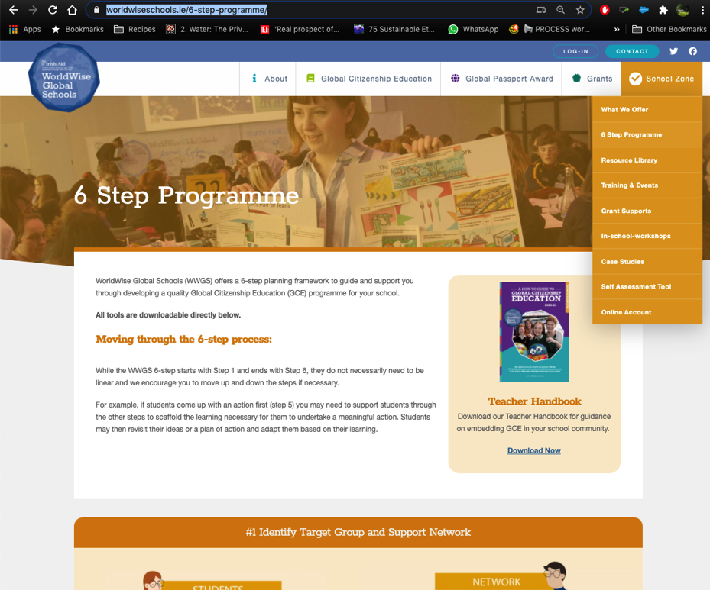

Slide 16

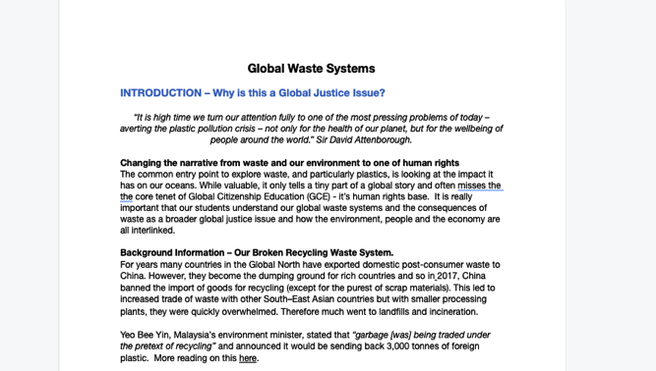
1. Hover over the symbol and a drop down menu appears!
2. Click on the theme and the resource sheet will pop up!
Notes:
Intro to thematic information sheets

Slide 17
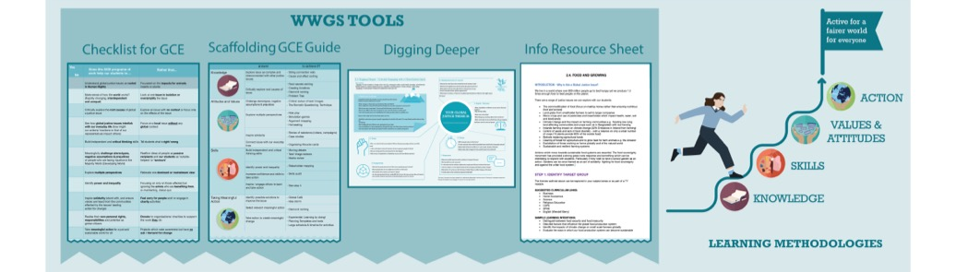
Pages
22-26
STEP 3:
EXPLORE THE THEME
Notes:
Be sure to change to your own date here!!

Slide 18

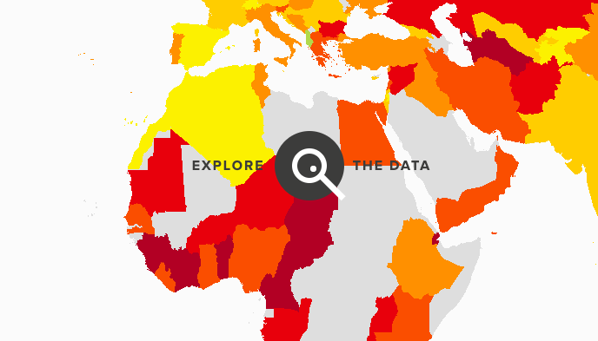

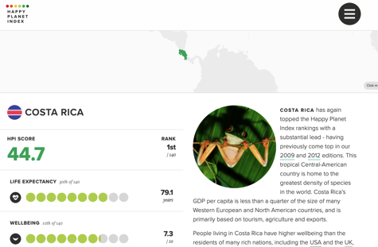
STEP 3: EXPLORE THE THEME
TEACHING AND LEARNING MATERIALS: Information websites:

Slide 19

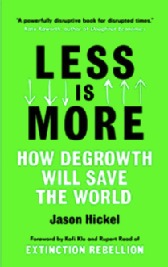
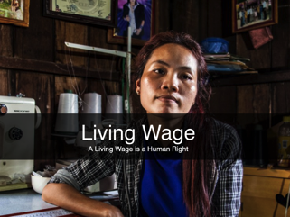
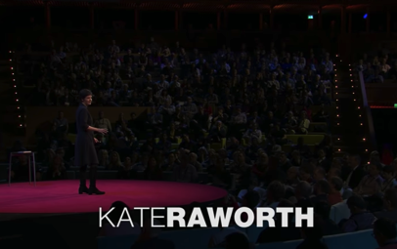
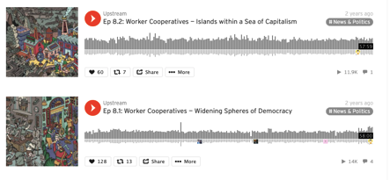
STEP 3: EXPLORE THE THEME
TEACHING AND LEARNING MATERIALS:

Slide 20
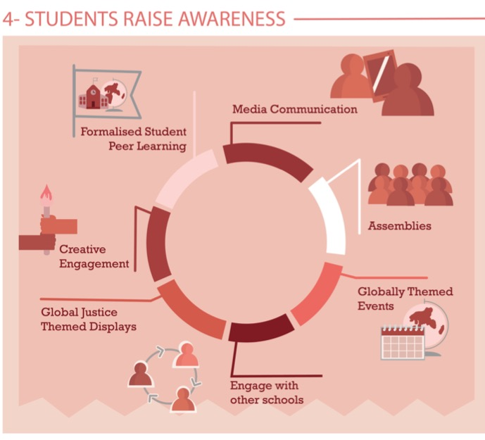
Share Learning
Pages
28-29
Notes:
Media Communication
Assemblies – Intercom
Themed Events –
Global Justice themed displays
Creative engagement
Formalised peer learning

Slide 21
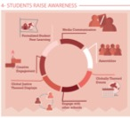
Celebrate Global Degrowth Day – show the videos in classes
Celebrate UN days of action:
    World Creativity and Innovation day - 21st April
    Valuing our Cities and Communities day - 31st October
Learn and create awareness campaign – Share what you've learned about Degrowth and sustainability so your whole school will learn how important it is
Do an online workshop on degrowth/sustainability/beyond consumerism – share your learning with other students & showcase your work
Crap-free Christmas

Slide 22
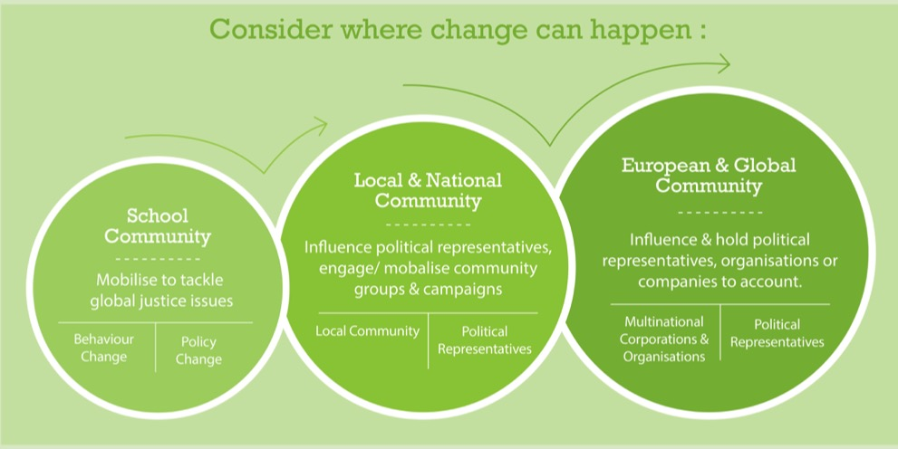
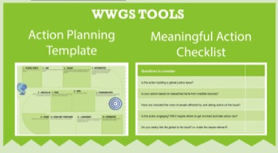
Page
30-35
STEP 5: TAKING MEANINGFUL ACTION
Aims to create Actual Change

Slide 23

STEP 5: TAKING MEANINGFUL ACTION
Ideas for School Community Actions:
Run a campaign or initiative through alternative economy (bartering, trading, alternative currency)
Debate the topic in class/at assembly
Create a school policy on circular economy
Ideas for Local and National Community Actions:
Participate in or organise events, activities, discussions on the issues of degrowth and sustainability. Showcase actions and organisations/ community initiatives. Stream an event online!
Lobby your local leaders and government to support community initiatives and local businesses
Ideas for European and Global Community Actions:
Join campaigns based on degrowth happening all over the world
Campaign on degrowth issues at a national and international level – Living standards, cooperation, alternative measures of success (not only GDP)
Link in with other communities working on degrowth and alternative sustainable initiatives like local alternative currencies or community library of things

Slide 24
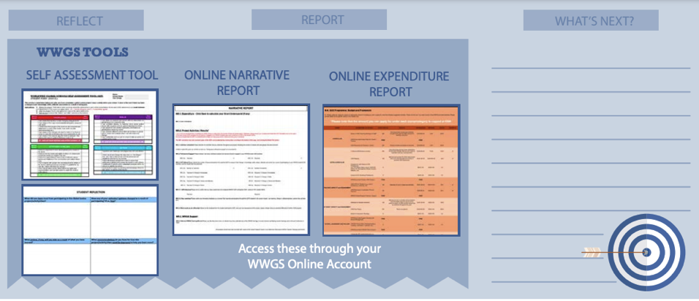
STEP 6:
REFLECT, REPORT AND WHAT’S NEXT?
Pages
36-41

Slide 25
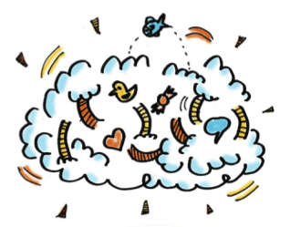
- What are the steps are you going to take next?
- What supports do you need?
Reflection & What Next?

Slide 26
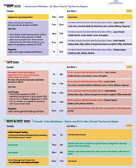
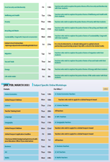
Upcoming Dates
Pages
4-6
Thematic Training Sessions
November
- Anti-Racism: - RECORDED
- Fast Fashion: RECORDED
- Food Security & Biodiversity: RECORDED
- Poverty: RECORDED
- Recycling & Waste: RECORDED
- Sustainability/ Degrowth: Now!
December
- Migration: Tues 1st
- Tax & Trade: Thur 3rd
- Energy: Mon 7th
- Life Under Water: Wed 9th
- Wellbeing & Health: Fri 11th
Global Passport Award
Webinar - January
Subject Specific Workshops
Jan- March 2020
Notes:
In terms of the breakdown of trainings, outline the 5 types of training
Purple – starter trainings – (today) for new schools and teachers new to GCE (perhaps their school has been involved longer)
Pink – WWGS approach and adapting to covid-19 – for ALL schools and teachers. Even for schools who have been involved for a while. Updated theory and practice
Green – Thematic areas
Blue – subject specific
Yellow – standard WWGS trainings and events. And deadlines.

Slide 27
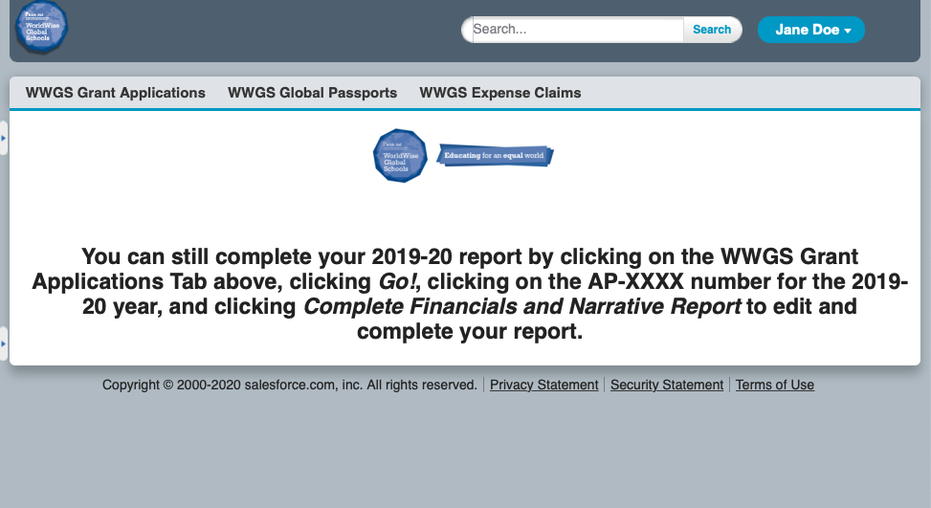
Or, if you think you will have an underspend, use your grant

Slide 28
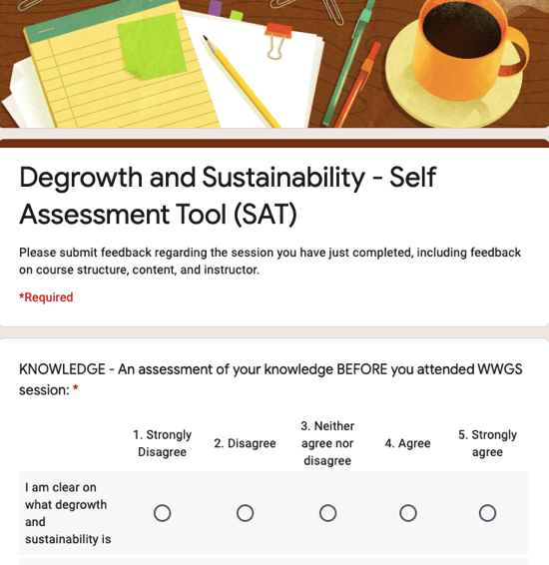
Evaluation for Today
https://docs.google.com/forms/d/e/1FAIpQLSfYkb731eCG2_XST_biBoA2l7BhXUpBXeftPtfpYOcgwB8ynw/viewform?usp=sf_link
Notes:
https://docs.google.com/forms/d/e/1FAIpQLSfYkb731eCG2_XST_biBoA2l7BhXUpBXeftPtfpYOcgwB8ynw/viewform?usp=sf_link

Slide 29



Thank you!
Questions???
sinead.hayes@worldwiseschools.ie
087 3502877

