Slide 1
Degrowth
Anitra Nelson
Honorary Principal Fellow
University of Melbourne
Australia
E: anitra.nelson@unimelb.edu.au

Slide 2
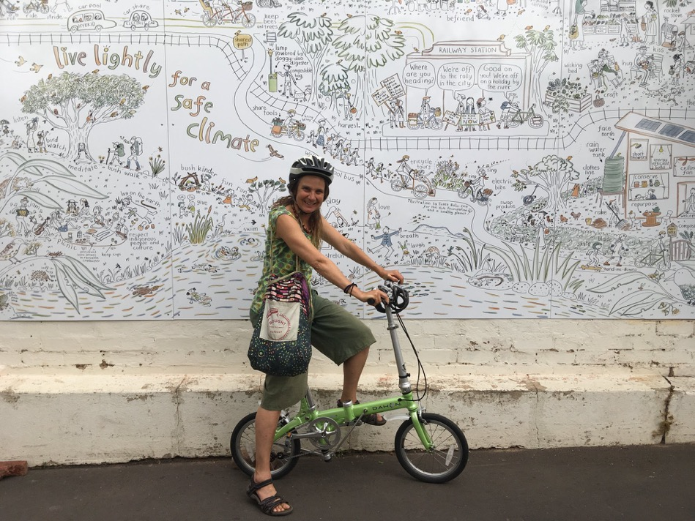

Slide 3



Slide 4



Slide 5
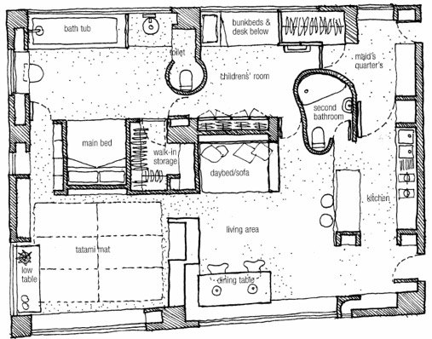
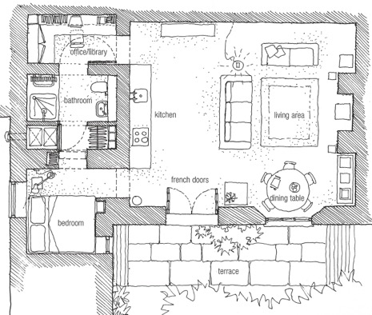
Small dwellings — respecting Earth’s ecological limits and focus on quality of life

Slide 6


Slide 7

https://csaveneto.wordpress.com/

Slide 8


http://cargonomia.hu/?lang=en%2F

Slide 9
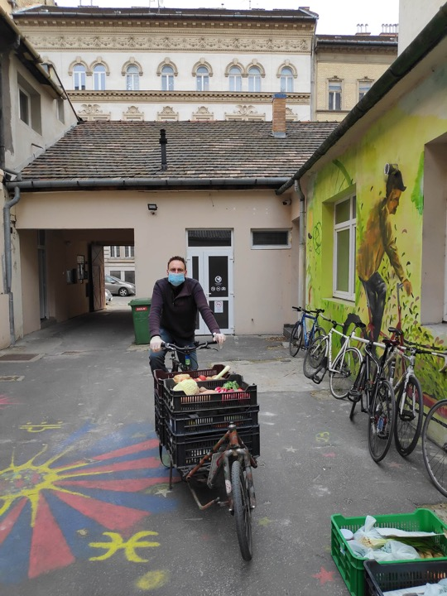
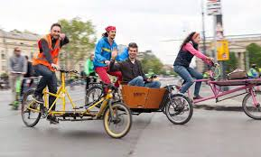

Slide 10
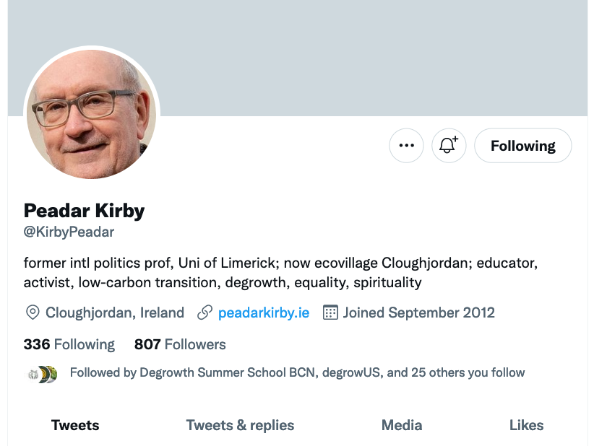
Cloughjordan Ecovillage

Slide 11


Slide 12



Slide 13

https://thefifthestate.com.au/urbanism/infrastructure/driving-is-
the-new-smoking-emissions-warning-labels-for-car-ads-in-france/

Slide 14

Defending the zad

Slide 15
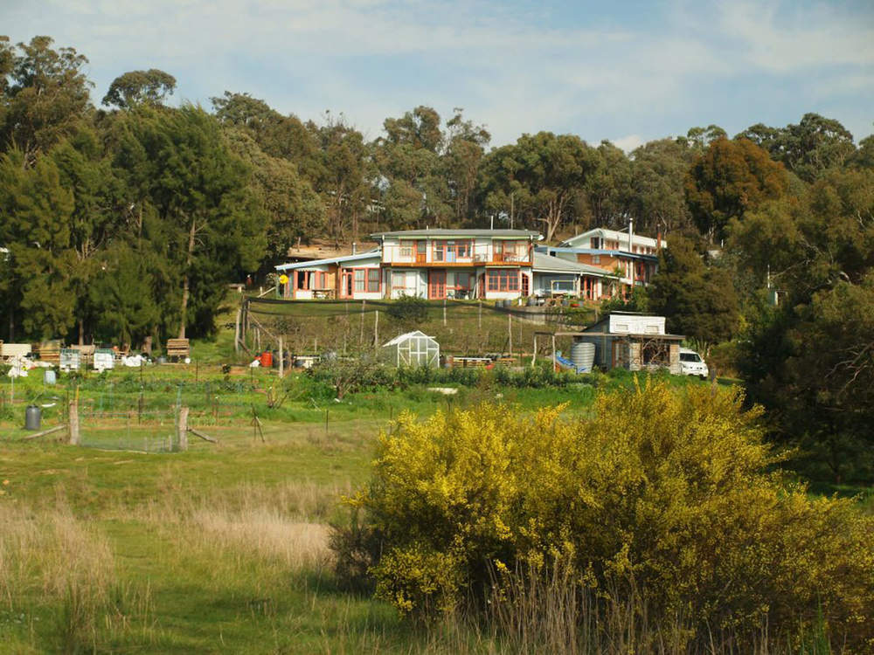
UNCONDITIONAL AUTONOMY ALLOWANCE (UAA)

Slide 16

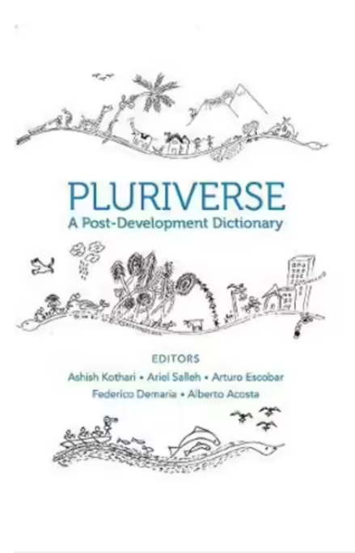

https://radicalecologicaldemocracy.org/
https://globaltapestryofalternatives.org/

Slide 17
Top down policy meets grassroots efforts
Policy objective — To enable citizens to create housing for degrowth by satisfying their own housing needs affordably and sustainably with households living one planet footprints.
Proposed policy changes:
  • revise planning and building application processes to enable simple self-built dwellings and collective land settlements
  • enhance social housing with sustainable renovations to preserve history and conserve nature
  • enable localized, off-grid, ecologically sustainable basic household services
  • apply maximum standards for homes, land and service use — such as maximum living space person)
  • flexibly apply planning conditions along ecological and affordability criteria.

Slide 18


Slide 19

1973

Slide 20


TRAVEL
Why?
How?
Where?
For what?
When?

Slide 21
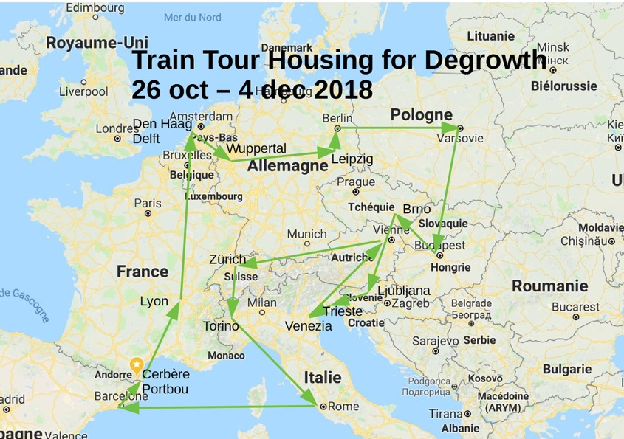
25 European events 26 Oct.–27 Nov. 2018
by train, ferry, bikes and legs

Slide 22
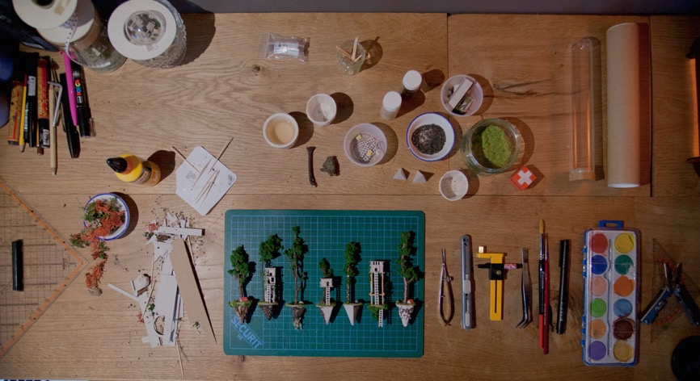

Slide 23


