Slide 1
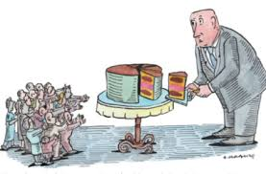
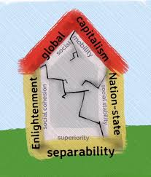
The What and How of the WWGS Approach to Global Citizenship Education
Autumn 2020
Notes:
Trigger warning for the new teachers-for some of you this is very new don’t change your programme. How can this influence my work-challenge you to be more critical in your work. Outcome may be different for new and more established schools.

Slide 2
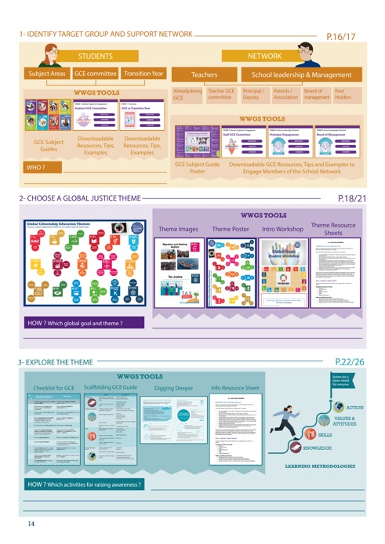
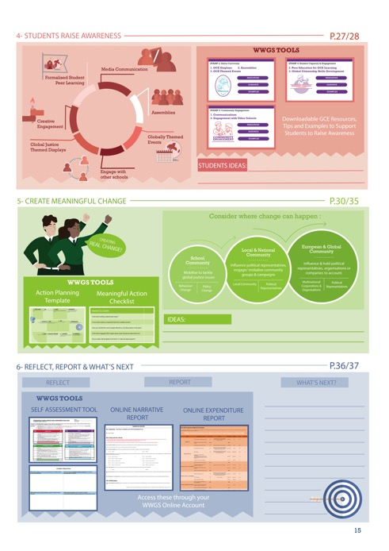
Page
14-15
Notes:
We will focus on Step 3 Digging Deeper into an issue today
If this step is done right it will influence step 4, 5 and 6!

Slide 3
The session will provide:
- What do we mean by a critical approach
- How to take a critical approach in GCE
- How to adapt my GCE programme
PART 1: WHAT and Digging Deeper
PART 2: HOW-Methodologies
Workshop on
Critical Approach to GCE

Slide 4
PART 1:
Envisaging a New World
Critical Approach Theory to Practice

Slide 5

https://www.youtube.com/watch?time_continue=14&v=ALN3UkxXA8g&feature=emb_logo
Notes:
Fits somewhere else? Theory at the start??
Critical approach.

Slide 6

Discussion Time!-7 minutes
Why does Arundhati Roy not want to return to ‘normality’?
What does she mean by the ‘doomsday machine’?
What would you imagine a new world to look like?
Notes:
https://docs.google.com/document/d/1_JlxmmhphMwfeWzhMU3SN42nxPaLMTkfuyQATezY8tA/edit?usp=sharing
Think socially, politically, economically, emotionally??
Do you agree that the ‘Pandemic is a Portal’?
You could also consider asking students what they might bring with them through the portal-get them to think of emotions and skills as well as possessions!
Is there any other questions you could ask?
Co-host puts the teachers into groups.

Slide 7
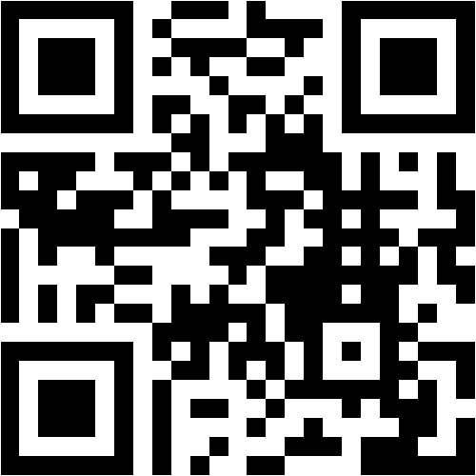
What would you like to change
about the world?
What issues would you address going through the portal?
Write 3 words on the Mentimeter by clicking on the link or holding your phone camera up here:
www.menti.com
69 01 41
Notes:
https://www.menti.com/2wpn7dssic
PUT UP THE MENTIMETER AFTER THIS SLIDE…...log in lizzy.noone@worldwiseschools.ie log in P0ppyU1tan again we might need to wipe each mentimeter after each.
Do you agree that the ‘Pandemic is a Portal’?
You could also consider asking students what they might bring with them through the portal-get them to think of emotions and skills as well as possessions!
Is there any other questions you could ask?

Slide 8
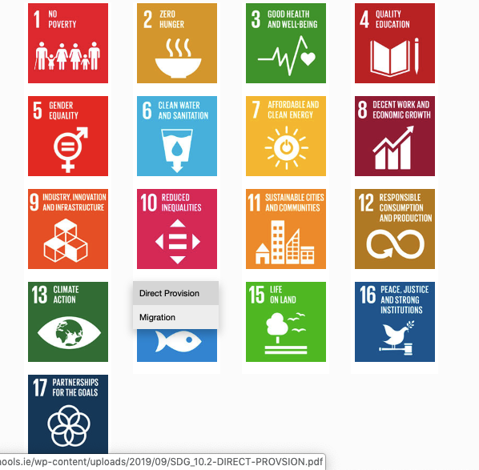
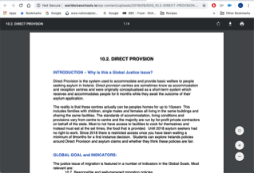
1. Hover over the symbol and a drop down menu appears!
2. Click on the theme and the resource sheet will pop up!
Notes:
Intro to thematic information sheets

Slide 9

€125 Billion
Voluntary overseas aid to Global South
Official overseas aid
$3.3 Trillion
Unfair Trade
Tax Injustice Illegitimate Debt
Illicit Financial Flows
$1:$24
Notes:
Covid-19 has provided a powerful lens through which inequality in its many forms can be seen. What’s equally obvious is that we cannot beat this virsu if we do not also tackle the disease of inequality.
Antonio Guterres the UN Secretary General but it well when he said C19 has exposed the lie that free markets can deliver healthcare for all, the fiction that unpaid care work isn’t work, the delusion that we live in a post racial world. We are all floating on the same sea but some are in super yachts and others clinging to drifting debris’.
The global economic system is key-campaigns to cancel the debt, tackle tax avoidance and how the IMF chooses to use its resources will be key.
No matter what theme you are exploring you can not avoid talking about structural and systematic inequalities that exist in the world.
What systems can you think of that might cause mass inequality???

Slide 10
Debt burdens were already taking much needed money away from healthcare and social protection before the Covid crisis hit and the situation is rapidly deterioting . Debt payments for poor countries are at the highest level in years. We need urgent action to cancel payments, keep debt to a sustainable level and rein in irresponsible lending to stop debt crises coming back to haunt us every decade’
Sarah Jayne Clifton, Jubilee Debt Campaign
Notes:
Rebecca Solnit author wrote ‘I have often thought that the wave of privatisation that has charactised neolibreal age began with the privatisation of the human heart the withdrawal from a sense of shared fate and social bonds. It is to be hoped that this shared experience of catastrophe will reverse the social bonds.
‘There’s a hole in the bucket…’
$4tn of external debts owed by developing countries costs them more than $1.5bn a day in repayments – and $34m of that comes from the very poorest countries.
52 countries are now in debt crisis
This has not taken full account of the impact of Covid’

Slide 11
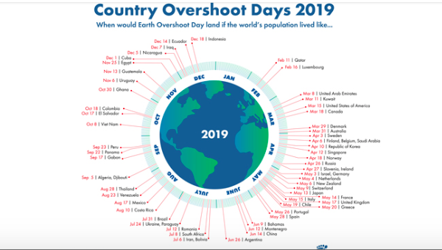
Notes:
The pandemic gave us a chance to appreciate nature and gave us a glimpse into what a fossil free future might look like offering a break from addictive consumerism (one would hope!)
George Monibot said that’ it [the pandemic] has to be a tipping point. This has to be a point to transform where we move from one system an exploitative political and economic system to a completely different one private sufficiency and public luxury.

Slide 12
“‘Developing countries’ is the name that experts use to designate countries trampled by someone else’s development.”
Eduardo Galeano
“The next time someone tells you they got rich through hard work, ask them whose?”
Don Marquis

Slide 13
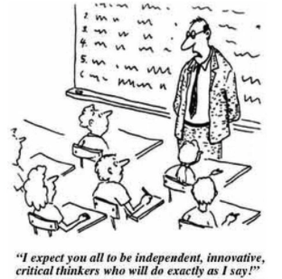
What is a critical + analytical approach to learning GCE?
Global issues are complex and need a critical pedagogical approach to exploring them!
Critical Thinking helps students seek out, listen to and incorporate marginalized perspectives in order to question and possibly unlearn mainstream ways of thinking and address inequitable balance between the dominant and marginalized perspectives
Karen Pashby

Slide 14
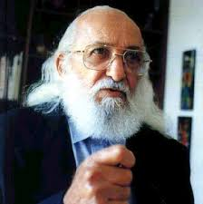
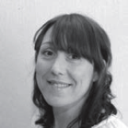
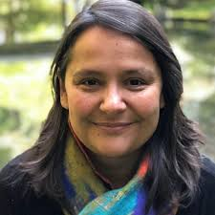
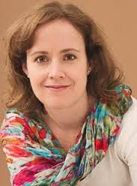
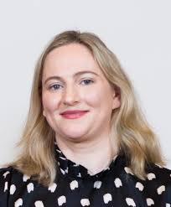
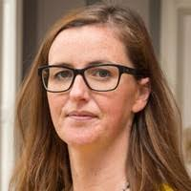
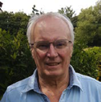
Pedagogy of the Oppressed
Pedagogy of the Rich!
Educational Theory behind the WWGS Approach
Notes:
All recognise a need for a more critical approach to Global Citizenship Education!

Slide 15
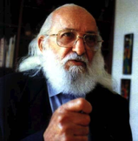
Roots of Development Education
Paulo Freire’s Pedagogy of the Oppressed
Banking education
Oppressive system
Passive students
Authoritarian teacher
Knowledge is static, transferred
Students are silenced
Problem posing education
- Dialogue
- Reciprocal relationships
- Connection to reality
- Critical awareness
- Social & Personal transformation

Slide 16
‘Education either functions as an instrument which is used to
facilitate integration of the younger generation into the logic of the present system and bring about conformity or it becomes the practice of freedom, the means by which men and women deal critically and creatively with reality and discover how to participate in the transformation of their world’
Paulo Freire, Pedagogy of the Oppressed

Slide 17
Dr. Audrey Bryan, DCU
‘Teachers should promote critical literacy in their classrooms that will enable
students to decode and develop ‘oppositional readings’ to dominant
development narratives in the formal curriculum and to critically self-reflect on
their own assumptions about development and the Global South’.

Slide 18
‘the study identified a striking absence and
use of theoretical frameworks, such as human
rights and global justice, to anchor the topics
explored in the classroom. [Students] interpretations indicate that discussion is a central feature of GCE classroom practice that is both welcome and counter to students’ prevailing formal education engagement. It is important to understand GCE from this perspective as it demonstrates its value in formal education to act as a disruptive and alternative experience to the dominant narratives that students encounter’
Maria Barry, St Patrick’s College, DCU

Slide 19
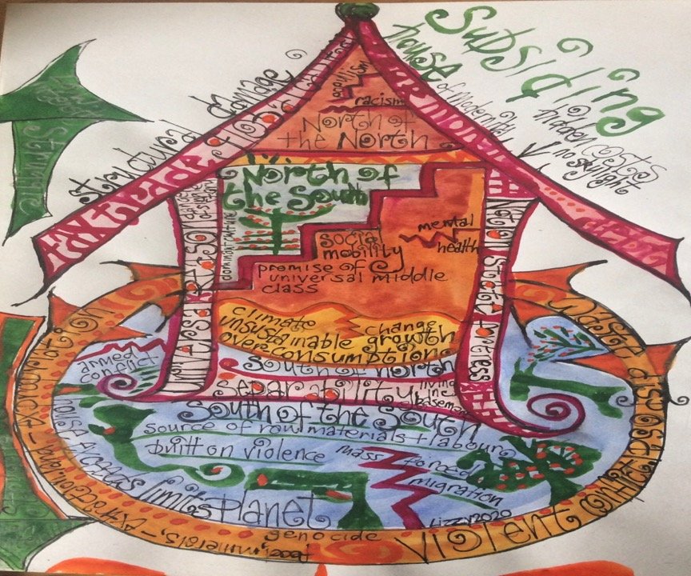

Slide 20
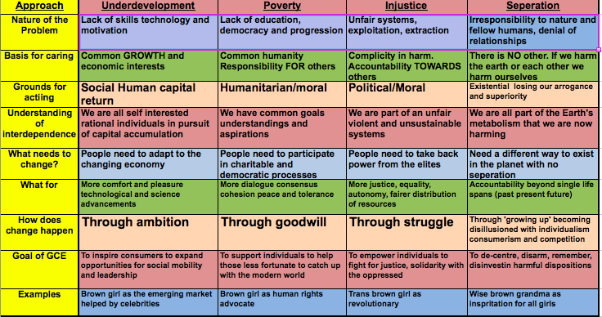
Different Approaches to GCE
Notes:
Gently refer to the different approaches a good exercise they can do individually is to use this a a self reflection on their theory of change and approach and tick the boxes they agree with. From doing this yourself it can help to be more conscious on how we are approaching globasl issues with students.

Slide 21
Page
14-15
Notes:
Briefly talk through the 6 steps

Slide 22
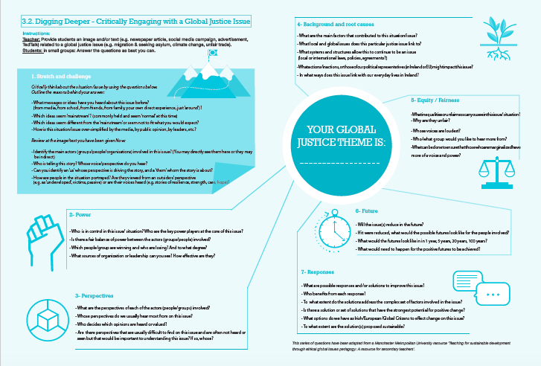

Slide 23
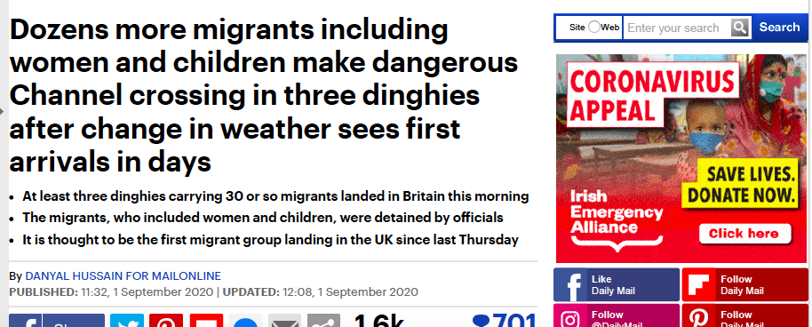
Read this short article
OR sit back close your eyes and I’ll read it out!
Spend some time reading this article-link in Chat
Notes:
https://docs.google.com/document/d/1VaSfR7lHTFCz7yRxzKBsVCUoVcDm_GjfbdEfAg0PtvY/edit?usp=sharing
Give participants the option of it being read out and they can sit back and close their eyes and you read it.

Slide 24


Notes:
You can use any theme photos, article art work for this exercise. Reflect on the thematic areas you chose earlier and see how this would work.
LINK TO ARTICLE: https://docs.google.com/document/d/1VaSfR7lHTFCz7yRxzKBsVCUoVcDm_GjfbdEfAg0PtvY/edit?usp=sharing

Slide 25
Digging Deeper
Together we will answer the first set of questions.
In your breakout rooms, you will each take a set of questions:
Room 1: Stretch and Challenge 2
Room 2: Power
Room 3: Perspective
Room 4: Background
Room 5: Equity/Fairness
Room 6: (if there is one) take Perspective questions as well.
When finished your set of questions look at what other questions have been answered and respond to: Future and Responses
Notes:
https://docs.google.com/document/d/1jTe7NOGvcO5nAiItEaxzb0_gaXbpzJyeprDDPvRvgOc/edit?usp=sharing
Note: we will need our own link for this or we can save our own documents and delete content for next group.

Slide 26
Stretch and Challenge 1
What messages or ideas have you heard about this issue before?
Which ideas seem ‘mainstream’?
Which ideas seem different from the ‘mainstream’
How is this situation/issue over-simplified by the media, by public opinion, by leaders, etc.?
Notes:
https://docs.google.com/document/d/1jTe7NOGvcO5nAiItEaxzb0_gaXbpzJyeprDDPvRvgOc/edit?usp=sharing
Note: we will need our own link for this or we can save our own documents and delete content for next group.

Slide 27
Future
-Will the issue(s) reduce in the future?
- If it were reduced, what would the possible futures look like for the people involved?
- What would the futures look like in 1 year, 5 years, 20 years, 100 years?
Notes:
https://docs.google.com/document/d/1jTe7NOGvcO5nAiItEaxzb0_gaXbpzJyeprDDPvRvgOc/edit?usp=sharing
Note: we will need our own link for this or we can save our own documents and delete content for next group.

Slide 28
Responses
What are possible responses and/or solutions to improve this issue?
- Who benefits from each response?
- To what extent do the solutions address the complex set of factors involved in the issue?
- Is there a solution or set of solutions that have the strongest potential for positive change?
- What options do we have as Irish/European/Global Citizens to effect change on this issue?
- To what extent are the solution(s) proposed sustainable?
Notes:
https://docs.google.com/document/d/1jTe7NOGvcO5nAiItEaxzb0_gaXbpzJyeprDDPvRvgOc/edit?usp=sharing
Note: we will need our own link for this or we can save our own documents and delete content for next group.

Slide 29
Active learning methodologies
3 categories:
Classroom-no technology
Limited online-one computer in classroom
All students have access to technology
If you have preference, put in chat the number that applies to you-you will put into breakout spaces according to this!
https://docs.google.com/document/d/1xDnlgxCC9ITOMOq1oOR1IN6i-B1_1RuCtftpQnJ6VkM/edit?usp=sharing
Notes:
https://docs.google.com/document/d/1xDnlgxCC9ITOMOq1oOR1IN6i-B1_1RuCtftpQnJ6VkM/edit?usp=sharing

Slide 30
Break Time!
Walk around outside or in a nice space in your home. If you can try not to pick up your phone or engage in any other distraction.
Pretend for a minute you are stepping through a portal-what do you see??
Notes:
https://docs.google.com/document/d/1VaSfR7lHTFCz7yRxzKBsVCUoVcDm_GjfbdEfAg0PtvY/edit?usp=sharing

Slide 31
PART 2:
Dos and Don’ts
Adapting my GCE Programme: active learning methodologies
Notes:
Pre ask them on the adapting part ask them about what room they’d like to go in…...

Slide 32
CHECKLIST TASK!
Each group will be given 1 point from the GCE checklist:
Discuss the DO and the DON’T using the following questions:
-How could you avoid your GCE programme falling into the ‘Don’t’ column?
-What resources, activities and the methodologies could help keep you on the ‘Do’ side?
Notes:
So all this theory obviously translate into the the tools that we create for teachers like our dos and don’ts list on page

Slide 33
Dos and Don’ts Page 23 of How To Guide
Room | DO | DON'T
Room 1 | Identify Power and Inequality | Focusing only on those affected and ignoring the actors who are benefiting or maintaining status quo
Room 2 | Explore Multiple Perspectives | Reiterate one dominant or mainstream view
Room 3 | Inspire Solidarity (stand with and ensure voices are heard from the communities effected by the issues/leading action for change) | Feel sorry for people and take a charity approach
Room 4 | Critically explore the root causes of a global justice issue | Explore an issue with no context or focus only on the effects of the issue
Notes:
Links to group work:
Room 1: https://docs.google.com/document/d/1ZxZMdY4WjooVH-Q0f7lrE6UqCvJLsRWEZiTocRZ4lh4/edit?usp=sharing
Room 2: https://docs.google.com/document/d/102aNcs2fHDkl6SQMQ8ejv-gBhp_w_nii7aQDVCUzrxM/edit?usp=sharing
Room 3:
https://docs.google.com/document/d/16QmDKh5puwOycSxukWAJVaUnpTsjsYBvJt_SZZxTpuw/edit?usp=sharing
Room 4:
https://docs.google.com/document/d/109jk-Quo6TcEfAhil7lnCjhuVBpjrvcTg9nCJN7T5Z4/edit?usp=sharing
Remind participants that it’s a good idea for one person to share screen and write in the feedback!

Slide 34
Page
14-15

Slide 35
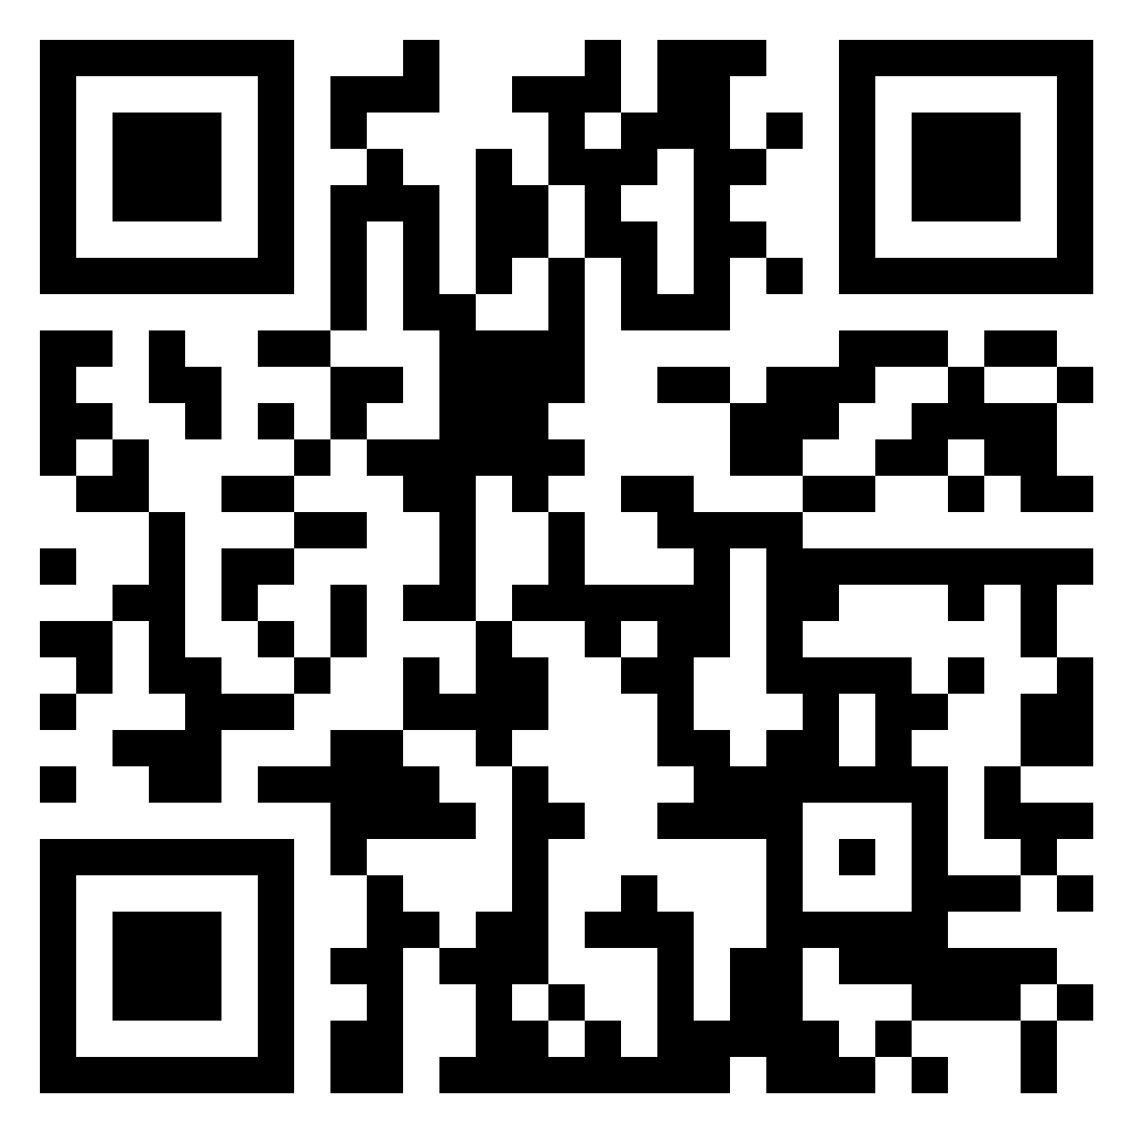
Practically adapting to this new world
How can we creatively and critically adapt our GCE programme during Covid 19?
Think of the Active Learning Methodologies and Activities I normally do with my students?
Notes:
Explain each one how we break them down…...
Discussion with the option of padlet if they want to write something in.
Active Methodologies https://padlet.com/lizzy_noone/enieyilq7n3wzq8m
Extra curricular:
Raising Awareness and Taking Action: https://padlet.com/lizzy_noone/4e9n7mb31wutuv5l

Slide 36
Active learning methodologies
3 categories:
Classroom-no technology
Limited online-one computer in classroom
All students have access to technology
If you have preference, put in chat the number that applies to you-you will put into breakout spaces according to this!
https://docs.google.com/document/d/1xDnlgxCC9ITOMOq1oOR1IN6i-B1_1RuCtftpQnJ6VkM/edit?usp=sharing
Notes:
https://docs.google.com/document/d/1xDnlgxCC9ITOMOq1oOR1IN6i-B1_1RuCtftpQnJ6VkM/edit?usp=sharing

Slide 37
A few Examples from our teacher advisory group
‘As a staff we are finding out about the other skills teachers can bring to the classroom e.g. one of our teachers makes hats out of sustainable materials so can do workshops with classes. I can bring students hiking so we can go on local field trips’
Philip Marillat Firhouse ETSS
‘I found a giant step, small step or stay put exercise worked
I brought the TYs out to the Tennis courts or Gym if it was free they all stood 2m apart and I asked a series of 10 Qs/statements on Fashion Sustainability
The first person to touch an object half way up the court won. It was fun and needed no resources’
Yvonne McGlynn,
Ardscoil Mhuire Ballinasloe
‘I altered the paper bag game so the students did it individually rather than as a group, it worked well and there was a great buzz in the classroom. Teachers brought in the newspapers for the students so this also created a bit of involvement from the teachers’ Rachel McEntee,
St. Oliver’s Drogheda
Notes:
While we’re doing all that let’s start the ball rolling!!!

Slide 38
Active learning methodologies
Feedback
What stood
out for you?
Any other ideas do you have to adapt your programme in general?
-Extra Curricular
-Teacher Capacity
-Policy & School Leadership
-Student Capacity
-Raising Awareness
-Taking Action
Notes:
https://docs.google.com/document/d/1xDnlgxCC9ITOMOq1oOR1IN6i-B1_1RuCtftpQnJ6VkM/edit?usp=sharing

Slide 39
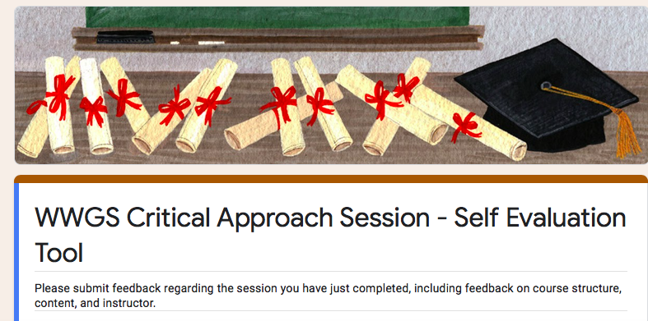
Evaluation for Today
https://forms.gle/VojjXxLDZF5nGbdL6
Notes:
https://forms.gle/5BeX3P9Qg1XYmRWz7

Slide 40
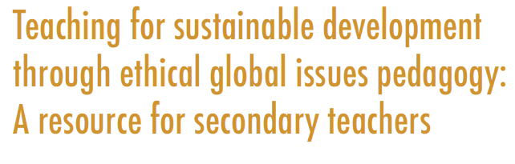
Reading
List-
Jason Hickel The Divide and Less is More
https://www.jasonhickel.org
https://www.developmenteducationreview.com/issue/issue-27/global-citizenship-education-critical-introduction-key-concepts-and-debates
GCE or Otherwise
https://decolonialfutures.net/gce/
Ethical Global Issues Pedagogy
https://www.mmu.ac.uk/media/mmuacuk/content/documents/esri/projects/teacher-resource-project/Ethical-Global-Issues-English.pdf
Learning to Read the World
https://developmenteducation.ie/resource/learning-to-read-the-world-teaching-and-learning-about-global-citizenship-and-international-development-in-post-primary-schools/

Slide 41
Reading list-Connecting Covid
The Pandemic is a Portal video and lesson plan
https://worldslargestlesson.globalgoals.org/resource/the-pandemic-is-a-portal/
The New Internationalist
https://newint.org/features/2020/08/11/big-story-covid-19-lessons-pandemic
Philip Alston ex UN special rapp. on Poverty
https://developmenteducation.ie/feature/7-key-takeaways-from-philip-alston-a-masterclass-on-extreme-poverty/
Climate Change and Covid 19
https://www.developmenteducationreview.com/issue/issue-30/climate-change-and-coronavirus-confluence-two-emergencies-learning-and-teaching

Slide 42

Go raibh mile maith agaibh!
22nd October 4.30-5.30

Slide 43
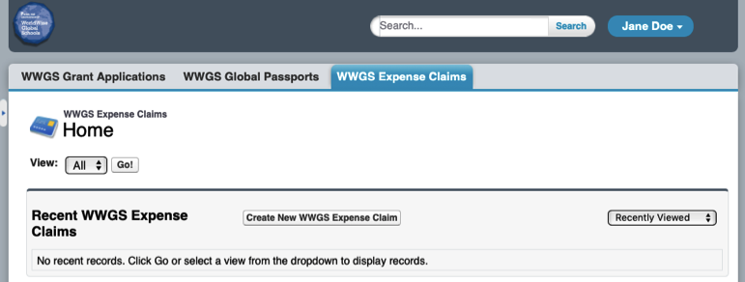
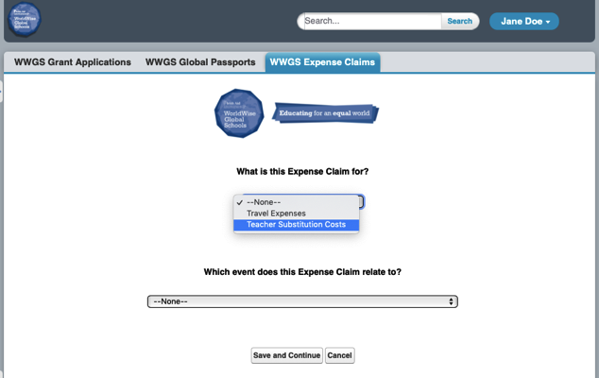
1. Create new expense Claim
2. Provide details

