Slide 1
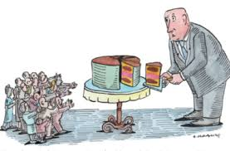
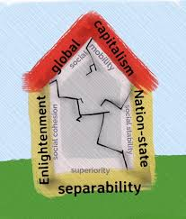
The What and How of the WWGS Approach to Global Citizenship Education
Autumn 2020
Notes:
Trigger warning for the new teachers-for some of you this is very new don’t change your programme. How can this influence my work-challenge you to be more critical in your work. Outcome may be different for new and more established schools.

Slide 2
The session will cover:
- The WWGS critical and analytical approach to GCE
* The theory that underpins our approach
* Reflect on our own GCE practice as teachers
* The tools we use to guide teachers on this approach
- COVID-19 as an opportunity and a challenge to GCE
* What opportunities does COVID-19 offer to create change
* How to adapt my GCE programme in the current context
Session Breakdown:
PART 1: WHAT – theory to practice
PART 2: HOW – Tools and methodologies
Workshop on
Critical Approach to GCE

Slide 3

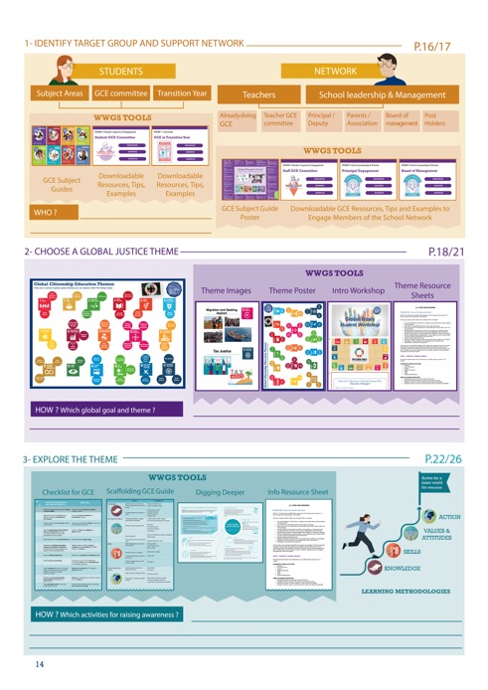
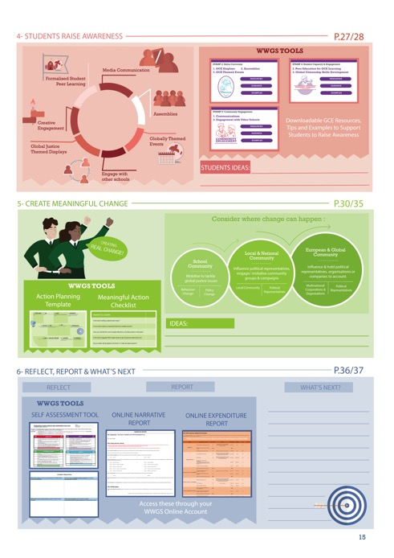
WWGS 6 Step Approach to GCE
Page
14-15
Notes:
We will focus on Step 3 Digging Deeper into an issue today
If this step is done right it will influence step 4, 5 and 6!

Slide 4
Page
14-15
Notes:
We will focus on Step 3 Digging Deeper into an issue today
If this step is done right it will influence step 4, 5 and 6!

Slide 5
PART 1: WHAT?
- Envisaging a New World
- Critical Approach - Theory to Practice

Slide 6

Consider during the clip:
Why does Arundhati Roy not want to return to ‘normality’?
What does she mean by the ‘doomsday machine’?
How would you imagine a new world look like?
Notes:
https://docs.google.com/document/d/1_JlxmmhphMwfeWzhMU3SN42nxPaLMTkfuyQATezY8tA/edit?usp=sharing
Think socially, politically, economically, emotionally??
Do you agree that the ‘Pandemic is a Portal’?
You could also consider asking students what they might bring with them through the portal-get them to think of emotions and skills as well as possessions!
Is there any other questions you could ask?
Co-host puts the teachers into groups.

Slide 7

Arundhati Roy
https://www.youtube.com/watch?time_continue=14&v=ALN3UkxXA8g&feature=emb_logo
Notes:
Fits somewhere else? Theory at the start??
Critical approach.

Slide 8
In Breakouts, answer the following questions:
Why does Arundhati Roy not want to return to ‘normality’?
What does she mean by the ‘doomsday machine’?
How would you imagine a new world look like?
Notes:
https://docs.google.com/document/d/1_JlxmmhphMwfeWzhMU3SN42nxPaLMTkfuyQATezY8tA/edit?usp=sharing
Think socially, politically, economically, emotionally??
Do you agree that the ‘Pandemic is a Portal’?
You could also consider asking students what they might bring with them through the portal-get them to think of emotions and skills as well as possessions!
Is there any other questions you could ask?
Co-host puts the teachers into groups.

Slide 9
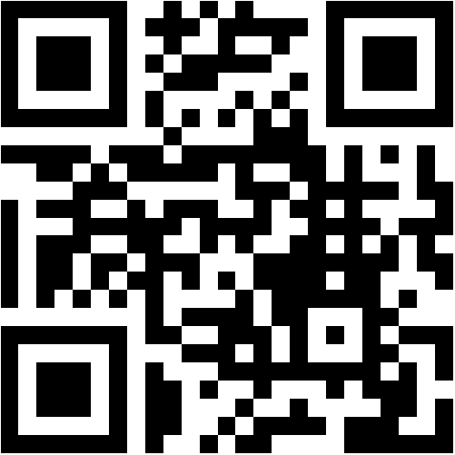
Menti-Meter
Key Questions to Consider:
What global justice issues do you wish to challenge going through this portal?
Task:
Write 3 words on the Mentimeter
Access:
Click the link in the chat https://www.menti.com/syb1omhdrs
OR
Go to www.menti.com & put in the code: 60 69 41
OR
Hold your phone camera up to the QR Code here:
Notes:
https://www.menti.com/2wpn7dssic
PUT UP THE MENTIMETER AFTER THIS SLIDE…...log in lizzy.noone@worldwiseschools.ie log in P0ppyU1tan again we might need to wipe each mentimeter after each.
Do you agree that the ‘Pandemic is a Portal’?
You could also consider asking students what they might bring with them through the portal-get them to think of emotions and skills as well as possessions!
Is there any other questions you could ask?

Slide 10

Notes:
Covid-19 has provided a powerful lens through which inequality in its many forms can be seen. What’s equally obvious is that we cannot beat this virsu if we do not also tackle the disease of inequality.
Antonio Guterres the UN Secretary General but it well when he said C19 has exposed the lie that free markets can deliver healthcare for all, the fiction that unpaid care work isn’t work, the delusion that we live in a post racial world. We are all floating on the same sea but some are in super yachts and others clinging to drifting debris’.

Slide 11
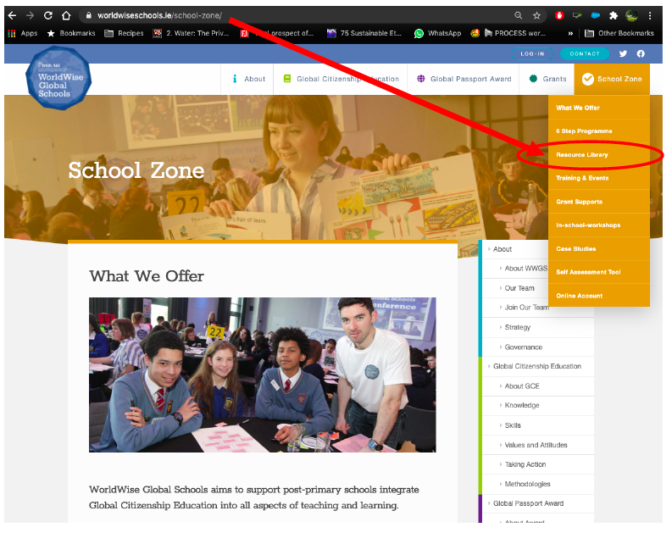
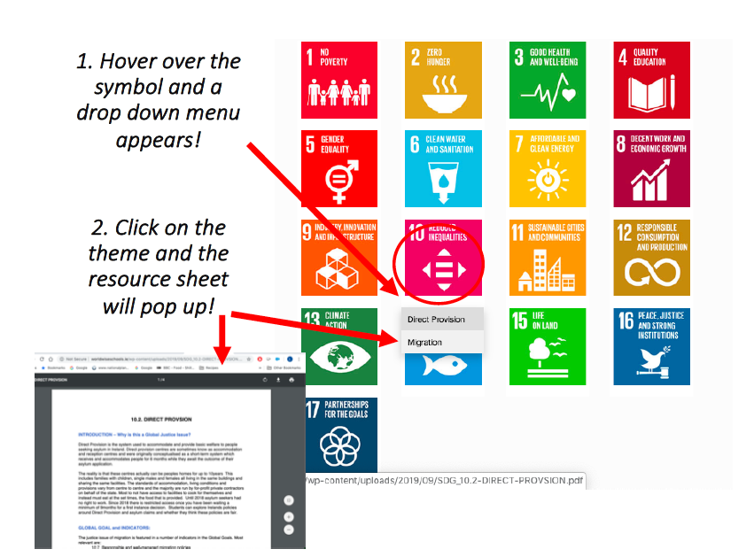

Slide 12
“it [the pandemic] has to be a tipping point. This has to be a point to transform where we move from one system an exploitative political and economic system to a completely different one private sufficiency and public luxury”.
George Monibot

Slide 13
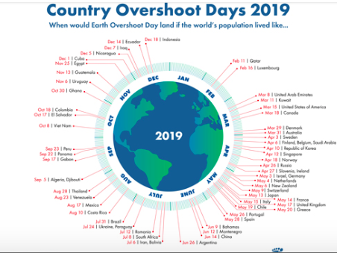
Notes:
The pandemic gave us a chance to appreciate nature and gave us a glimpse into what a fossil free future might look like offering a break from addictive consumerism (one would hope!)
Earth Overshoot Day marks the date when humanity's demand for ecological resources and services in a given year exceeds what Earth can regenerate in that year. We maintain this deficit by liquidating stocks of ecological resources and accumulating waste, primarily carbon dioxide in the atmosphere.
George Monibot said that’ it [the pandemic] has to be a tipping point. This has to be a point to transform where we move from one system an exploitative political and economic system to a completely different one private sufficiency and public luxury.

Slide 14


Slide 15

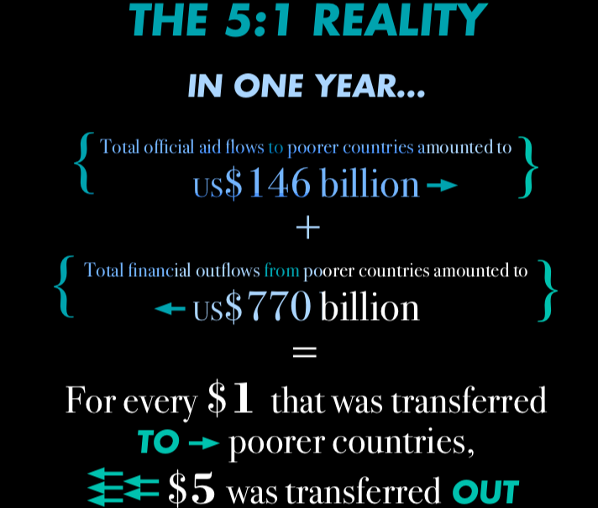
Notes:
The global economic system is key-campaigns to cancel the debt, tackle tax avoidance and how the IMF chooses to use its resources will be key.
No matter what theme you are exploring you can not avoid talking about structural and systematic inequalities that exist in the world.
What systems can you think of that might cause mass inequality???

Slide 17
“‘Developing countries’ is the name that experts use to designate countries trampled by someone else’s development.”
Eduardo Galeano
“The next time someone tells you they got rich through hard work, ask them whose?”
Don Marquis

Slide 18
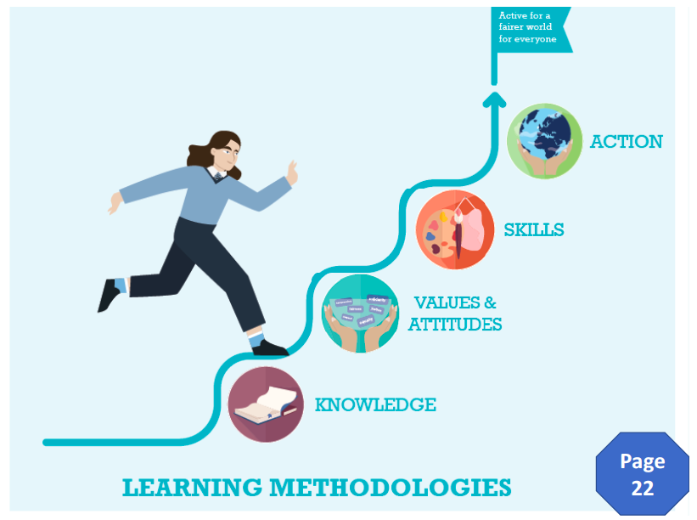
Transformative Journey to Create a Better World
How do we take a critical and analytical approach to GCE?

Slide 19
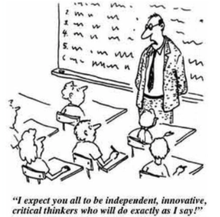
What is a critical + analytical approach to learning GCE?
Global issues are complex and need a critical pedagogical approach to exploring them!
Notes:
Critical Thinking helps students seek out, listen to and incorporate marginalized perspectives in order to question and possibly unlearn mainstream ways of thinking and address inequitable balance between the dominant and marginalized perspectives
Karen Pashby

Slide 20
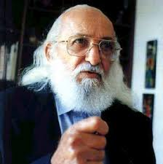
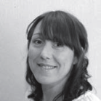
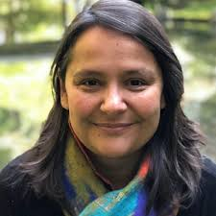
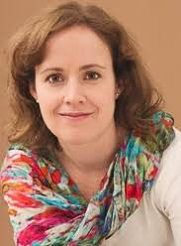
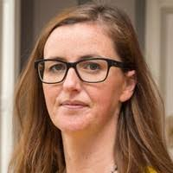
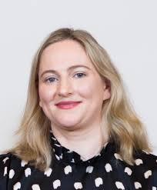
Pedagogy of the Oppressed
Pedagogy of the Rich!
Educational Theory behind the WWGS Approach
Notes:
All recognise a need for a more critical approach to Global Citizenship Education!

Slide 21
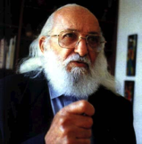
Paulo Freire

Slide 22

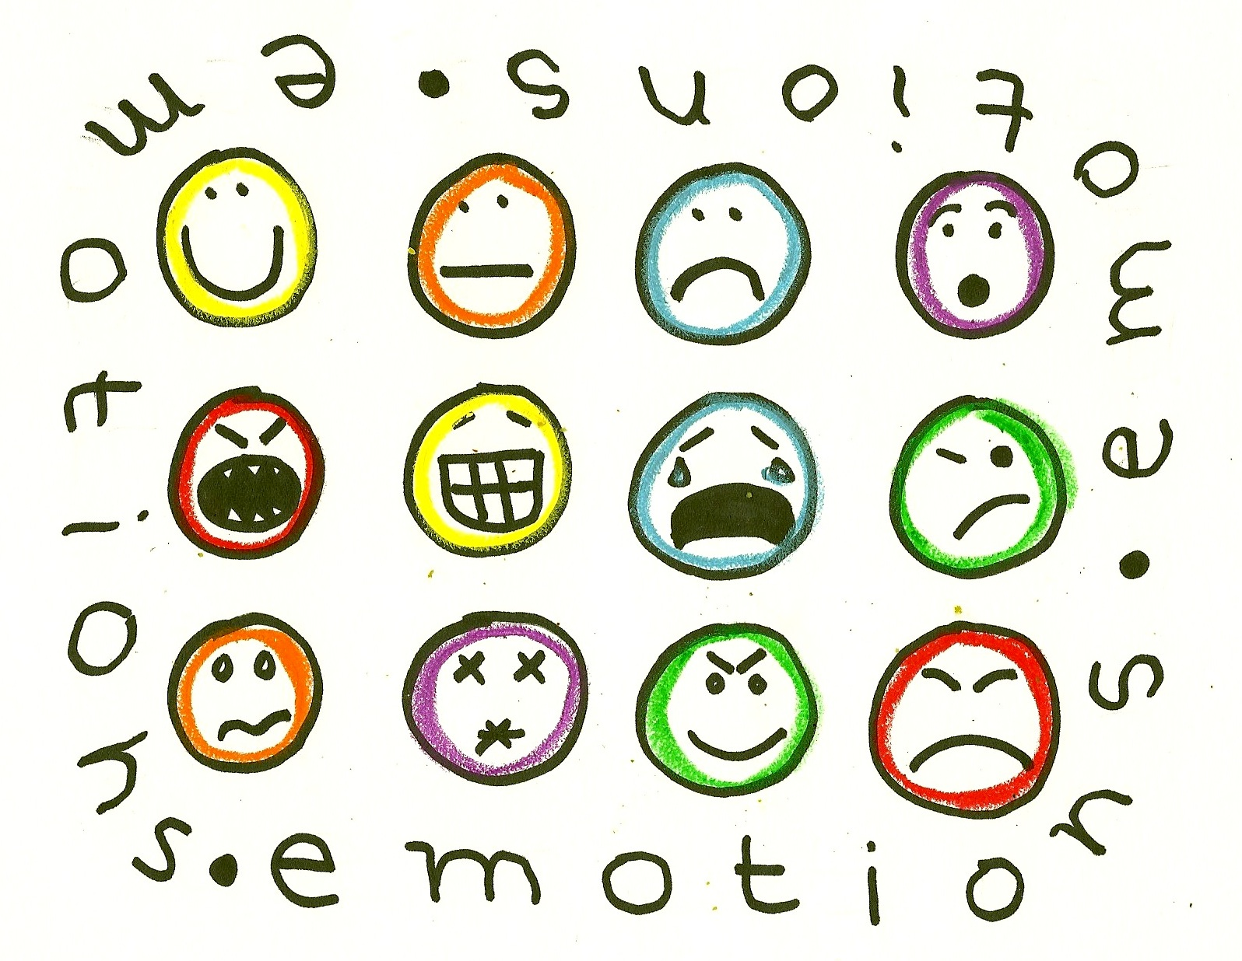

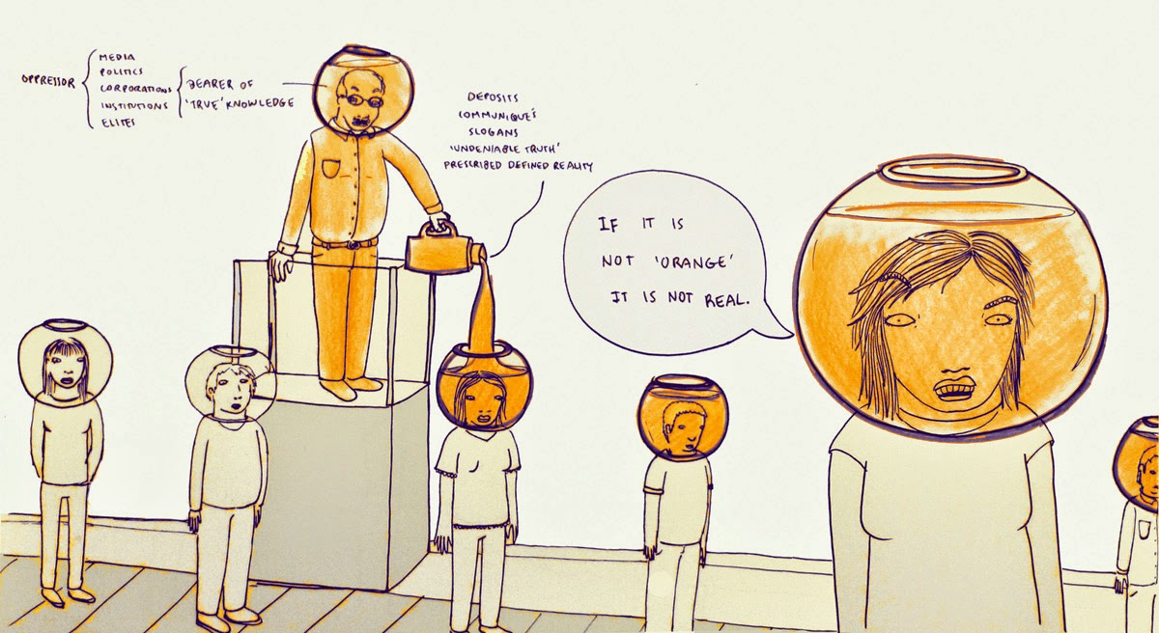


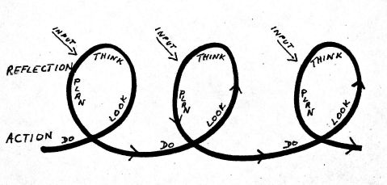
Roots of Development Education
Paulo Freire’s Pedagogy of the Oppressed
Aim of Education:
Radical Transformation
2. Relevant:
Generative Themes
3. Dialogue:
6. No Education is Neutral
4. Problem posing
Search for solutions
5. Reflection and Action
Notes:
1. The aim of education is radical transformation!
Transformative education is based on the hope that is it possible to change life for the better!
Based on a vision for a new, more just society.
Radical means going to the roots! The values underpinning the modern world.
2. Relevant – Generative themes
Link between emotion and motivation to act
Feeling breaks through apathy
Role of facilitator to tap into natural energy and break apathy
3 Dialogue
People learn, remember and apply what they learn in dialogue with their peers
Requires patience, humility and a real belief that one can learn from the other
Role of facilitator to create a climate in which true dialogue can take place
4. Problem posing approach
Faciliator provides a framework for thinking, creative active particpants to consider a common problem and find solutions
Faciliator raises questions such as why, how, who?
Particpants are active, describing, analysing, suggesting, deciding and planning
People are actively involved in the social consturction of knowledge.
5. Cycle of reflection and action key for transformation - this requires special meetings for discussion
Plan of action may solve some aspect of a problem but not root causes
By celebrating success and analysing mistakes – become capable of transforming lives
Role of facilitator support group learning from others (receiving inputs)

Slide 24
The House that Modernity Built
LOW INTENSITY
GLOBAL CAPITAL
NORTH OF THE NORTH
NORTH OF THE SOUTH
Unsustainable Growth & over consumption
UNIVERSAL KNOWLEDGE
STRUGGLE
NATION STATE
Expropriation
SOUTH OF THE NORTH
Waste Disposal
SEPARABILITY
SOUTH OF THE SOUTH
HIGH INTENSITY
PLANET
Notes:
Vanessa Andreotti, University of British Columbia – Moscrium reserve
Social Cartography – create conversations

Slide 25

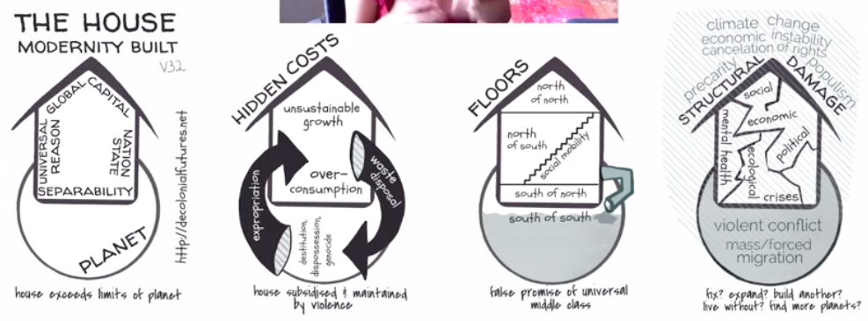
Vanessa Andreotti, University of British Columbia
Notes:
Vanessa Andreotti, University of British Columbia – Moscrium reserve
Social Cartography – create conversations
Value of planet animals etc are calculated as value
Similar to people

Slide 26
Dr. Audrey Bryan, DCU
‘Teachers should promote critical literacy in their classrooms that will enable students to decode and develop ‘oppositional readings’ to dominant
development narratives in the formal curriculum and to critically self-reflect on their own assumptions about development and the Global South’.
Notes:
Associate Professor of Sociology in the School of Human Development, DCU, where I teach courses across the range of programme offerings on the Humanities (Human Development) and Education programmes.
My research interests lie in an exploration of the subjective experiences of those who are ‘othered’ or marginalised by inequitable and discriminatory educational structures, relations, and practices, and with the broad pedagogical and ethical question of what it means to educate for social and global justice

Slide 27
Maria Barry, St Patrick’s College, DCU
‘the study identified a striking absence and
use of theoretical frameworks, such as human
rights and global justice, to anchor the topics
explored in the classroom.
[Students] interpretations indicate that discussion is a central feature of GCE classroom practice that is both welcome and counter to students’ prevailing formal education engagement.
It is important to understand GCE from this perspective as it demonstrates it’s value in formal education to act as a disruptive and alternative experience to the dominant narratives that students encounter’
Notes:
Maria Barry is a teacher educator and researcher in history and citizenship education in DCU's IoE. She is a qualified post primary teacher and has extensive experience of working across both primary and post primary settings in the areas of curriculum development, human rights programmes for young people and teacher education.
School of STEM Education, Innovation & Global Studies

Slide 28
Critical Thinking helps students seek out, listen to and incorporate marginalized perspectives in order to question and possibly unlearn mainstream ways of thinking and address inequitable balance between the dominant and marginalized perspectives
Karen Pashby

Slide 29
Page
14-15
Notes:
Briefly talk through the 6 steps

Slide 30
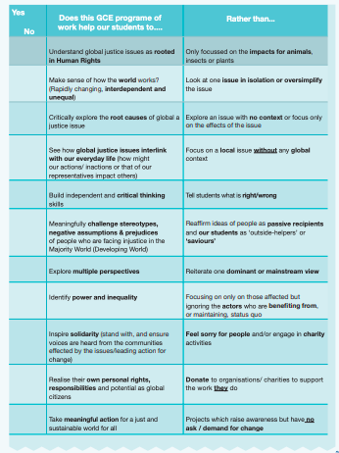
Page
25

Slide 31
Dos and Don’ts Page 23 of How To Guide
Room | DO | DON'T
Room 1 | Identify Power and Inequality | Focusing only on those affected and ignoring the actors who are benefiting or maintaining status quo
Room 2 | Explore Multiple Perspectives | Reiterate one dominant or mainstream view
Room 3 | Inspire Solidarity (stand with and ensure voices are heard from the communities effected by the issues/leading action for change) | Feel sorry for people and take a charity approach
Room 4 | Critically explore the root causes of a global justice issue | Explore an issue with no context or focus only on the effects of the issue
Notes:
Links to group work:
Room 1: https://docs.google.com/document/d/1ZxZMdY4WjooVH-Q0f7lrE6UqCvJLsRWEZiTocRZ4lh4/edit?usp=sharing
Room 2: https://docs.google.com/document/d/102aNcs2fHDkl6SQMQ8ejv-gBhp_w_nii7aQDVCUzrxM/edit?usp=sharing
Room 3:
https://docs.google.com/document/d/16QmDKh5puwOycSxukWAJVaUnpTsjsYBvJt_SZZxTpuw/edit?usp=sharing
Room 4:
https://docs.google.com/document/d/109jk-Quo6TcEfAhil7lnCjhuVBpjrvcTg9nCJN7T5Z4/edit?usp=sharing
Remind participants that it’s a good idea for one person to share screen and write in the feedback!

Slide 32
CHECKLIST TASK!
Each group will be given 1 point from the GCE checklist:
Discuss the DO and the DON’T using the following questions:
-How could you avoid your GCE programme falling into the ‘Don’t’ column?
-What resources, activities and the methodologies could help keep you on the ‘Do’ side?
Notes:
So all this theory obviously translate into the the tools that we create for teachers like our dos and don’ts list on page

Slide 33
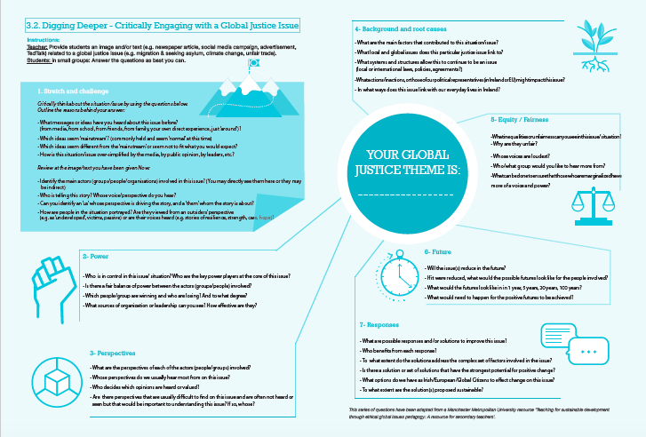

Slide 34
Digging Deeper
In your breakout rooms, you will each take a set of questions:
Room 1: Stretch and Challenge 2
Room 2: Power
Room 3: Perspective
Room 4: Background
Room 5: Equity/Fairness
Room 6: (if there is one) take Perspective questions as well.
When finished your set of questions look at what other questions have been answered and respond to: Future and Responses
Notes:
https://docs.google.com/document/d/1jTe7NOGvcO5nAiItEaxzb0_gaXbpzJyeprDDPvRvgOc/edit?usp=sharing
Note: we will need our own link for this or we can save our own documents and delete content for next group.

Slide 35


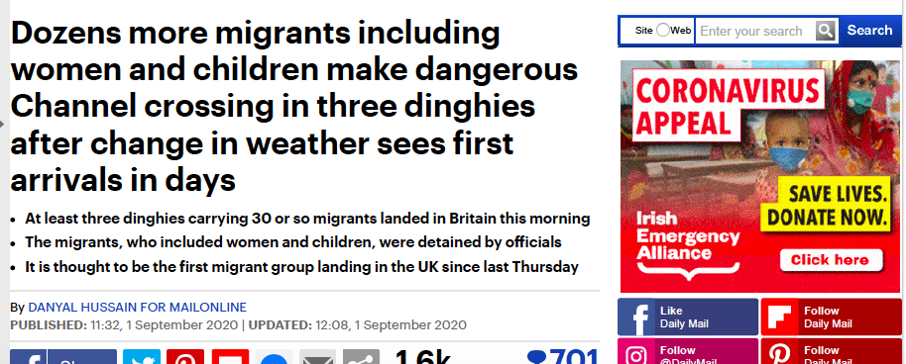
Notes:
You can use any theme photos, article art work for this exercise. Reflect on the thematic areas you chose earlier and see how this would work.
LINK TO ARTICLE: https://docs.google.com/document/d/1VaSfR7lHTFCz7yRxzKBsVCUoVcDm_GjfbdEfAg0PtvY/edit?usp=sharing

Slide 36
Read this short article
Spend some time reading this article-link in Chat
Notes:
https://docs.google.com/document/d/1VaSfR7lHTFCz7yRxzKBsVCUoVcDm_GjfbdEfAg0PtvY/edit?usp=sharing
Give participants the option of it being read out and they can sit back and close their eyes and you read it.

Slide 37
Stretch
and Challenge
What messages or ideas have you heard about this issue before?
Which ideas seem ‘mainstream’?
Which ideas seem different from the ‘mainstream’
How is this situation/issue over-simplified by the media, by public opinion, by leaders, etc.?
Notes:
https://docs.google.com/document/d/1jTe7NOGvcO5nAiItEaxzb0_gaXbpzJyeprDDPvRvgOc/edit?usp=sharing
Note: we will need our own link for this or we can save our own documents and delete content for next group.

Slide 38
PART 2:
Dos and Don’ts
Adapting my GCE Programme: active learning methodologies
Notes:
Pre ask them on the adapting part ask them about what room they’d like to go in…...

Slide 39
Breakout Rooms- Reflection

Slide 40
Break Time!
Walk around outside or in a nice space in your home. If you can try not to pick up your phone or engage in any other distraction.
Pretend for a minute you are stepping through a portal-what do you see??
Notes:
https://docs.google.com/document/d/1VaSfR7lHTFCz7yRxzKBsVCUoVcDm_GjfbdEfAg0PtvY/edit?usp=sharing

Slide 41
Future
-Will the issue(s) reduce in the future?
- If it were reduced, what would the possible futures look like for the people involved?
- What would the futures look like in 1 year, 5 years, 20 years, 100 years?
Notes:
https://docs.google.com/document/d/1jTe7NOGvcO5nAiItEaxzb0_gaXbpzJyeprDDPvRvgOc/edit?usp=sharing
Note: we will need our own link for this or we can save our own documents and delete content for next group.

Slide 42
Responses
What are possible responses and/or solutions to improve this issue?
- Who benefits from each response?
- To what extent do the solutions address the complex set of factors involved in the issue?
- Is there a solution or set of solutions that have the strongest potential for positive change?
- What options do we have as Irish/European/Global Citizens to effect change on this issue?
- To what extent are the solution(s) proposed sustainable?
Notes:
https://docs.google.com/document/d/1jTe7NOGvcO5nAiItEaxzb0_gaXbpzJyeprDDPvRvgOc/edit?usp=sharing
Note: we will need our own link for this or we can save our own documents and delete content for next group.

Slide 43
Practically adapting to this new world
How can we creatively and critically adapt our GCE programme during Covid 19?
Think of the Active Learning Methodologies and Activities I normally do with my students?
Notes:
Explain each one how we break them down…...
Discussion with the option of padlet if they want to write something in.
Active Methodologies https://padlet.com/lizzy_noone/enieyilq7n3wzq8m
Extra curricular:
Raising Awareness and Taking Action: https://padlet.com/lizzy_noone/4e9n7mb31wutuv5l

Slide 44
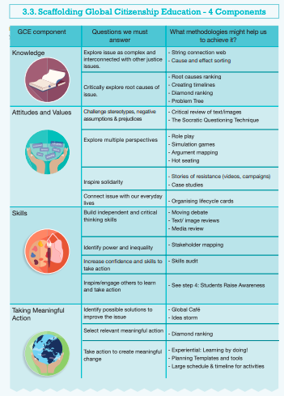
Page
26

Slide 45
Active learning methodologies
3 categories:
Classroom - no technology
Limited online - one computer in classroom
All students have access to technology
https://docs.google.com/document/d/1xDnlgxCC9ITOMOq1oOR1IN6i-B1_1RuCtftpQnJ6VkM/edit?usp=sharing
Notes:
https://docs.google.com/document/d/1xDnlgxCC9ITOMOq1oOR1IN6i-B1_1RuCtftpQnJ6VkM/edit?usp=sharing

Slide 46
A few Examples from our teacher advisory group
‘As a staff we are finding out about the other skills teachers can bring to the classroom e.g. one of our teachers makes hats out of sustainable materials so can do workshops with classes. I can bring students hiking so we can go on local field trips’
Philip Marillat Firhouse ETSS
‘I found a giant step, small step or stay put exercise worked
I brought the TYs out to the Tennis courts or Gym if it was free they all stood 2m apart and I asked a series of 10 Qs/statements on Fashion Sustainability
The first person to touch an object half way up the court won. It was fun and needed no resources’
Yvonne McGlynn,
Ardscoil Mhuire Ballinasloe
‘I altered the paper bag game so the students did it individually rather than as a group, it worked well and there was a great buzz in the classroom. Teachers brought in the newspapers for the students so this also created a bit of involvement from the teachers’ Rachel McEntee,
St. Oliver’s Drogheda
Notes:
While we’re doing all that let’s start the ball rolling!!!

Slide 47
Active learning methodologies
Feedback
What stood
out for you?
Any other ideas do you have to adapt your programme in general?
-Extra Curricular
-Teacher Capacity
-Policy & School Leadership
-Student Capacity
-Raising Awareness
-Taking Action
Notes:
https://docs.google.com/document/d/1xDnlgxCC9ITOMOq1oOR1IN6i-B1_1RuCtftpQnJ6VkM/edit?usp=sharing

Slide 48
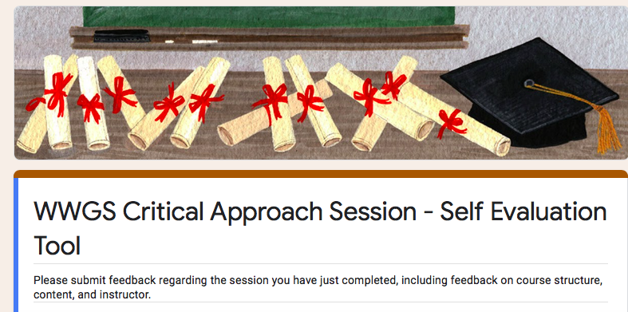
Evaluation for Today
https://forms.gle/VojjXxLDZF5nGbdL6
Notes:
https://forms.gle/5BeX3P9Qg1XYmRWz7

Slide 49
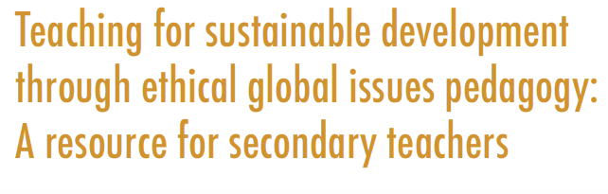
Reading
List-
Jason Hickel The Divide and Less is More
https://www.jasonhickel.org
https://www.developmenteducationreview.com/issue/issue-27/global-citizenship-education-critical-introduction-key-concepts-and-debates
GCE or Otherwise
https://decolonialfutures.net/gce/
Ethical Global Issues Pedagogy
https://www.mmu.ac.uk/media/mmuacuk/content/documents/esri/projects/teacher-resource-project/Ethical-Global-Issues-English.pdf
Learning to Read the World
https://developmenteducation.ie/resource/learning-to-read-the-world-teaching-and-learning-about-global-citizenship-and-international-development-in-post-primary-schools/

Slide 50
Reading list-Connecting Covid
The Pandemic is a Portal video and lesson plan
https://worldslargestlesson.globalgoals.org/resource/the-pandemic-is-a-portal/
The New Internationalist
https://newint.org/features/2020/08/11/big-story-covid-19-lessons-pandemic
Philip Alston ex UN special rapp. on Poverty
https://developmenteducation.ie/feature/7-key-takeaways-from-philip-alston-a-masterclass-on-extreme-poverty/
Climate Change and Covid 19
https://www.developmenteducationreview.com/issue/issue-30/climate-change-and-coronavirus-confluence-two-emergencies-learning-and-teaching
Catch them if you can – online hub
https://8020.ie/catchthemifyoucan/

Slide 51

Go raibh mile maith agaibh!
22nd October 4.30-5.30

Slide 52
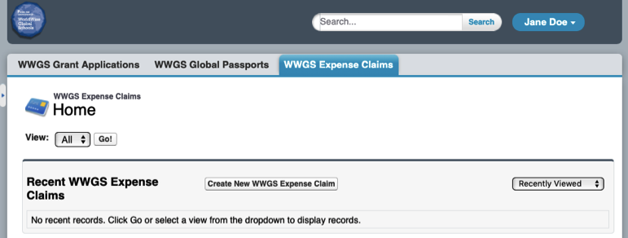
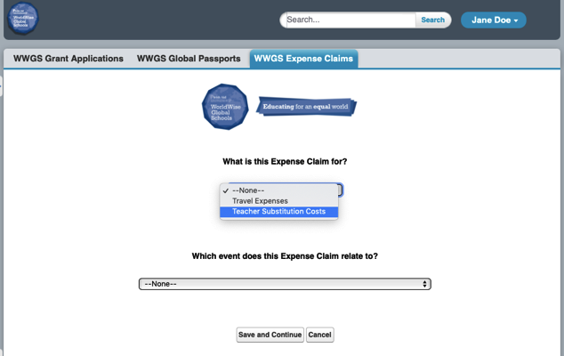
1. Create new expense Claim
2. Provide details

