Slide 1


Slide 2


Slide 3


Slide 4


Slide 5


Slide 6


Slide 7
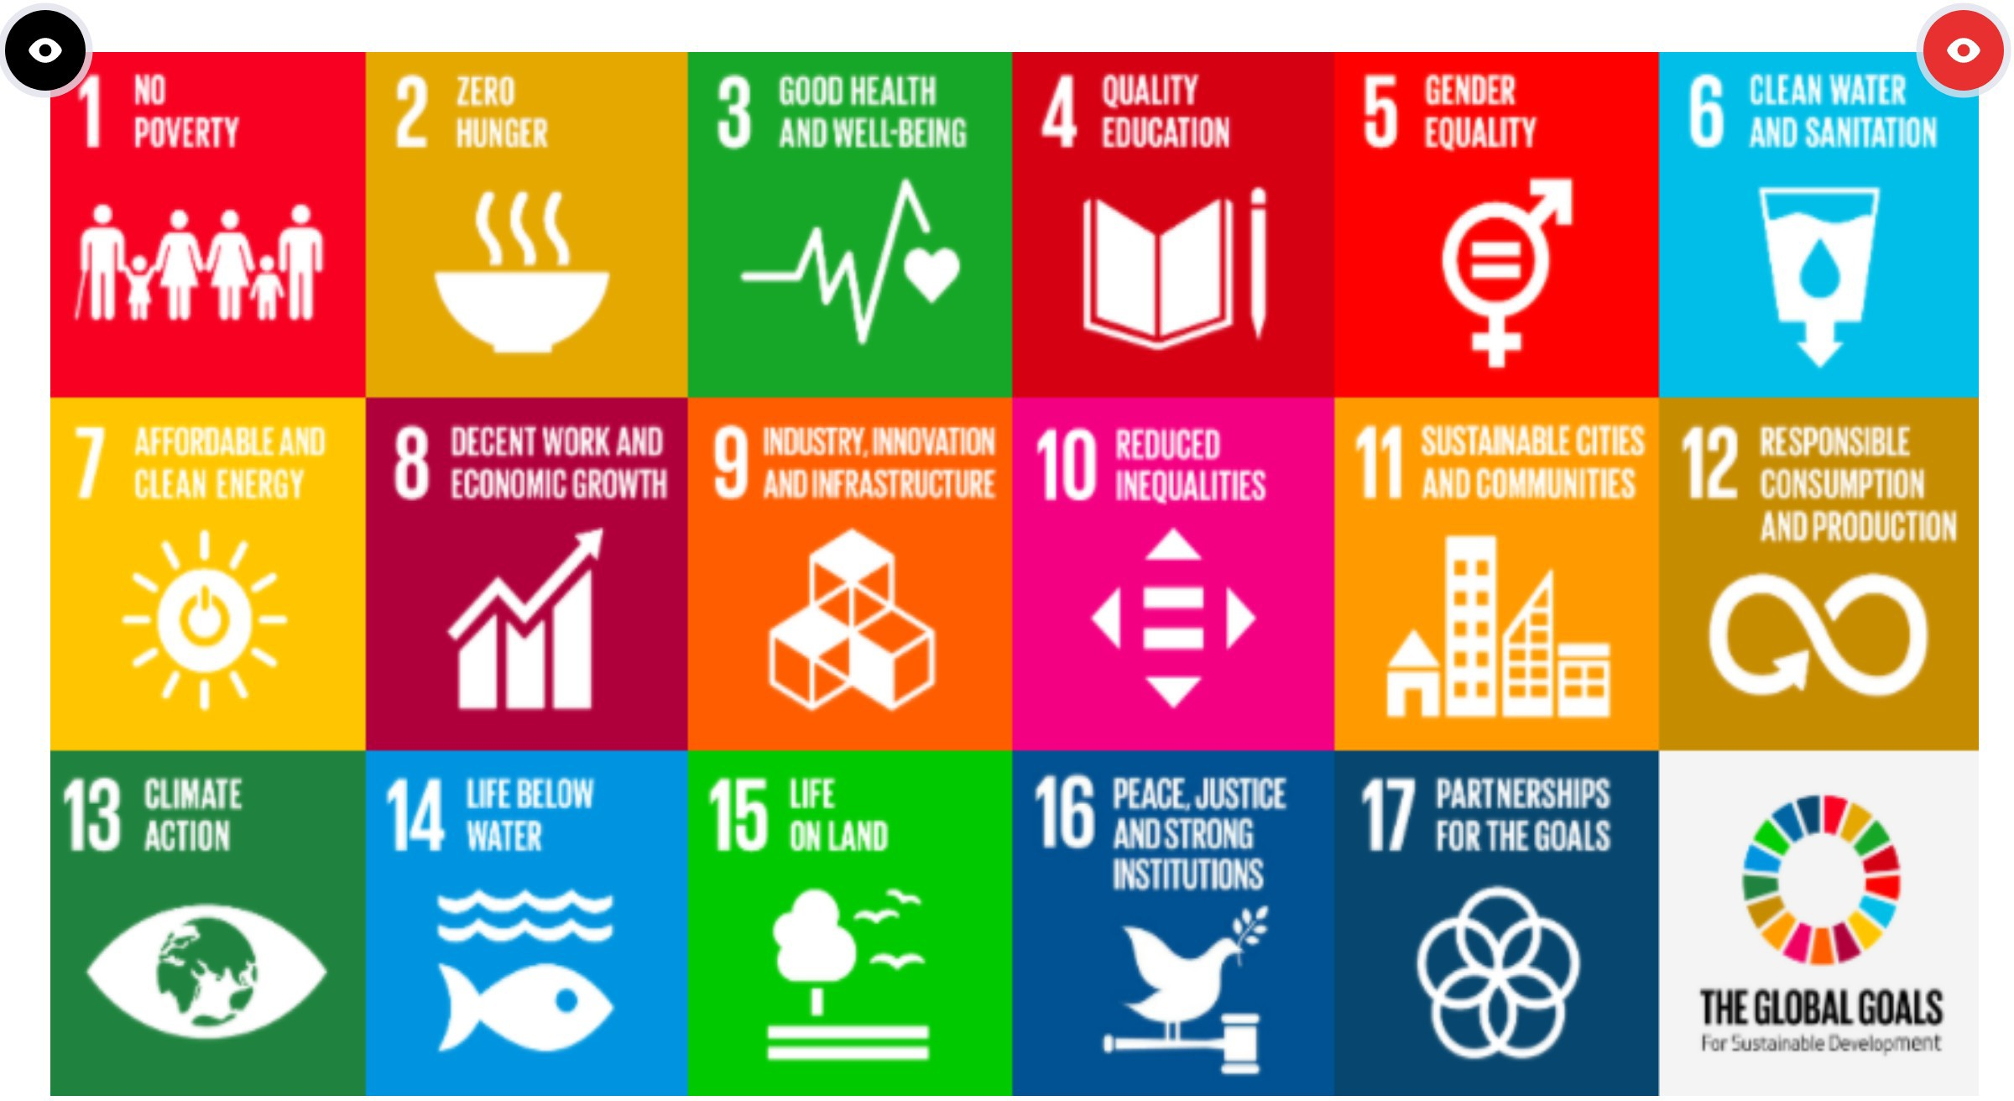

Slide 8


Slide 9
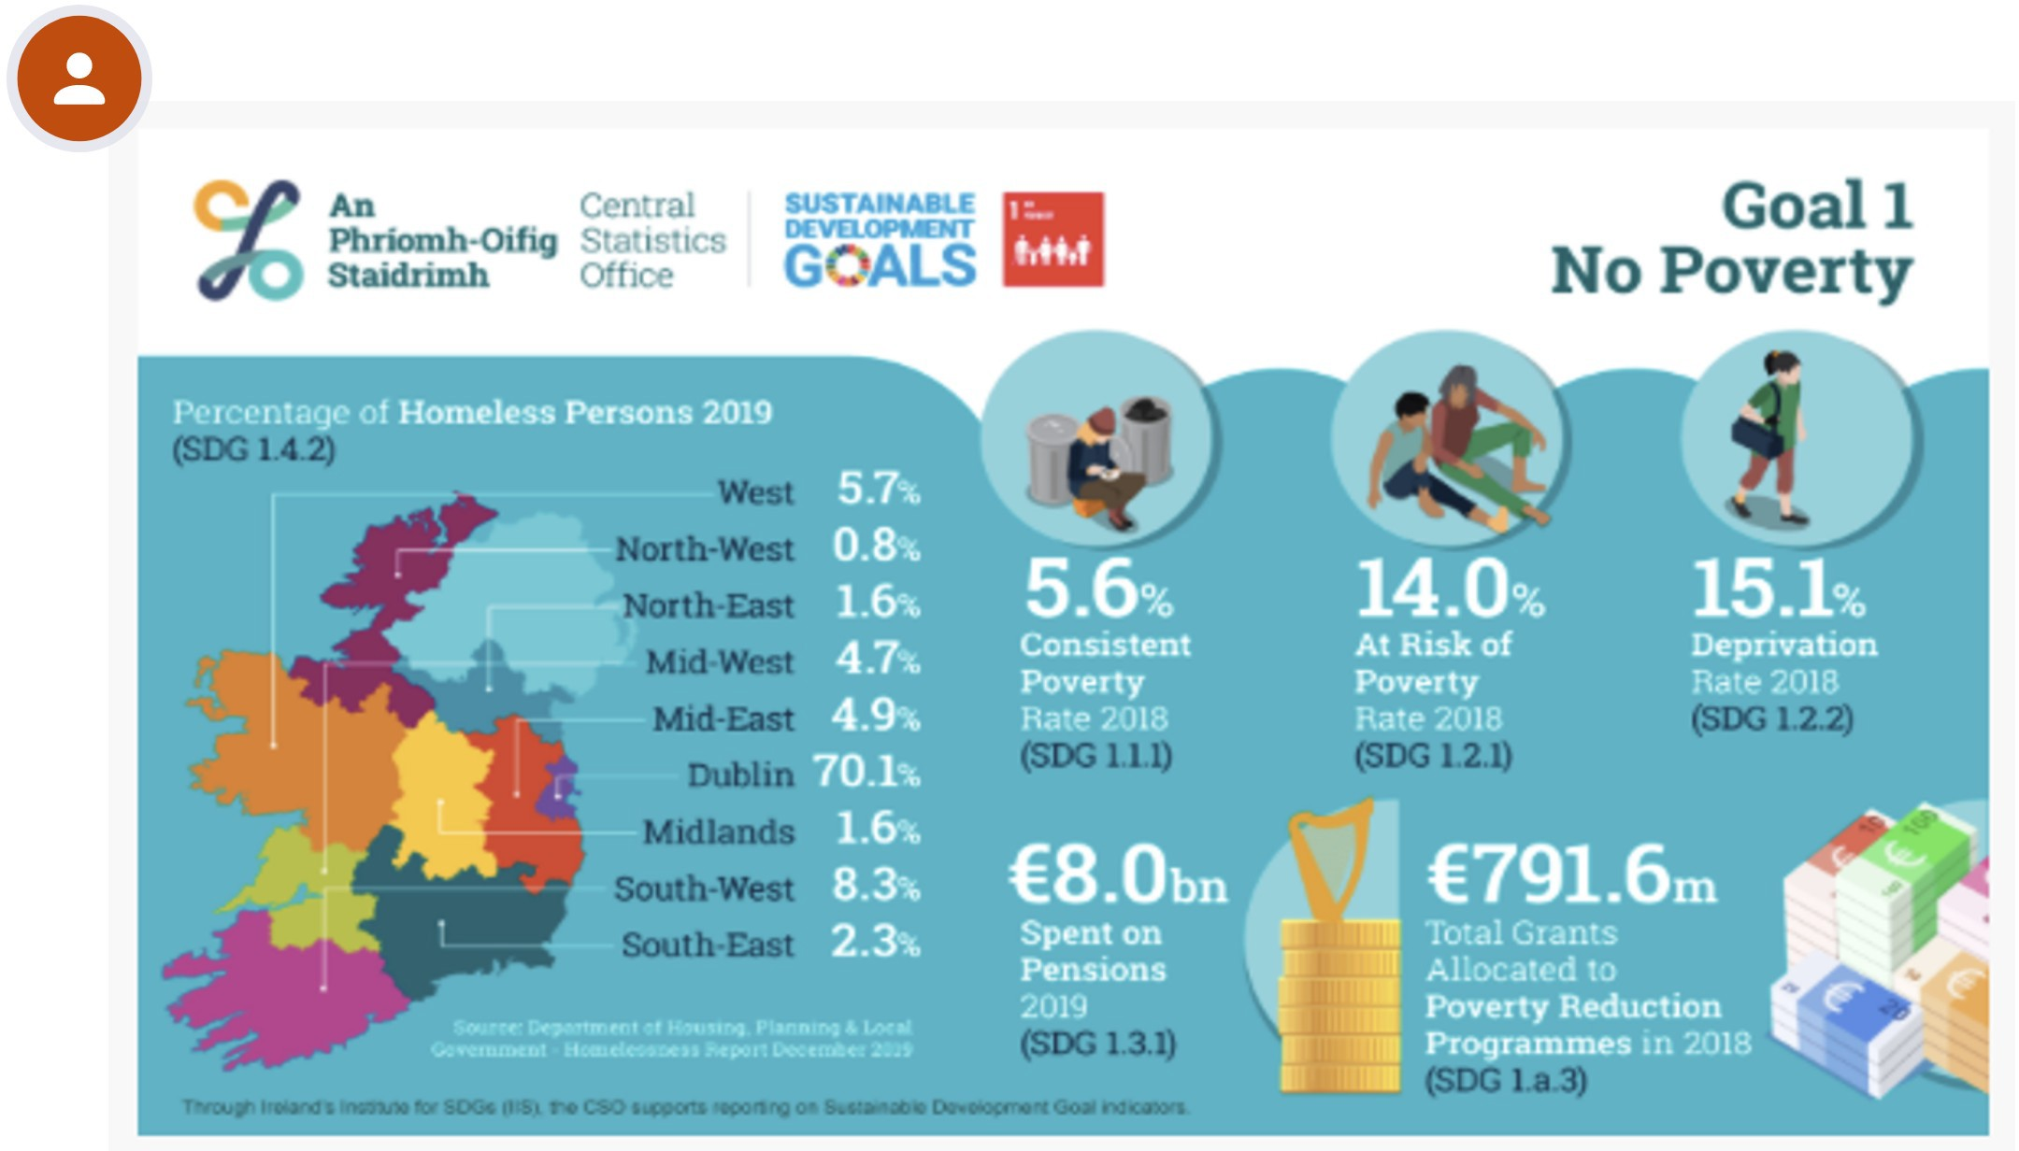

Slide 10


Slide 11


Slide 12
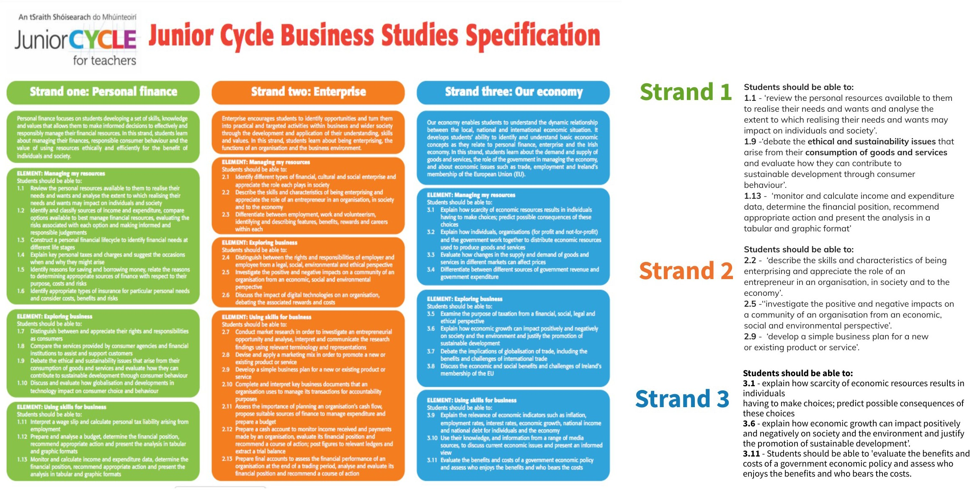

Slide 13


Slide 14


Slide 15
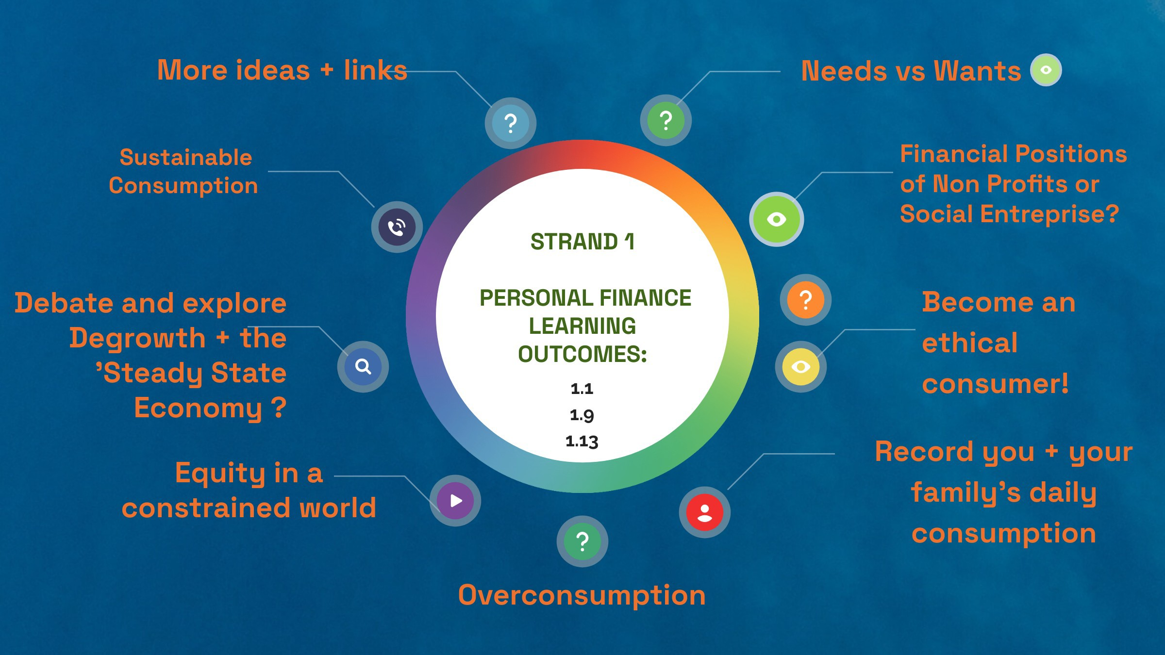

Slide 16
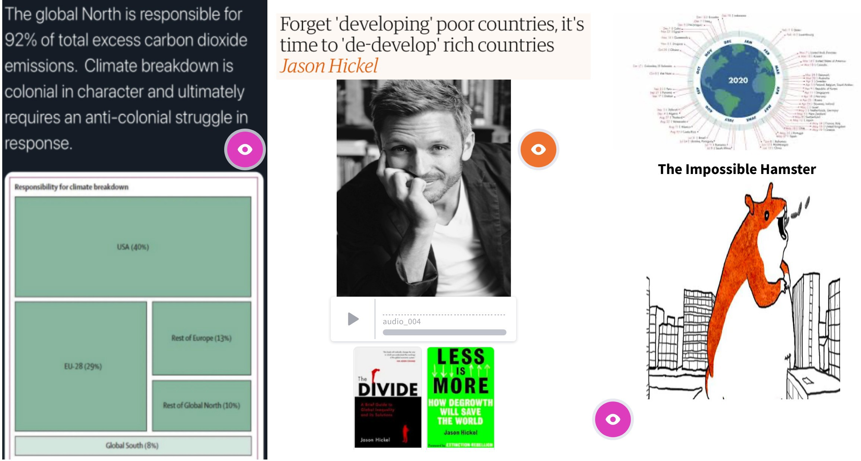

Slide 17


Slide 18


Slide 19


Slide 20


Slide 21


Slide 22


Slide 23


Slide 24
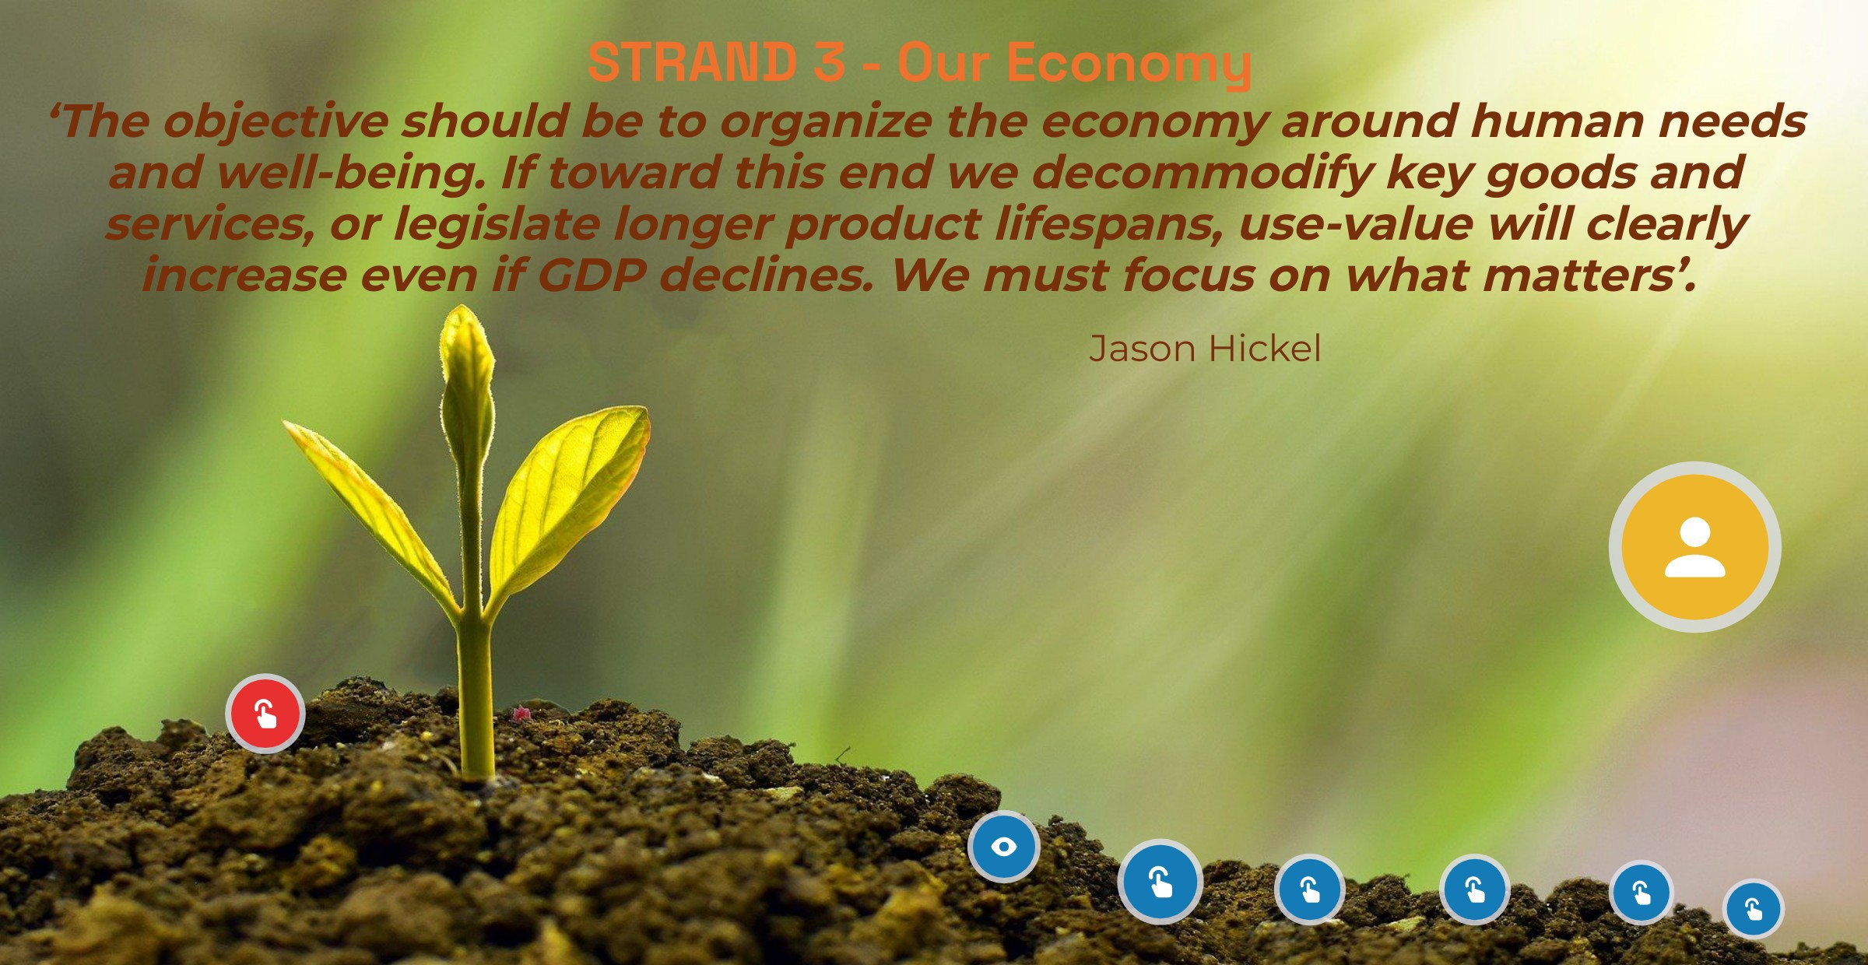

Slide 25


Slide 26


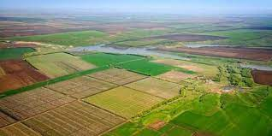

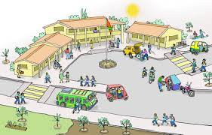

Statistics of Extraction-Global South to Global South
All of this could…
10 billion tonnes
800 million hectares
23 exajoules of energy
200 million person-years of labour

Slide 27
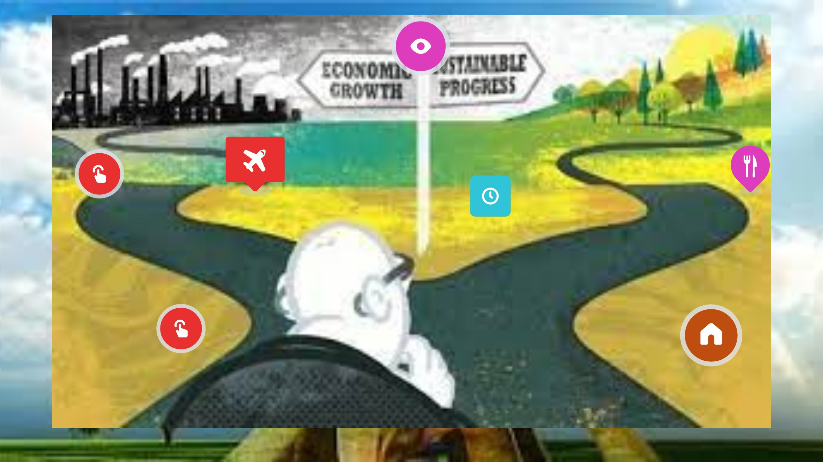

Slide 28

Modern Monetary Theory
Doughnut Economics

Slide 29


Slide 30


Slide 31
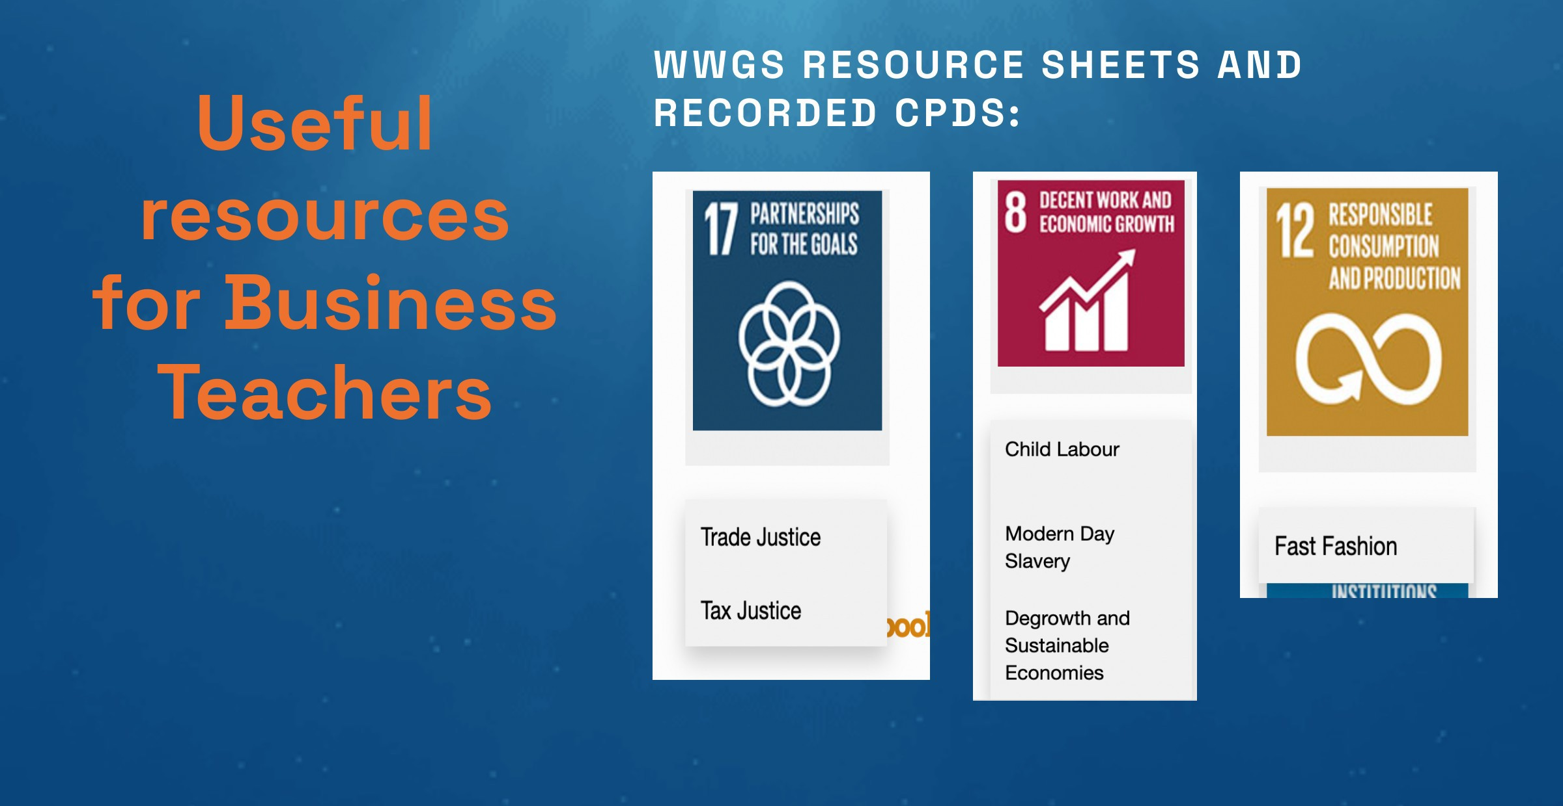

Slide 32


Slide 33


Slide 34


Slide 35


Slide 36


