Slide 1

Integrating Global Citizenship Education into
the Art Curriculum

Slide 2

What we will cover
What is Global Citizenship Education (GCE) & Why is it relevant to our teaching and learning
Using a GCE Approach
Explore the GCE connections within JC Visual Art
  Break
Whole school engagement/ cross curricular opportunities
Explore the GCE connections within SC Visual Art
GCE Resources

Slide 3

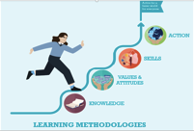






Principals Underpinning GCE
Notes:
The WWGS programme aims to:
familiarise learners with the concepts of interdependence, development, globalisation and sustainability
enable teachers to move learners from a charity mentality to a social justice mentality
community of practice that stretches across regions and continents. An informal and flexible network that can share experience and resources
stimulate critical thinking about global issues, both at a whole school and learner level help schools promote greater awareness and understanding of global justice issues.

Slide 4
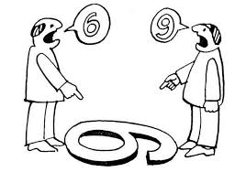
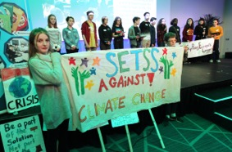
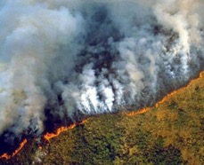
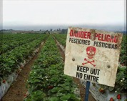
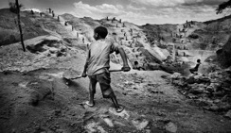

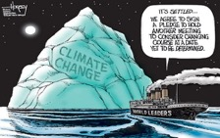
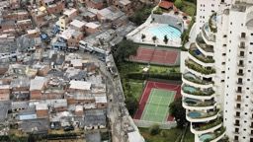
What does GCE mean to you?
Why is it important for you to embed it into your subject area?

Slide 5
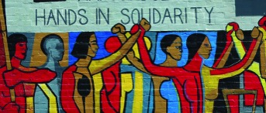



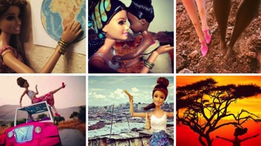
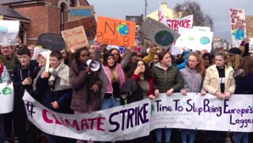
Global Citizenship Education & Art
Global Citizenship Education & Visual Art
Exploring root causes
of inequality & global justice issues
Connects & Inspires Solidarity
Hope
Linking justice issues
with our everyday lives
Challenge stereotypes
Art for Change

Slide 6

Changing the world through teaching!
Art educators have an opportunity to communicate the significance of creating and sustaining an improved quality of life for all from a global perspective
Encourage the ability to see the world as an interdependent system and to be aware of one's influence in the interactions of the world's system.
Build ability to perceive the world as a single system→ to be aware of one's involvement in it; to act to influence the system and to recognise the interconnected nature of the planet and all living on it
Information, attitudes, awareness, and skills, which, taken together, can help us understand our world, how we affect it, and how it affects us

Slide 7
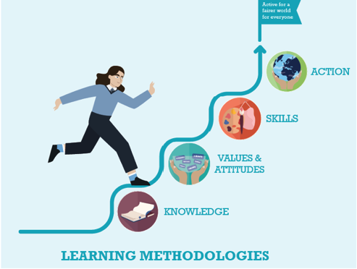
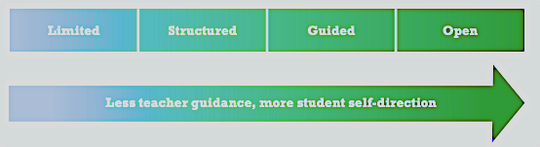

Changing the world through teaching!
Real world Problem solving & Collaboration
Express ideas, feelings and opinions
Experiment, fail, learn
Critical thinking and responsibility
Multiple Intelligence – expression and empathy

Slide 8





Key Elements To Include In You Lesson(s)
1. Asking Questions (being critical)
2. Making Connections
3. Exploring viewpoints and attitudes)
4. Responding as Active Global Citizens
5. Assessing Learning (Reflection)

Slide 9
Element | Explained
1. Asking Questions (being critical) | What are the factors that are shaping each group’s perspective of an issue? Who actually gets the most say in the process and in the response to the issue? How would this issue be seen differently in another context? What are they assuming to be the causes of, and solutions to, the issue? Where am I in all this? (local/personal connection) Engaging in awareness building involves asking critical questions about the information → through group dialogue so that the learning is shared-any questions that get students to really think about the issue(s)
2. Making Connections | How can you relate the theme/issue to your students lives or to a local context, or if it is a local issue, what is the global situation like? Demonstrate Relevant: making a local and global connection. Get your students to make connections in the lesson
3. Exploring viewpoints and attitudes) | What do you students think/feel about the theme/issue? What has shaped their perspective? Is there bias? Influence from the media? What is my own perspective of this issue and what are the other perspectives of this issue? Media messages: What is and isn’t being said in the media and why? Whose voice is missing?
4. Responding as Active Global Citizens | What can we do? Can your students come up with solutions? You may not have time in this lesson, but get them thinking about it. Are they empowered to make changes? Further opportunities for Action: awareness raising, letter-writing, campaigns, research, performances, exhibitions etc.
5. Assessing Learning (Reflection | Have students perspectives changed? Reflection → key element during the debriefing phases of the lesson It is important for everyone involved to recognise changes (if any) in their own thinking and perspectives. Hence two key questions driving reflection are: What did I think about this issue and the people involved beforehand? And, what do I think now?

Slide 10
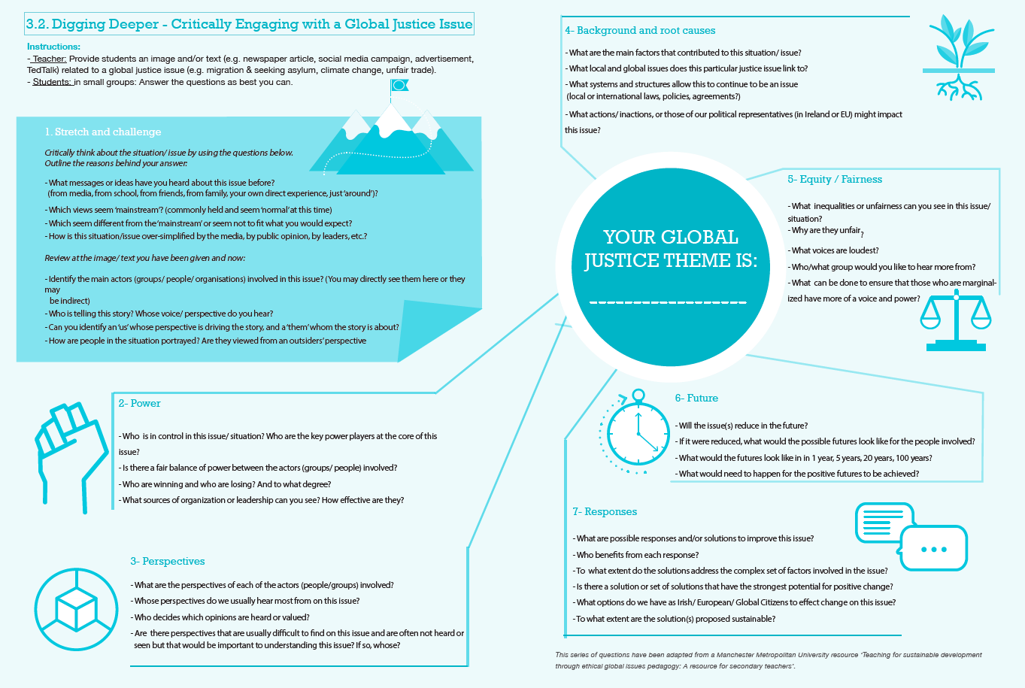

Asking Questions, Making Connections, Exploring viewpoints, responding as Global Citizens , Reflecting

Slide 11
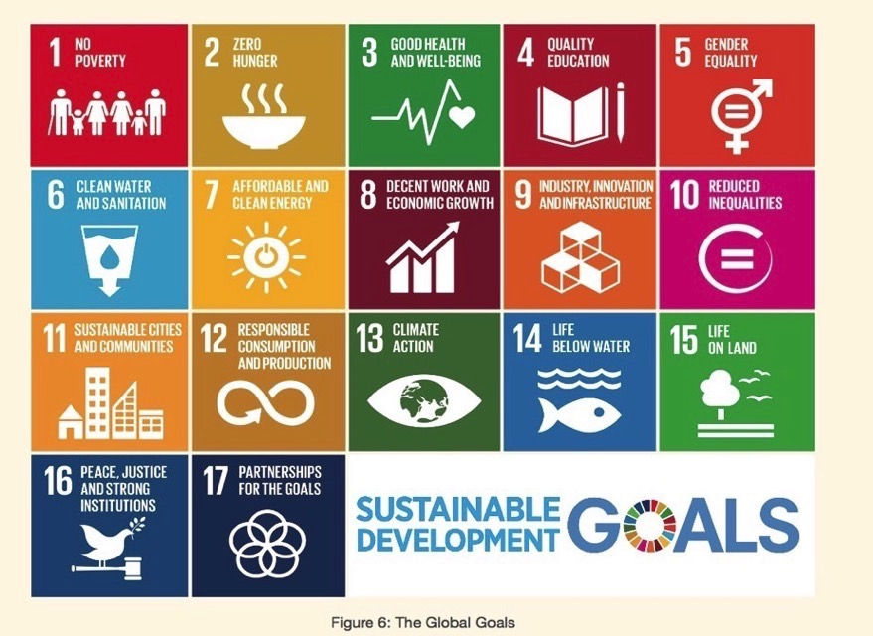
A Framework for Exploring GCE

Slide 12
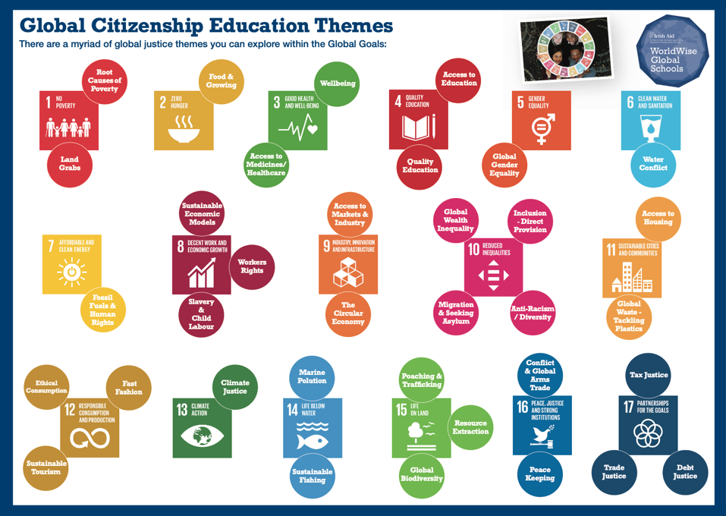
Pages
20-21
Notes:
- Briefly introduce the Global Goals for those that are not aware of them. Explain these are a popular and useful tool for engaging students in GCE. They are part of something much bigger – working together to create global change.
- Reiterate that not all the global goals have the “global to local” or “Justice” elements necessary for it to be GCE.
- Emphasise that it is important, where possible (committee and TY) to allow students to determine what they care about, want to learn about and take action on.
- Note that last year we advised that teachers facilitate students to pick issues that they were interested to take action on but as the Glboal Goals are so broad they sometimes picked a purely local theme, or one with no justice element
We have now taken out the key justice themes from the Global goals and their indicators. These will now help teachers guide students in picking relevant global justice themes.
Resource supports have been developed to support teachers unpack each of these goals.
Activity
Take a minute to investigate this slide – each theme is linked to a sustainable development goal. Using the chat box, write which subjects you teach and which themes you think could be linked to your teaching.
Anyone doing a module?

Slide 13
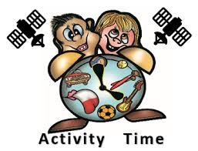
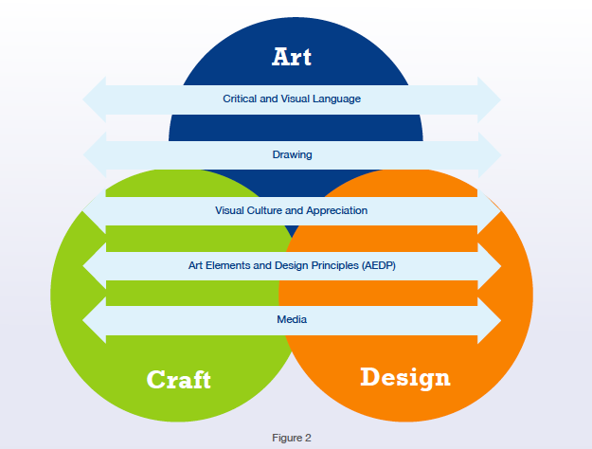
Art & Global Citizenship
Education…what is the link?
Mind Map –
What opportunities exist within the JC framework to explore Global Justice themes?
Notes:
https://jamboard.google.com/d/14NhcvzILUol8KcohJPPGVOeaC2fK_2MVrHalT31Lb94/edit?usp=sharing

Slide 14
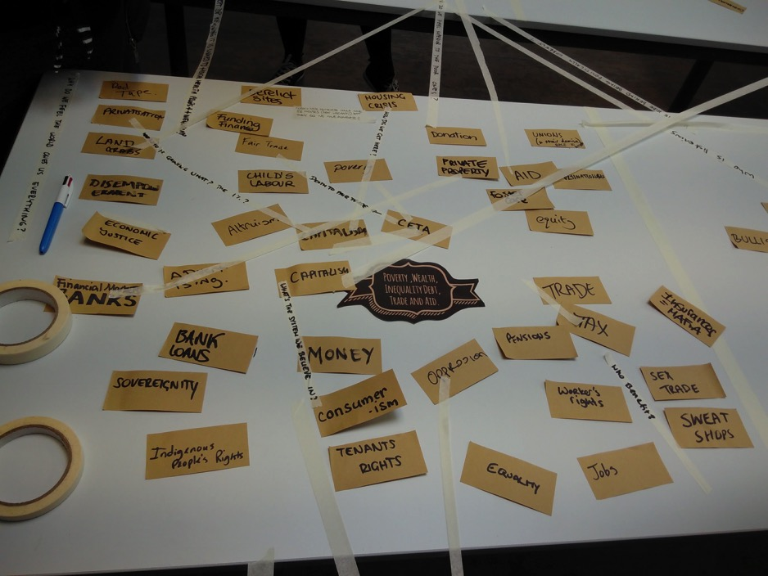

Slide 15



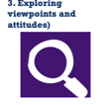
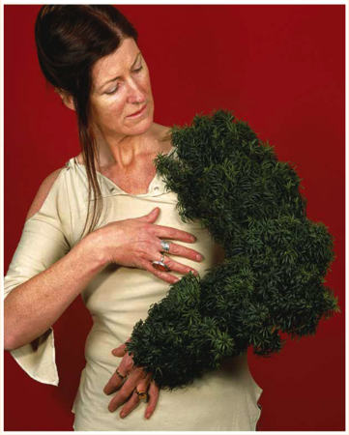
Literal ‘reading’ - Linked to LOs 1.1, 1.2, 1.3, 1.9 & 1.15
Look at the image on the board and in small groups discuss the following:
Using your own words describe what is happening in the image.
Where is your eye drawn to in the image? Why?
What, if anything, does the use of colour mean in this image?
What, if anything, do you find interesting about the image?
How does this image make you feel?
Could this image be ‘read’ differently by different people? Explain your answer.
What, if any, media was used in the creation of this image? How effective is the choice of media?
Write a catalogue entry - Linked to LOs 1.1, 1.2, 1.3, 1.7 & 1.8
Imagine you work for the Irish Museum of Modern Art. You have been asked by the curator of Alice Maher’s exhibition to write the catalogue entry for her work entitled Limb. Your catalogue Real-world Problem: Deforestation. The entry should help the people who visit the exhibition interpret Alice Maher’s work.
Your catalogue entry might provide answers to some or all of the following questions:
What theme(s) does the image address?
What is the image saying or not saying about the theme?
Is the image positive, negative, neutral, or a combination of these?
What emotions are contained within the image?
What questions are left unanswered by the image?
What knowledges/perceptions are being challenged or reinforced by this image?

Slide 16
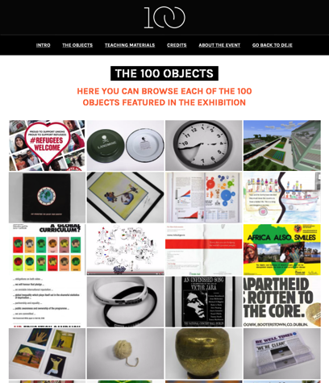
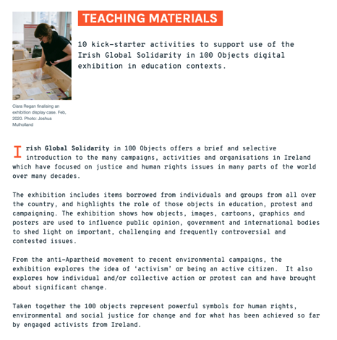
What other stimulus can you use to explore real-world problems?
https://developmenteducation.ie/100objects/browse-the-objects/

Slide 17
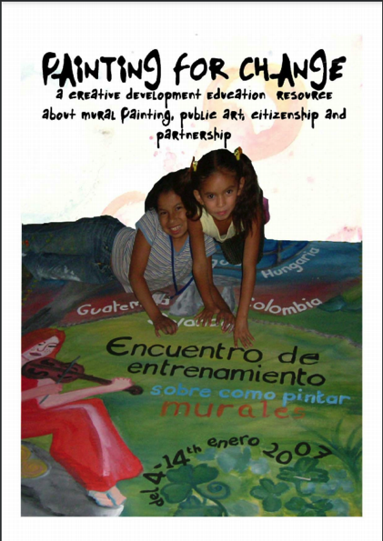
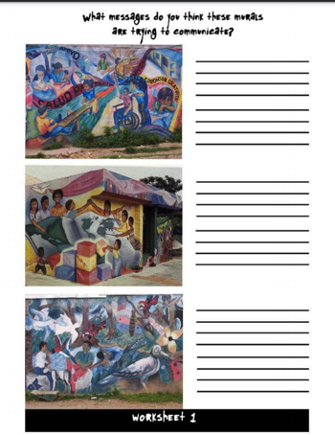
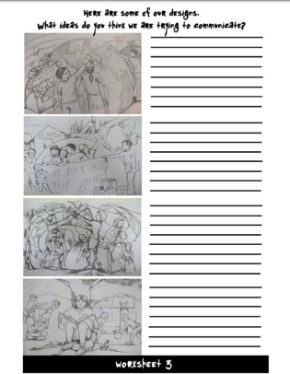
Critical and visual language, Visual culture and appreciation
https://developmenteducation.ie/media/documents/Mayfield_painting_for_change.pdf

Slide 18
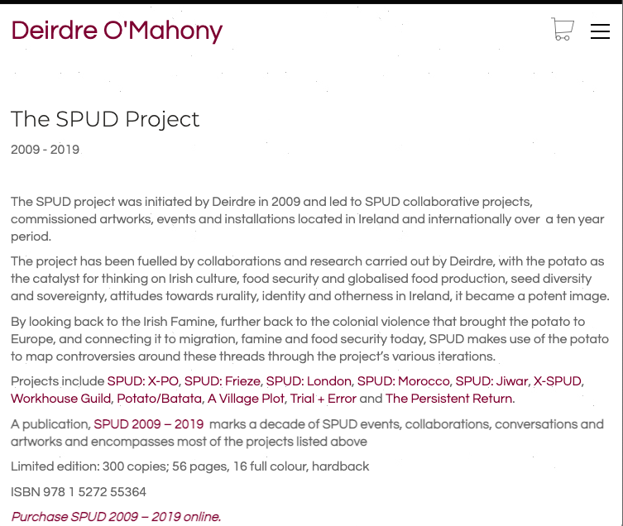
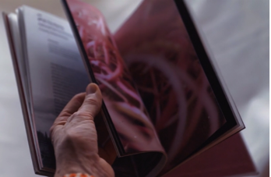
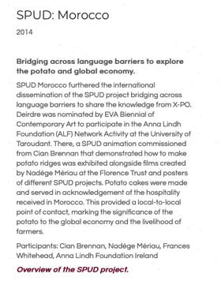
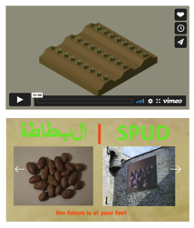

Slide 19


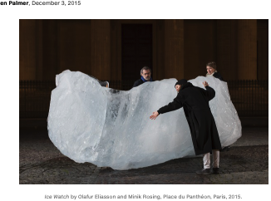
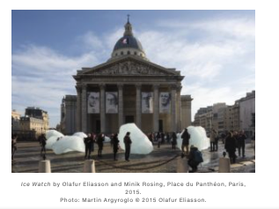

https://news.artnet.com/art-world/ice-watch-olafur-eliasson-climate-summit-384704

Slide 20
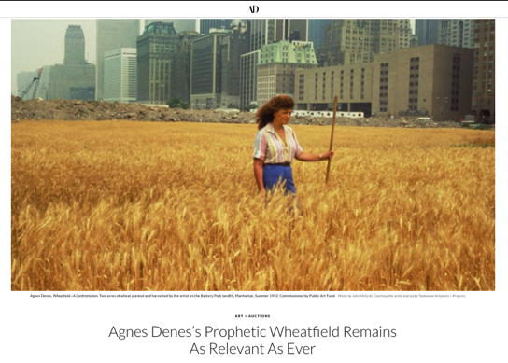
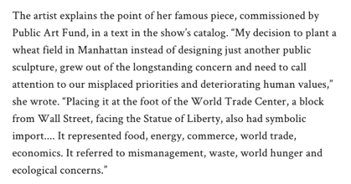
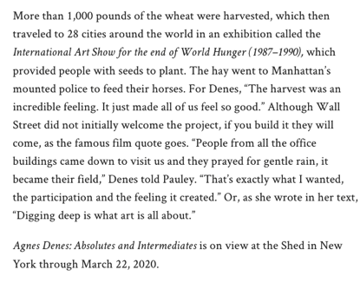
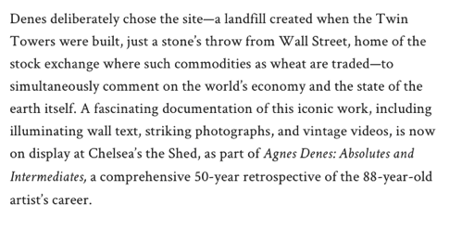
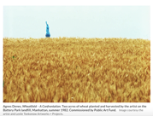
https://www.architecturaldigest.com/story/agnes-denes-prophetic-wheatfield-remains-as-relevant-as-ever

Slide 21
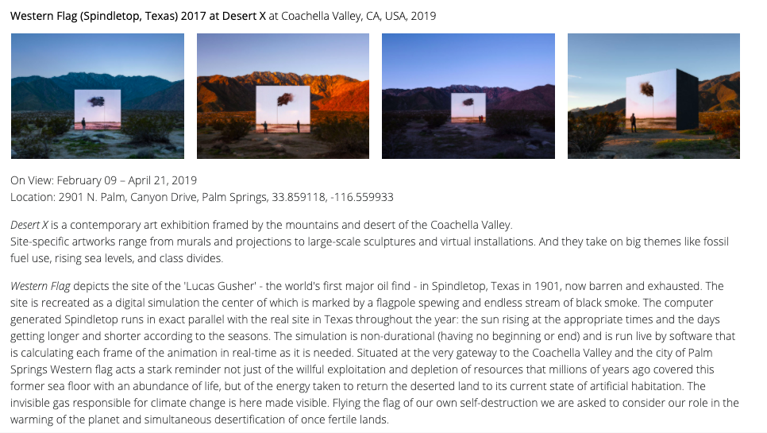
http://www.johngerrard.net/western-flag-spindletop-texas-2017.html

Slide 22
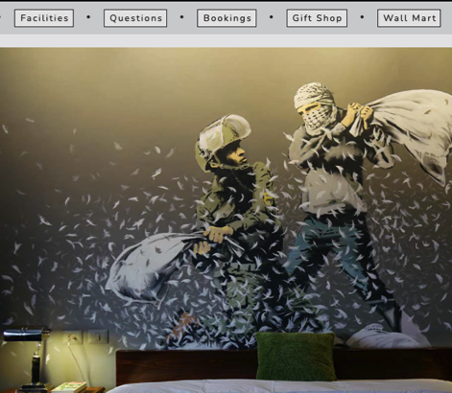
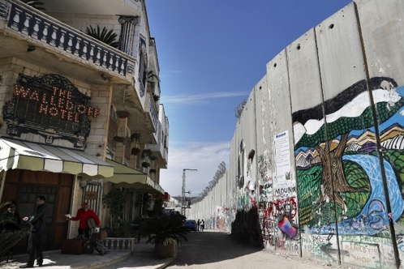
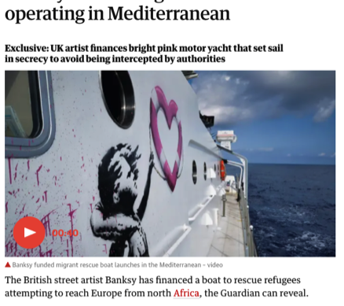
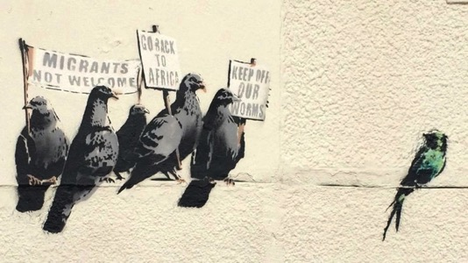
Banksy

Slide 23

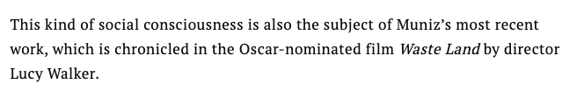
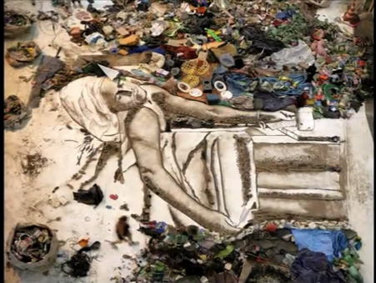
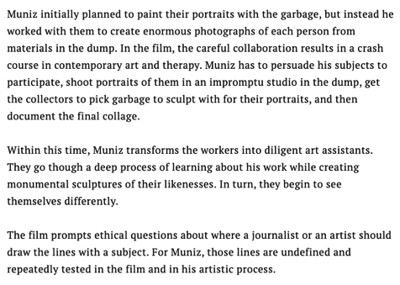

Slide 24
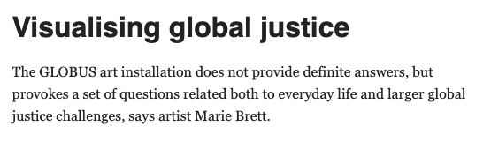
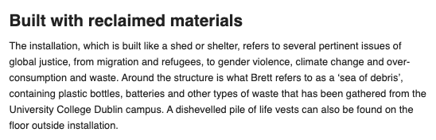
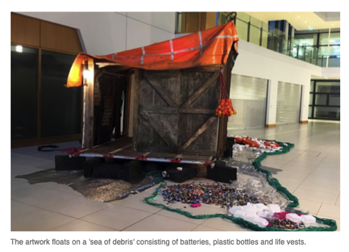
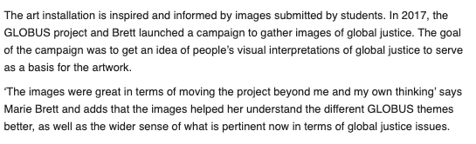
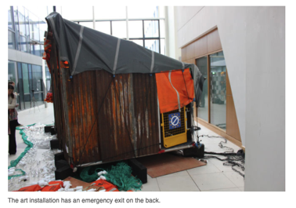

https://www.globus.uio.no/news/2019/art-installation-launch-dublin-apr19.html

Slide 25




Invisible - Linked to LOs 2.2, 2.9, 2.12 & 2.14
Watch sculptor Jason de Caires Taylor’s talk (link below) about his underwater art, marine conservation, restoration and the importance of acting now to fight climate change.
In small groups, create a 3-D tactile piece in an upside-down cardboard box depicting the often invisible but interdependent relationship between people and the sea.
Materials that might be useful include: toilet rolls, paper cups, straws, toothpicks, Styrofoam, egg cartons, bubble wrap and pipe cleaners. As the work progresses discuss the use of form, texture and shape. Invite students and teachers from your year group to view and touch your finished work. Explain your work, and reflect on the reactions of others to it.
Extension activity: Sea that, now what?
Take a photo of one of your finished craft pieces. Send the photo to your local county council or TD with a letter or email summarising the sources of inspiration for your work, and encouraging the government to be proactive and ambitious in the fight against climate change.
Loreto Secondary School,
Clonmel

Slide 26

Opportunities for action
https://www.youtube.com/watch?v=FETY7T-tw40
Action ideas: https://craftivist-collective.com/projects

Slide 27




From Craft to Exhibition

Slide 28



Step 1: Class dissection - understanding and engaging through key questions
Step 2: Mind mapping – Themes and Emotions Link to LO 3.5
For example, defiance, hope, solidarity, pride, provocation, oppression, unfairness, injustice, hurt, sorrow, etc).
Step 3: Inspiration Bank – Go deeper Link to LOs 3.2, 3.3 & 3.9
• Choose one or two ideas from your mind maps, gather related images, text and photographs of objects in your Visual Art sketchpad..
• Research awareness-raising tools and identify inspirational ways to display and raise awareness.
• Decide on the type of awareness-raising tool that most interests you or your group.
Step 4: Experiment in your sketchpad - Link to LO 3.4
In your Visual Art sketchpad create a series of drawings representing your ideas about ‘And Still I Rise’ and based on your research. Experiment with colour, line, shape, texture and layout to explore how these might be used to best represent your ideas, for example: which colours represent pride or hurt? What style of font best represents a speech?

Slide 29

Step 5: Share your ideas, discuss awareness raising tools - Link to LO 3.10
In class, share the drawings etc in your Visual Art Sketchpad. Discuss these and your sample awareness raising tools, highlighting what you think are the stand out ideas/images/presentations.
Step 6: Plan your awareness raising tool - Link to LOs 3.5, 3.11 & 3.12
Plan some layouts using a variety of art elements.
Step 7: Decision time & Feedback- Link to LOs 3.2, 3.11 & 3.15
Select the visuals and text for inclusion in your awareness raising tool. Prepare a (individual/group) presentation of approximately 2 minutes about the design concept for your awareness-raising tool. Your presentation might include:
a description of the focus of your tool
an explanation of your interpretation of And Still I Rise
how the visuals/text on your tool is related to your interpretation
the completion of the following sentence - In designing this awareness raising tool I/we learned…’.
Ask the class for feedback and take their comments on board before you finalise the design of your awareness-raising tool.
Extension activity: Be/aware
Complete your awareness-raising tool and display it in a public forum, such as, on appropriate online websites, the school’s virtual noticeboard, in the local library and/or community centre.

Slide 30


What other stimulus can you use to explore real-world problems?

Slide 31





Slide 32



Slide 33




Global Wealth Inequality
https://www.oxfamireland.org/sites/default/files/bp-the-inequality-virus-summ-250121-en.pdf

Slide 34




Biodiversity loss, Planetary Boundaries

Slide 35


Ecological footprint, Country Overshoot Day

Slide 36




Opportunities for Raising Awareness
Loreto SS, Letterkenny

Slide 37



Cork Educate Together Secondary School

Slide 38


CLASS BASED ASSESSMENTS
CBA1: From Process to Realisation
Community art project on global justice issue
Redesign an aspect of their environment, a product or a building -cradle-to-cradle principles
Link with local artist whose work represents a positive response to real-world problems
Respond to a primary source, such as an artefact, from or representing the Global South
(for example: items manufactured or including raw materials sourced in the Global South – food (and/or food wrapping), textiles, technology or medicine;
Respond to literature-check out our book list!
CBA2: Communicate and Reflect
Response Contemporary Issue in the news
Working with a primary source
Functional or decorative craftwork
My own scenario is…….., based on….
Notes:
https://developmenteducation.ie/100objects/

Slide 39





CBA - Workhouses and forced Migration
Orlagh Meegan-Gallagher is the Artist in Residence and Education Officer at the Workhouse in Carrickmacross

Slide 40

Breakout Rooms
What art processes do you use to interrogate Global Justice issues?
How do you/could you engage your students in action on local to global justice issues?
How might the CBA provide an opportunity for students to engage the school community / local community and beyond in global justice issues?

Slide 41

Take a Break!

Slide 42




Cross Curricular Projects
Miscellany of Stories-Blakestown Community School

Slide 43

Cross Curricular Projects
‘In visual art learners have looked at consumer responsibility, material sustainability, up-cycling and recycling. This has tied in with ethical education where students looked at the environmental values, employment values and marketing values of retail giant H&M. Students researched and displayed these values, discussing the company's ethics and global environmental impact’ Goatstown ETSS
2nd year Creative Engagement Project on the theme of 'Migration'. Students designed a number of dry point prints for the theme of Migration. During the project students worked with artist Clare Henderson. The project has been on a permanent display in our school and in March this year will also be displayed on the Creative Engagement website. Bremore ETSS

Slide 44


Slide 45



Slide 46






Visual Studies
Why was it created?
Before the movement,
The movement,
After the movement

Slide 47


Visual Studies
Content Area 1 and 2:
Notes:
This section of focus will engage the students in exploring how artists
create an awareness and understanding of the social, cultural, political and
economic structures that affect today’s societies. Artists, past and present
have used art to critically examine and articulate their concerns over issues
of importance as well as make sense of the world through visual means and
image making. The themes and concepts that artists devise and engage with
can be powerful and often have broad social and global importance.
Using the Visual Studies Framework, students will explore this more
thoroughly. They will learn how art can inspire activism and bring about
change in how we see ourselves within connected communities. Art can go
beyond physical spaces and engage an audience in communal debate, discussion,
participation and action, and the idea and action can, in itself, be the art.
Art and the
environment
This section of focus recognises the importance of the environment to
artists and how it can be a primary source for inspiration and use as a
medium in its own right. It also acknowledges that students are surrounded
by their own local environment, which can be a source of inspiration. Art
and the environment includes a range of artistic practices encompassing
both historical depictions and traditional approaches to nature in art. More
recent developments have seen environmental artwork that addresses
social and political issues, which can include the use of the environment
itself as the medium and/or the message. How an artist uses or responds to
an environment reflects how they are often sensitive to questions such as
the preservation of built heritage, cultural lives of people in the community,
ecology and nature, etc. and recognise its importance to themes of identity.
Using the Visual Studies Framework, the environment can be explored as
a resource which sees artists often elaborate on the unique characteristics
peculiar to that environment and enhance or comment on it in some
way. Architecture, Land Art and the landscape itself, Street Art, Public
Art, Environmental Design, urban/rural design, issues and ideas around
Education for Sustainable Development, Consumer/Product Design, Interior
Design, and even Online Environments are among many of the rich sources
for visual research and study in this section of focus.

Slide 48


Visual Studies
Content Area 1 and 2:
Notes:
This section of focus will engage the students in exploring how artists
create an awareness and understanding of the social, cultural, political and
economic structures that affect today’s societies. Artists, past and present
have used art to critically examine and articulate their concerns over issues
of importance as well as make sense of the world through visual means and
image making. The themes and concepts that artists devise and engage with
can be powerful and often have broad social and global importance.
Using the Visual Studies Framework, students will explore this more
thoroughly. They will learn how art can inspire activism and bring about
change in how we see ourselves within connected communities. Art can go
beyond physical spaces and engage an audience in communal debate, discussion,
participation and action, and the idea and action can, in itself, be the art.
Art and the
environment
This section of focus recognises the importance of the environment to
artists and how it can be a primary source for inspiration and use as a
medium in its own right. It also acknowledges that students are surrounded
by their own local environment, which can be a source of inspiration. Art
and the environment includes a range of artistic practices encompassing
both historical depictions and traditional approaches to nature in art. More
recent developments have seen environmental artwork that addresses
social and political issues, which can include the use of the environment
itself as the medium and/or the message. How an artist uses or responds to
an environment reflects how they are often sensitive to questions such as
the preservation of built heritage, cultural lives of people in the community,
ecology and nature, etc. and recognise its importance to themes of identity.
Using the Visual Studies Framework, the environment can be explored as
a resource which sees artists often elaborate on the unique characteristics
peculiar to that environment and enhance or comment on it in some
way. Architecture, Land Art and the landscape itself, Street Art, Public
Art, Environmental Design, urban/rural design, issues and ideas around
Education for Sustainable Development, Consumer/Product Design, Interior
Design, and even Online Environments are among many of the rich sources
for visual research and study in this section of focus.

Slide 49




Visual Studies
Content Area 3: Today’s world
Art as Social Commentary or Commentator
Art in the
Environment
Notes:
This section of focus will engage the students in exploring how artists
create an awareness and understanding of the social, cultural, political and
economic structures that affect today’s societies. Artists, past and present
have used art to critically examine and articulate their concerns over issues
of importance as well as make sense of the world through visual means and
image making. The themes and concepts that artists devise and engage with
can be powerful and often have broad social and global importance.
Using the Visual Studies Framework, students will explore this more
thoroughly. They will learn how art can inspire activism and bring about
change in how we see ourselves within connected communities. Art can go
beyond physical spaces and engage an audience in communal debate, discussion,
participation and action, and the idea and action can, in itself, be the art.
Art and the
environment
This section of focus recognises the importance of the environment to
artists and how it can be a primary source for inspiration and use as a
medium in its own right. It also acknowledges that students are surrounded
by their own local environment, which can be a source of inspiration. Art
and the environment includes a range of artistic practices encompassing
both historical depictions and traditional approaches to nature in art. More
recent developments have seen environmental artwork that addresses
social and political issues, which can include the use of the environment
itself as the medium and/or the message. How an artist uses or responds to
an environment reflects how they are often sensitive to questions such as
the preservation of built heritage, cultural lives of people in the community,
ecology and nature, etc. and recognise its importance to themes of identity.
Using the Visual Studies Framework, the environment can be explored as
a resource which sees artists often elaborate on the unique characteristics
peculiar to that environment and enhance or comment on it in some
way. Architecture, Land Art and the landscape itself, Street Art, Public
Art, Environmental Design, urban/rural design, issues and ideas around
Education for Sustainable Development, Consumer/Product Design, Interior
Design, and even Online Environments are among many of the rich sources
for visual research and study in this section of focus.

Slide 50

Research Strand
Notes:
Students will learn how to become a visual researcher. As part of the research process, they will learn
to select a stimulus, choose relevant primary sources and develop, rationalise and contextualise their
ideas and work further. The learning outcomes in this strand address the research methods employed
within a visual subject, including the recording of these within a visual sketchpad. Learners will have
the opportunity to also use their locality, including galleries, museums, architecture, public sculpture
and more, for research purposes.

Slide 51

Create Strand
Notes:
Learners will be engaged in the process of making/creating art from conception to realisation using
a range of skills and chosen material(s), as appropriate. They will create work based on a starting
stimulus, respond to it and develop it as their work progresses. Mundano
https://fellowsblog.ted.com/this-artist-takes-the-spirit-of-protest-from-the-streets-to-the-gallery-de811442ffb5

Slide 52
Create Strand
5th years: Collaborated with a local family centre 'Aster' as Part of the UN Day for the Eradication of Poverty to spread awareness about poverty and its impact on young people in Ireland. Students designed a numbers of posters to represent how poverty affects young people and also they created a video to go along with this campaign.
Bremore ETSS
Notes:
Learners will be engaged in the process of making/creating art from conception to realisation using
a range of skills and chosen material(s), as appropriate. They will create work based on a starting
stimulus, respond to it and develop it as their work progresses. Mundano
https://fellowsblog.ted.com/this-artist-takes-the-spirit-of-protest-from-the-streets-to-the-gallery-de811442ffb5

Slide 53



Notes:
http://globalmigrationcollective.com/projects/a-film-trilogy-by-anthony-haughey-the-global-migration-collective/

Slide 54

Respond Strand
3.2 Contextual enquiries locate their own work in relation to other artwork within a particular context/s (stylistically, socially, politically, ethically, etc)
Notes:
Learners need to understand that in Art they can, and do, react to artwork, whether it is their own
or another’s. They will learn to stand outside of their own work and to reflect on it critically. Learners
will also learn about and learn from aspects of Visual Studies, which will help to increase their
knowledge of Art and so inform their opinions of their work and the work of others.
The learning outcomes related to Responding involve the use of Analysis; the making of Contextual
enquiries to further understanding and knowledge; looking at ways to judge Impact and value;
employing Critical and personal reflection; and learning to think about and rationalise their Process.
Some of the learning outcomes in the Respond Strand can also apply to practical making of work and
to Visual Studies.
3.2 Contextual enquiries locate their own work in relation to other artwork within a
particular context/s (stylistically, socially, politically, ethically,
etc.)

Slide 55
The Chat Strand
What are your examples that you use in your classroom that express a global justice issue or gave a very good social commentary?
What other examples/case studies of Senior Cycle Art and GCE could we share?
Notes:
https://jamboard.google.com/d/16PJkXuUdCkS4cRR0IfLJbcu9wf8g3eFjYlKXK49Fg7I/edit?usp=sharing

Slide 56



Artivism-Taking Action With Art!
The role of the artist is to make revolution irresistible
-Toni Cade Bambara

Slide 57

Nicholas Sputnik Miller from Draw the Line

Slide 58
PUT IN CHAT or Chat!
The Resources you have used in your classroom!
Podcasts
Videos
Books
TV programmes/documentaries
People and organisations
Articles
Stories

Slide 59





Useful Links and Resources
http://www.worldwiseschools.ie/resource-item/art-global-citizenship-education/
www.creativityandchange.ie
www.financialjustice.ie
www.developmenteducation.ie
www.globaldimension.org.uk
Notes:
Afri-They All Had Names: A Survey of Tithe na mBocht and Famine Graveyards in Ireland
Truman on Trial:

Slide 60






Webinars on relevant Global Justice Themes
Fast Fashion
Food security & Biodiversity
Waste
DeGrowth & Sustainability
Energy

Slide 61






1. Hover over the symbol and a drop down menu appears!
Resource Sheets
– activities, videos, suggested actions etc
2. Click on the theme and the resource sheet will pop up!

Slide 62




https://www.developmenteducation.ie/media/documents/Activists%20Handbook%20FINAL.pdf
https://www.homelesshub.ca/resource/cardboard-citizens
https://arestlessart.com/
https://c4aa.org/art-action-academy

Slide 63








Some Resources

Slide 64






Creativity & Change
Carousel of activities

Slide 65


The New Internationalist

Slide 66

Facebook: WorldWise Global Schools

Slide 67

Twitter: WorldWise Schools

Slide 68


Upcoming key dates for your diary
https://docs.google.com/forms/d/1T5MazPO7bcoR3m68sy-6M05sF12LiOD0EF3CCXZJ2Bk/edit?usp=sharing
Annual Student Conference: April 29th – online
Funding application for Schools 2021-2022 school year: Opens: April 12th Closes: May 14th
WWGS support for schools: ongoing
Notes:
https://www.creativityandchange.ie/non-accredited-training-previously-masterclasses/
https://www.nationalgallery.ie/whats-on/online-workshop-fashion-activism

Slide 69



THANKS A MILLION!
WE’RE ALL HERE FOR YOU!
TÓG BOG É

