Slide 1
A sporting chance?
Use the Olympics to explore inequality

Slide 2
MATHS SESSION
Measuring the gaps

Slide 3
RIO OLYMPIC GAMES 2016
10,500 athletes from 206 nations will be taking part. During the 17 days of the games there will be 306 medal events. For each event, three medals will be awarded – gold, medal and bronze.
How many medals will be awarded in total during the games?
If each nation participated in every single sporting event and had an equal chance of winning a medal, approximately how many medals would each nation expect to win?

Slide 4

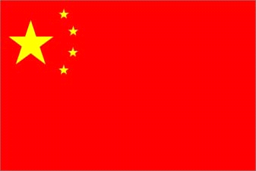


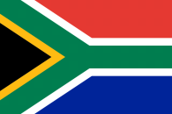
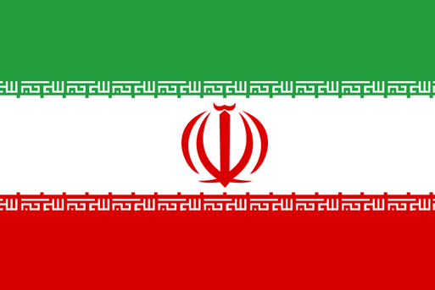
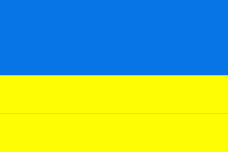
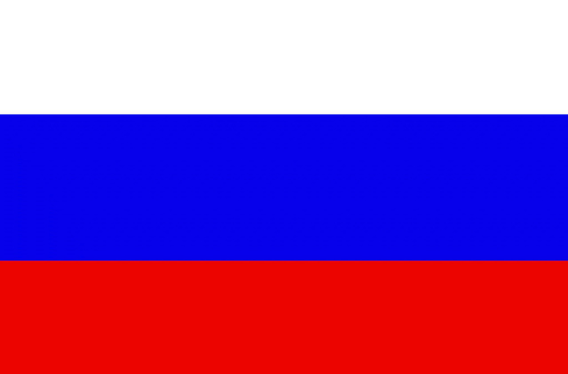

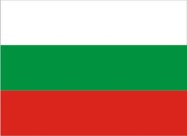
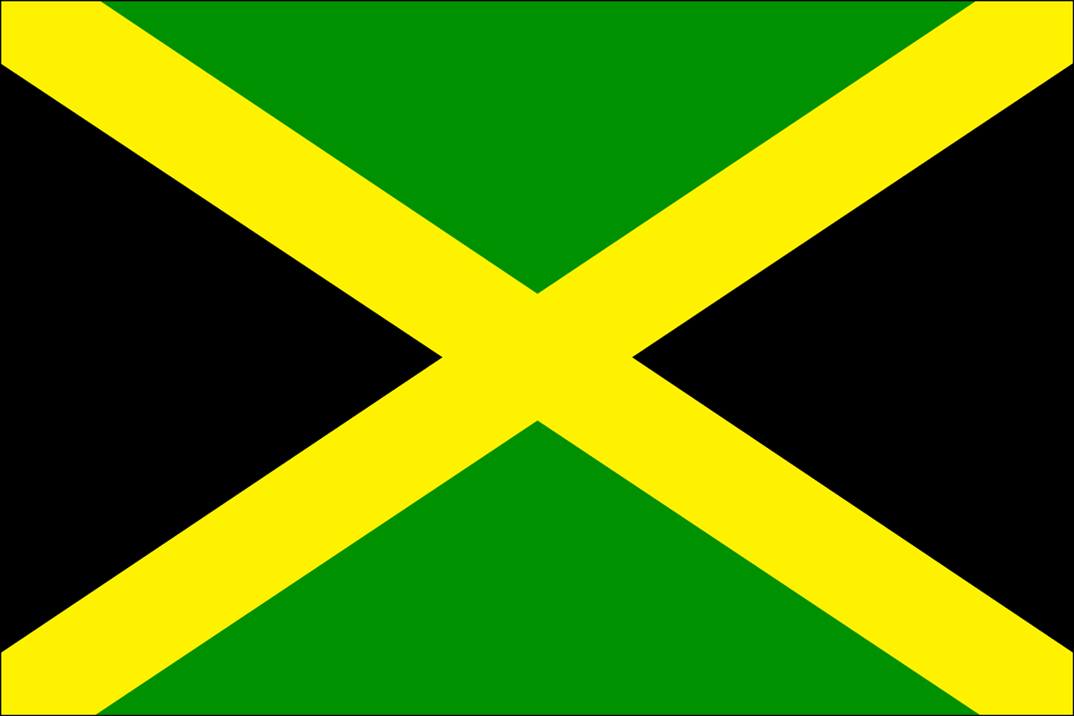


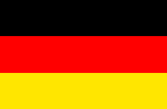
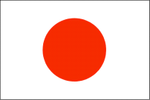
FLAG SPOTTING
Notes:
From left to right
First row from top: Ethiopia, China, Norway, UK, Brazil
Second row from top: Mexico, India, South Africa, Iran, Ukraine
Third row from top: Russian Federation, United States, Tunisia, Kenya, Bulgaria
Fourth row from top: Jamaica, Mongolia, Australia, Germany, Japan

Slide 5
NUMBERS OF ATHLETES
United Kingdom
556
India
83
Russian Federation
437
Sierra Leone
2
Brazil
267

Slide 6
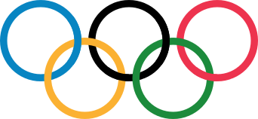
WHAT’S IMPORTANT?
Friendship
Excellence
Determination
Respect
Inspiration
Courage
Equality
Notes:
Image source: International Olympic Committee - www.olympic.org/ Note: This is editorial usage only and this resource is not associated in any way with the International Olympic Committee.

Slide 7




COUNTRY INCOMES
The World Bank classifies each country as one of the following:
a low-income country (LIC)
a lower-middle-income country (LMIC)
an upper-middle-income country (UMIC)
a high-income country (HIC)
Which group do you think each of these countries is in?
Brazil
UK
Nepal
Nigeria
UMIC HIC LIC LMIC
Notes:
Average income per person: Brazil ($11,530/£8.016), UK ($43,430/£30,533), Nepal ($730/£513), Nigeria ($2,970/£2,088)
Data source: These figures are for GNI per capita, Atlas method (current US$), World Bank (data from 2014 or 2013) data.worldbank.org/
Figures correct at the time of publication.

Slide 8
TIME TO THINK
Which group of countries has the highest percentage of countries winning at least one medal?
Which group of countries has the lowest percentage of countries winning at least one medal?
Why do you think the percentage of countries winning at least one medal is greater in the higher income country groups than in the lower income country groups?
According to this data, which group of countries is the most likely to contain a country that wins at least one medal? Which group of countries is the least likely to contain a country that wins at least one medal?
What other factors might affect the chances a country has of winning at least one medal?

Slide 9
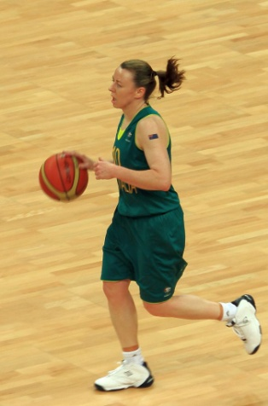
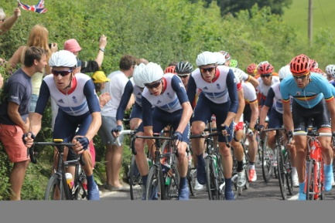
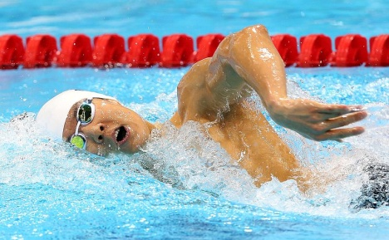
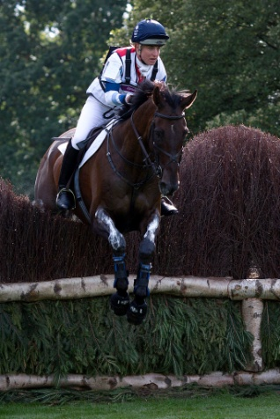
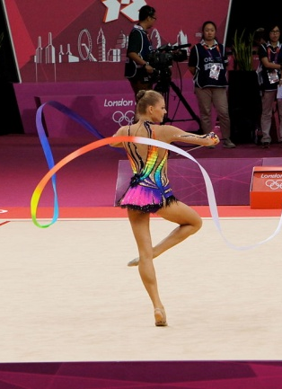
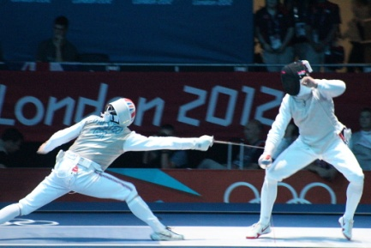
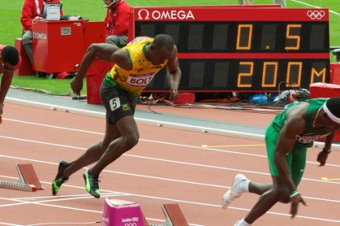
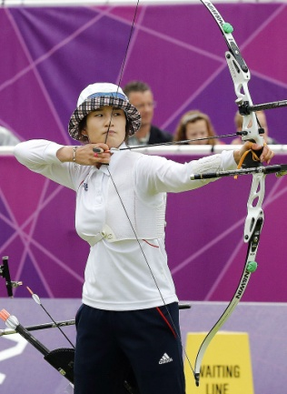
OLYMPIC SPORTS
Notes:
Clockwise from top left
Image info: Australian womens basketball and club player for Bendigo Spirit, Kristi Harrower dribbles the ball forward in this Group B London Olympic preliminary game against Russia.
Photo credit: &DCfrom Coulsdon, Greater London, United Kingdom
commons.wikimedia.org/wiki/File:Kristi_Harrower_-_London_2012_Olympics_Womens_Basketball_(Australia_v_Russia).jpg
Licensed under the Creative Commons Attribution-Share Alike 2.0 Generic license: creativecommons.org/licenses/by/2.0/deed.en
Image info: Team GB on Box Hill circuit (by Nower Wood, near Headley), Surrey, during the Men’s Road Race in the London 2012 Olympic Games.
Photo credit: Paul Wilkinson commons.wikimedia.org/wiki/File:Team_GB_on_Box_Hill_circuit_(by_Nower_Wood,_near_Headley),_Surrey,_during_2012_Olympics_Mens_Road_Race.jpg
Licensed under the Creative Commons Attribution-Share Alike 2.0 Generic license: creativecommons.org/licenses/by/2.0/deed.en
Image info: Korea Park Taehwan Men's 400m Freestyle Silver medallist at the 2012 London Olympic Games.
Photo credit: Korea.net/Korean Culture and Information Service (Korean Olympic Committee)
commons.wikimedia.org/wiki/File:KOCIS_Korea_LondonOlympics_ParkTaehwan_02_(7682601150).jpg
Licensed under the Creative Commons Attribution-Share Alike 2.0 Generic license: creativecommons.org/licenses/by/2.0/deed.en
Image info: Tina Cook and Miners Frolic, competing for the UK, at fence 9, during the cross-country phase of the Eventing during the 2012 Olympic Games in Greenwich Park, London.
Photo credit: Henry Bucklow/Lazy Photography
commons.wikimedia.org/wiki/File:Tina_Cook_Miners_Frolic_cross-country_London_Olympics_2012.jpg
Licensed under the Creative Commons Attribution-Share Alike 3.0 Unported license:
creativecommons.org/licenses/by-sa/3.0/deed.en
Image info: Korean London Olympic Archery Women’s team
Photo credit: Korea.net/Korean Culture and Information Service (Korean Olympic Committee)
commons.wikimedia.org/wiki/File:KOCIS_Korea_London_Olympic_Archery_Womenteam_18_(7682348690).jpg
Licensed under the Creative Commons Attribution-Share Alike 2.0 Generic license: creativecommons.org/licenses/by/2.0/deed.en
Image info: Usain Bolt at the start of the 200m in the London 2012 Olympic Games
Photo credit: Nick Webb commons.wikimedia.org/wiki/File:Usain_Bolt_2012_Olympics_start.jpg
icensed under the Creative Commons Attribution-Share Alike 2.0 Generic license: creativecommons.org/licenses/by/2.0/deed.en
Image info: Fencing (Men's Team foil) at the 2012 London Olympic Games.
Photo credit: Steve Fair, commons.wikimedia.org/wiki/File:Fencing_at_the_2012_Summer_Olympics_5557.jpg
Licensed under the Creative Commons Attribution-Share Alike 2.0 Generic license: creativecommons.org/licenses/by/2.0/deed.en
Image info: Rhythmic Gymnastics at the 2012 London Olympic Games.
Photo credit: cdephotos, commons.wikimedia.org/wiki/File:London_2012_Rhythmic_Gymnastics_-_Belarus.jpg
Licensed under the Creative Commons Attribution-Share Alike 2.0 Generic license: creativecommons.org/licenses/by/2.0/deed.en

Slide 10
TIME TO THINK
Which sporting events do you think might have few or no athletes from lower-income countries taking part and winning medals? Why do you think this?
Which sporting events do you think might have more athletes from lower-income countries taking part? Why do you think this?
How could you investigate this?

Slide 11

INEQUALITY BETWEEN COUNTRIES
There is inequality between countries in the world.
This means things are not shared fairly between countries.
For example, some countries are wealthy while others are extremely poor.

Slide 12

INEQUALITY WITHIN COUNTRIES
There is also inequality within countries.
This means things are not shared fairly within the same country.
For example, some people may have more money than others.

Slide 13
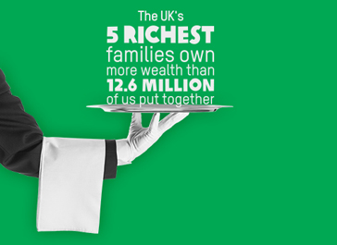
Notes:
Source: A Tale of Two Britains: Inequality in the UK, Sarah Dransfield, Oxfam (2014) http://policy-practice.oxfam.org.uk/publications/a-tale-of-two-britains-inequality-in-the-uk-314152

Slide 14


SCORING INEQUALITY WITHIN COUNTRIES
Countries can be given a score (called the Gini index) to show how equal or unequal they are.
0
A score of 0 means that the country is completely equal, that everyone in that country has the same amount of money.
That would look something like this:
In reality, no country looks like this.

Slide 15

SCORING INEQUALITY WITHIN COUNTRIES
A score of 100 means the country is completely unequal.
This would look something like this:
100
In reality, thankfully, no country looks like this either.

Slide 16
INEQUALITY WITHIN COUNTRIES
What do you think the equality score for the UK is?
What do you think equality score for Brazil is?
Where would they come on the chart below?
0 25 50 75 100
Completely
equal
Completely
unequal
UK
Brazil

Slide 17
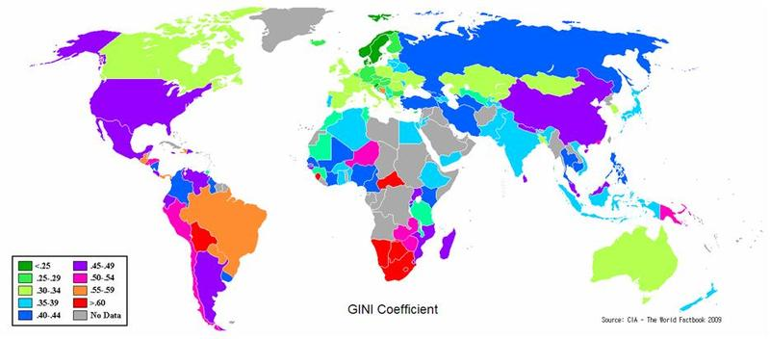
INEQUALITY AROUND THE WORLD
FAIRNESS SCORE
Notes:
This world map shows how the countries of the world compare on income inequality according to the GINI index. Countries that are more equal are shaded in green. Countries that are more unequal are shaded in pink, orange and red.
Source: The World Factbook, CIA, 2009: www.cia.gov/library/publications/the-world-factbook/fields/2172.html

Slide 18
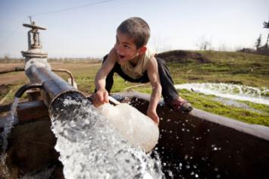
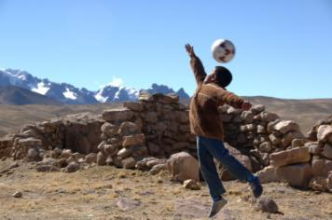
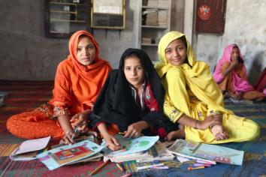
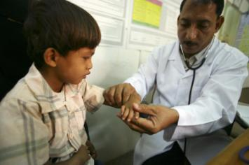
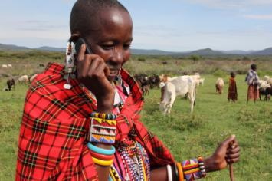
THINKING ABOUT INEQUALITY
Inequality is not just about how money is shared between and within countries.
There can also be inequality in the kinds of opportunities people have in life.
Notes:
Clockwise from top left.
Access to water
Image info: A boy collects water from a well in Dargalar, Azerbaijan.
Photo credit: David Levene/Oxfam
Access to play
Image info: Lucas lives in Macuscani, a small town high in the mountains of Peru.
Photo credit: Annie Bungeroth/Oxfam
Access to education
Image info: Students at a girls’ school in the village of Sanjar Bhatti, Kambar Shahdad Kot district, Sindh Province, Pakistan. From left to right- Gori Bhatt, Amna Khatoon Brohi and Shazzia Bhatti.
Photo credit: Irina Werning/Oxfam
Access to healthcare
Image info: Dr Amen Yagoub looks at Barka age 6 at the Maddodha Health Clinic in Sayoun, Yemen.
Photo credit: Abbie Trayler-Smith/Oxfam
Access to technology
Image info: Women’s leader Noorkishili Naing’isa receives a call on her mobile phone while grazing her livestock in Mairowa Chini, Ololosokwan, Ngorongoro, Tanzania.
Photo credit: Geoff Sayer/Oxfam

