Slide 1
A sporting chance?
Use the Olympics to explore inequality

Slide 2
GEOGRAPHY SESSION
Equal or unequal?

Slide 3
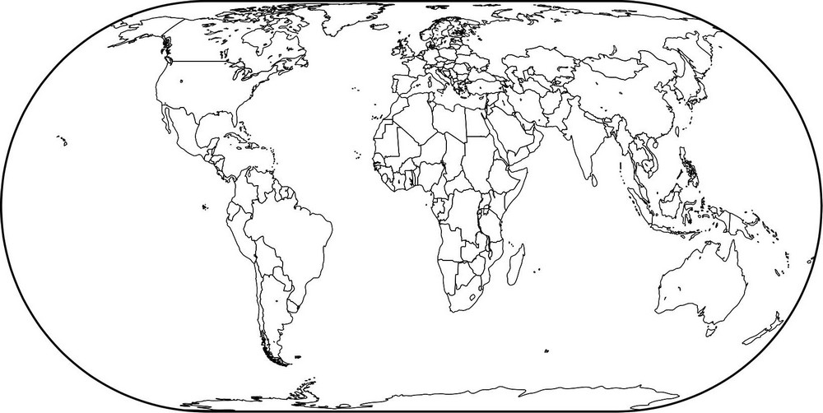
WHERE IN THE WORLD?
UK
Viet Nam
Ethiopia
India
Peru
Can you locate the UK and Brazil on a world map?
Notes:
Click forward on the slide to reveal the locations of these countries.
Map source: Geographical Association www.geography.org.uk

Slide 4
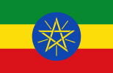



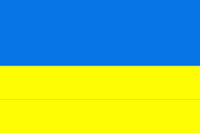


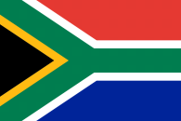


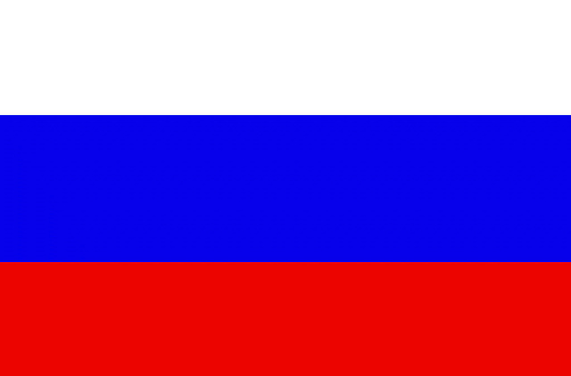

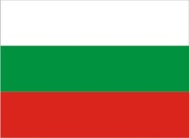






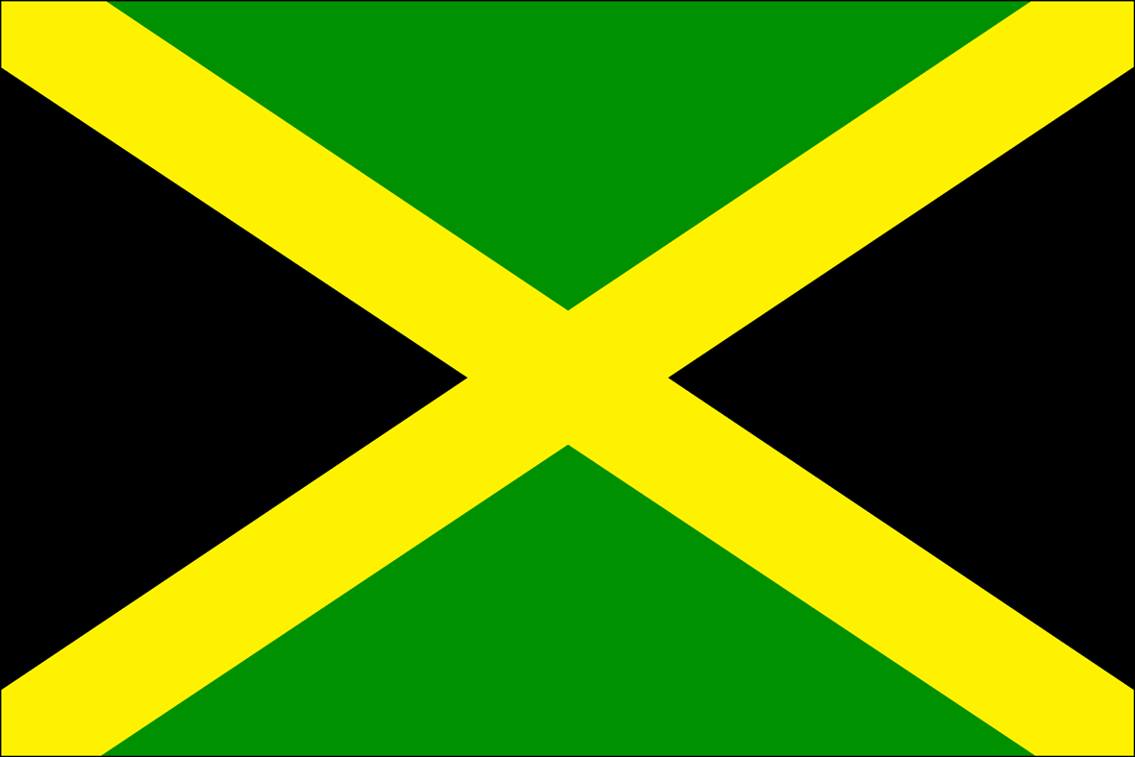
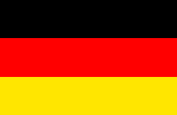
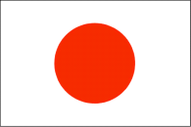
FLAG SPOTTING
Notes:
From left to right
First row from top: Ethiopia, India, Peru, Vietnam, UK, Brazil
Second row from top: Ghana, China, Norway, Pakistan, Ukraine, Nigeria
Third row from top: Mexico, Italy, South Africa, Iran, Malawi
Fourth row from top: Russian Federation, United States, Tunisia, Chile, Bulgaria
Fifth row from top: Nepal, Mongolia, Australia, Philippines, Bolivia
Sixth row from top: Yemen, Rwanda, Jamaica, Germany, Japan

Slide 5

SIMILARITIES AND DIFFERENCES
What similarities and differences do you think there are between these countries and the people living in them?

Slide 6
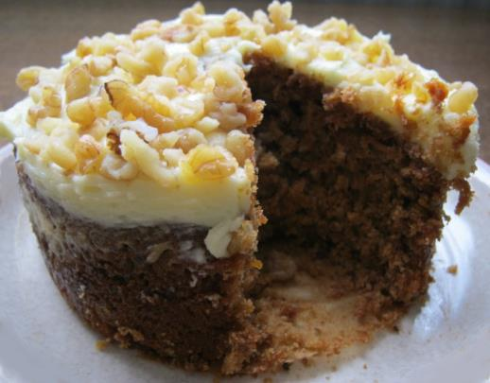
WHAT DOES INEQUALITY MEAN?
We can think of inequality as the difference between the things some groups of people have compared to other people.
It is a bit like looking at how a big a slice of cake one person has compared to another.
Notes:
Photo credit: Liz Newbon/Oxfam

Slide 7

INEQUALITY BETWEEN COUNTRIES
There is inequality between countries in the world.
This means things are not shared fairly between countries.
For example, some countries are wealthy while others are extremely poor.

Slide 8
Put these countries in order by their average income per person.
Nigeria
Brazil
Nepal
UK
$2,970
$11,530
$730
$43,430
Notes:
Corresponding amounts in British Pounds: Nigeria: £2,088 / Brazil: £8,106 / Nepal: £513 / UK: £30,533
Data source: These figures are for GNI per capita, Atlas method (current US$), World Bank (data from 2014 or 2013) data.worldbank.org/

Slide 9

INEQUALITY WITHIN COUNTRIES
There is also inequality within countries.
This means things are not shared fairly within the same country.
For example, some people may have more money than others.

Slide 10


SCORING INEQUALITY WITHIN COUNTRIES
Countries can be given a score (called the Gini index) to show how equal or unequal they are.
0
A score of 0 means that the country is completely equal, that everyone in that country has the same amount of money.
That would look something like this:
In reality, no country looks like this.

Slide 11

SCORING INEQUALITY WITHIN COUNTRIES
A score of 100 means the country is completely unequal.
This would look something like this:
100
In reality, thankfully, no country looks like this either.

Slide 12
INEQUALITY WITHIN COUNTRIES
What do you think the equality score for the UK is?
What do you think equality score for Brazil is?
Where would they come on the chart below?
0 25 50 75 100
Completely
Equal
Completely
Unequal
UK
Brazil
Notes:
Data source: World Bank Open Data (2012–2013), data.worldbank.org Figures are for Gini index (World Bank estimate)

Slide 13
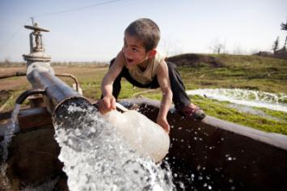
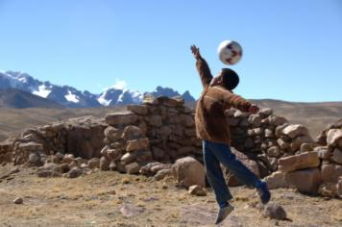
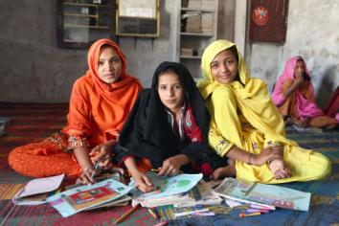
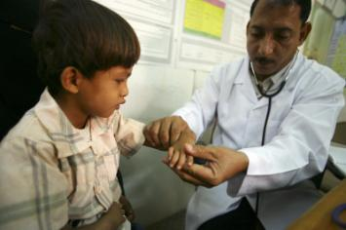
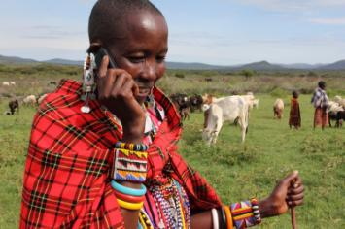
THINKING ABOUT INEQUALITY
Inequality is not just about how money is shared between and within countries.
There can also be inequality in the kinds of opportunities people have in life.
Notes:
Clockwise from top left.
Access to water
Image info: A boy collects water from a well in Dargalar, Azerbaijan.
Photo credit: David Levene/Oxfam
Access to play
Image info: Lucas lives in Macuscani, a small town high in the mountains of Peru.
Photo credit: Annie Bungeroth/Oxfam
Access to education
Image info: Students at a girls’ school in the village of Sanjar Bhatti, Kambar Shahdad Kot district, Sindh Province, Pakistan. From left to right- Gori Bhatt, Amna Khatoon Brohi and Shazzia Bhatti.
Photo credit: Irina Werning/Oxfam
Access to healthcare
Image info: Dr Amen Yagoub looks at Barka age 6 at the Maddodha Health Clinic in Sayoun, Yemen.
Photo credit: Abbie Trayler-Smith/Oxfam
Access to technology
Image info: Women’s leader Noorkishili Naing’isa receives a call on her mobile phone while grazing her livestock in Mairowa Chini, Ololosokwan, Ngorongoro, Tanzania.
Photo credit: Geoff Sayer/Oxfam

Slide 14
MEDALS AND ATHLETES
1st
2nd
3rd

Slide 15
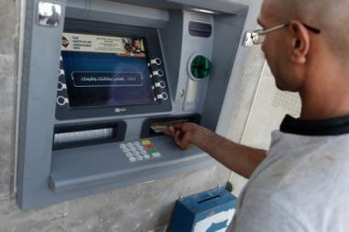
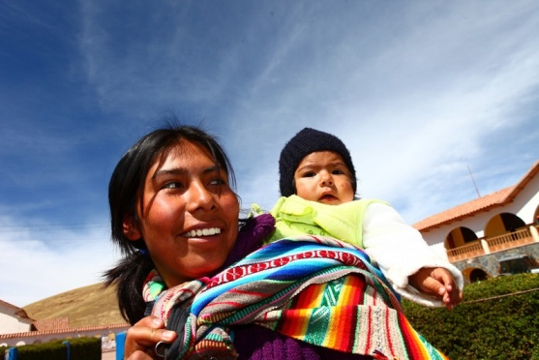
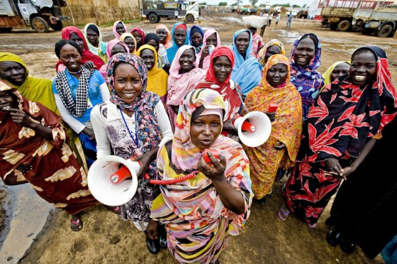
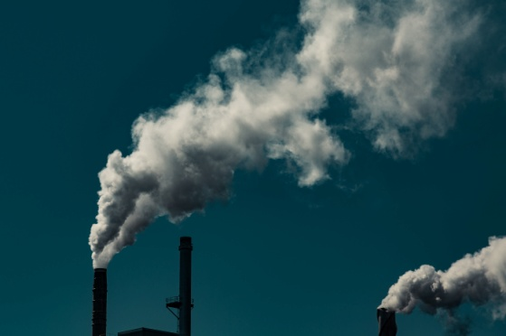
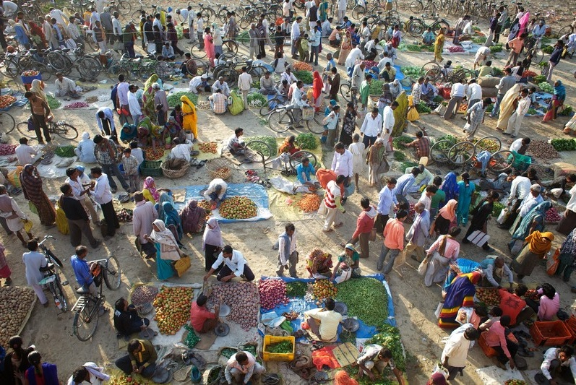
Average income per person
OLYMPIC TRUMPS
Life expectancy
Fairness score
Gender equality score
Carbon footprint
Population
Notes:
Clockwise from top left:
Average income per person
This is the average amount of income of each person in a country.
Image info: A man withdraws money from a cash machine in Baqa, Jordan.
Photo credit: Sam Tarling
Life expectancy
This is the average number of years a person is expected to live.
Image info: A mother and child in Pampamarca main square in Peru.
Photo credit: Percy Ramírez/Oxfam
Fairness score
Countries are given a score between 0 and 100 according to how equal or unequal they are. More equal countries will have a score closer to 0, less equal countries will have a score closer to 100.
Photo credit: Liz Newbon/Oxfam
Gender equality score
This score is calculated by looking at how equal life is for women and men (or girls and boys). It covers areas such as access to healthcare, how much women and men get paid for similar jobs, the percentage of girls who go to school compared to the percentage of boys and the numbers of women in politics. The higher the score, the more equal life is for women and men.
Image info: Voluntary members of the Oxfam water and sanitation committee head into Jamam refugee camp to spread over the loud-speaker vital messages to young women about good hygiene practices and to distribute female hygiene kits, which include underwear, soap and sanitary cloth.
Photo credit: John Ferguson
Carbon footprint
This is the average amount of CO₂ emitted per person each year, for example as a result of electricity, transport and food. CO₂ is one of the greenhouse gases responsible for climate change. The larger the carbon footprint the greater the impact on our planet
Image info: J.D. Irving Smoke Stacks in Fallsview Park/Reversing Falls, Saint John, New Brunswick, Canada.
Photo credit: Tony Webster: commons.wikimedia.org/wiki/File:J.D._Irving_Smoke_Stacks_(22475694145).jpg
Licensed under the Creative Commons Attribution-Share Alike 2.0 Generic license: creativecommons.org/licenses/by-sa/2.0/
Population
This is the total number of people living in the country.
Image info: A twice-weekly vegetable market in the town of Bara Gaon, India.
Photo credit: Tom Pietrasik/Oxfam

Slide 16
HIGHEST OR LOWEST?
London 2012 Olympics athletes (highest score is best)
London 2012 Olympics medal total (highest score is best)
Life expectancy (highest score is best)
Average income per person (highest score is best)
Fairness score (lowest score is best)
Population (highest score is best)
Gender equality score (highest score is best)
Carbon footprint (lowest score is best)

Slide 17
TIME TO THINK
What differences do you notice between the countries?
Do any of these statistics surprise you? Which ones and why?
Do you notice any patterns between the numbers of Olympic medals and athletes a country has and its other indicator values?

Slide 18
QUESTIONING THE DATA
Which country has the lowest value for this indicator?
Which country has the highest value for this indicator?
Choose two countries. What is the difference between their indicator values? Repeat this for another pair of countries.

Slide 19
THINKING ABOUT MAPS
Which countries have the highest values for these indicators?
Which countries have the lowest values for these indicators?
What do you think might be the reasons for the differences in average income per person between countries?
What do you think might be the reasons for the differences in the Olympics medal total between countries?
Do you think these inequalities are fair?

Slide 20
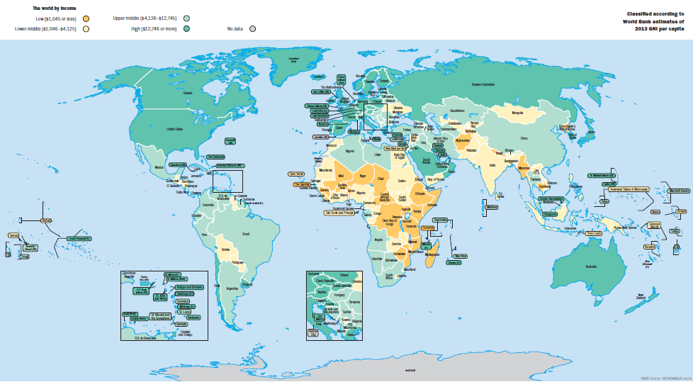
INCOME PER PERSON
Notes:
This world map shows average income per person in different countries across the world. Countries with a lower average income are shaded in orange and yellow; those with a higher average income are shaded in green.
Credit: World Bank, 2015: data.worldbank.org/maps2015

Slide 21
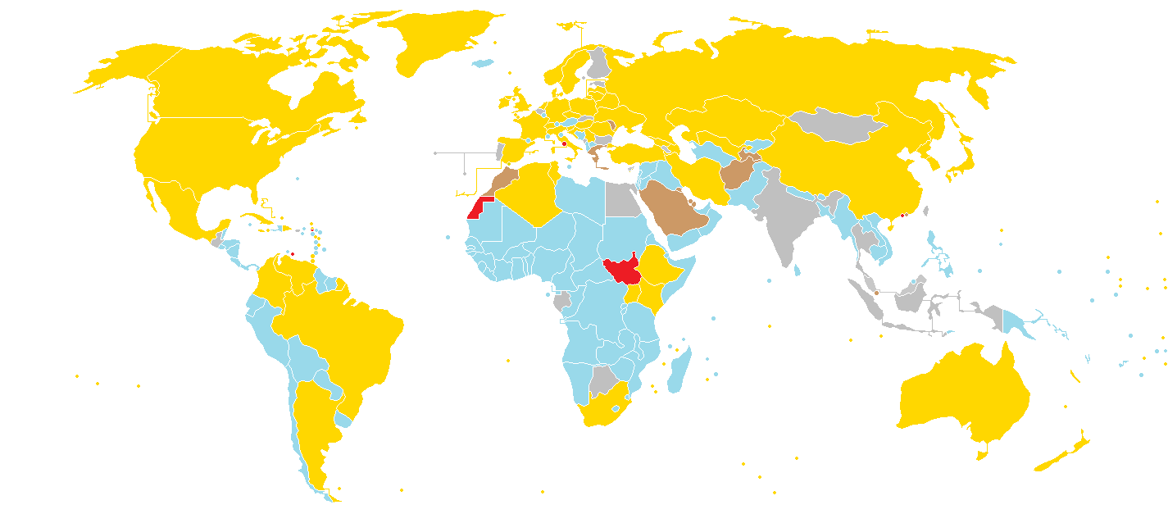
OLYMPIC MEDALS
Notes:
This world map shows the medals achieved by countries participating in the London 2012 Olympic Games.
Gold represents countries that won at least one gold medal.
Silver represents countries that won at least one silver medal.
Bronze represents countries that won at least one bronze medal.
Blue represents countries that didn’t win any medals.
Red represents countries that did not participate in the London 2012 Olympic Games.
Note: This map was created on 9th August 2012 and may not represent the final results.
Credit: Spacejam2: commons.wikimedia.org/wiki/File:2012_Summer_Olympics_medal_map.png
Licensed under the Creative Commons Attribution-Share Alike 3.0 Unported license: creativecommons.org/licenses/by-sa/3.0/deed.en

