Slide 1
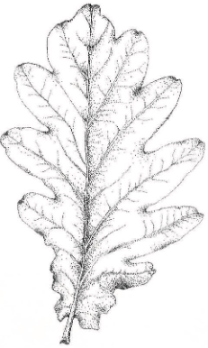
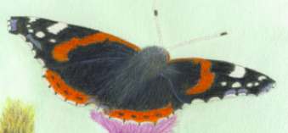
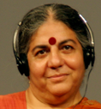
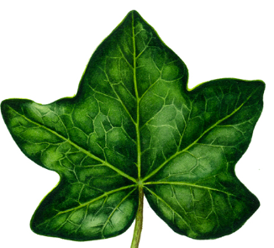

Global Garden Bingo
Student Name: |  | Class / Year group: |  | Date:
1.I am from which tree? _ _ _ | 2. I support 18 species of butterflies…. ________________ | 3. Draw one Global Goal | 4. There is not enough food to feed everyone | 5. Irish households' waste €550 €700 €900 worth of food per year. (Please circle correct answer)
6. _ _% What percentage of food produced globally is wasted ? | 7. Name this social activist _ _ _ _ _ _ _ _ _ _ _ _ | 8. Seed sovereignty is …… | 9. Name three herbs growing in the garden | 10. My name as gaeilge is ‘Slán Iomaire’ in English I am… _ _ _ _ _ _ _ _ _ _ _
Which type of seeds can be saved for free? O.P or F1 Hybrid or GMO (Please circle correct answer) | 12. 90% of Irelands _ _ _ _ _ _ _ _ _ varieties have become extinct | 13. One positive action our school community can do is: | 14. My leaves have many health benefits _ _ _ _ _ _ | 15.
TRUE
or
FALSE
a. Giving free seeds to poor farmers OR
b. The rights of farmers to save their own seed
15.What I like about our global garden is…..

Slide 2



What is a global garden?
A global garden is designed to minimise its environmental impact in a world facing climate change and increased demand for limited resources such as water and oil. It is a living resource to educate our community about global justice; to show how our actions can have a global impact.
Our school global garden:
reduces food miles and carbon emissions by growing fruit and vegetables for local consumption
uses organic, open-pollinated seeds which can be saved and passed on to future generations
does not use oil-based fertilisers, pesticides or chemicals
uses harvested rainwater to reduce water consumption
reduces waste sent to landfill by composting
limits its carbon footprint by using locally sourced re-used and renewable materials where possible
Cross-curricular links
It also is designed to enrich student's learning experience across the whole curriculum, from CSPE to History, Science and Literacy.
Our school global garden:
includes plants which are especially suited to exploring historical, cultural and economic contexts
uses the practical experience of growing to enable students to understand our connections to people around the world
explores students critical thinking skills about our unsustainable food systems, exploitation and trade, child labour, farmers rights and food waste
helps to develop the knowledge, understanding, skills and values students need if they are to make a positive contribution, both locally and globally

