Slide 1
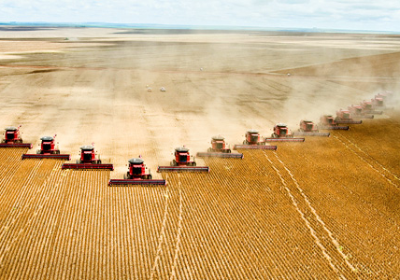
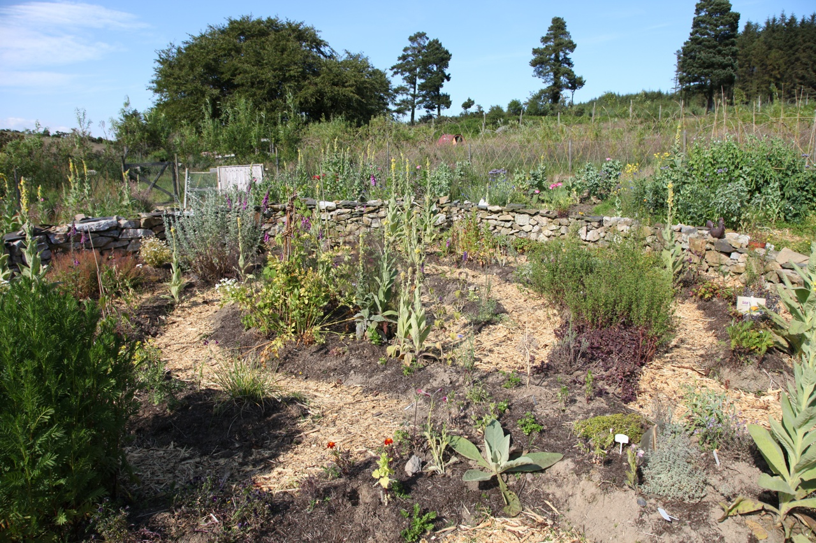
Global Garden – an introduction
Junior Cycle Short Course: Sustainability Unit of Learning Global Garden: 3rd Years
Notes:
Use the two images as discussion questions: what do the images suggest you will be studying in the UoL?

Slide 2
Intro Global Garden Lesson 2
Learning Intentions
Junior Cycle Short Course: Sustainability Unit of Learning Global Garden: 3rd Years
By the end of this lesson…
A. I will be able to explain how food growing is connected to biodiversity loss
B. I will understand how food consumption impacts people and our natural environment
C. I can define food miles and carbon footprints.
Notes:
GJ 3Discuss, with evidence, what are the possible root causes of climate change, biodiversity loss and one at least one other sustainability issue.
GJ 4 Illustrate using data and/or visuals how different ideas about economic growth and consumption impact on our own wellbeing and that of others locally and globally.
GJ 8 Research a particular company or interest group that benefits from continuing one unsustainable practice, how it exerts political power, and how powerful opposition to ending this practice has been, or could be, challenged successfully.

Slide 3

6 steps
#1 Identify Target Group and Support Network
#2 Choose A Global Justice Theme
#3 Explore our theme
#4 Raise Awareness
#5 Create change
#6 Reflect

Slide 4
#1 Identify Target Group and Support Network
3rd yr SUS
TY Outdoor Learning
5th yr Art

Slide 5
#1 Identify Target Group and Support Network
NWET students
other subject teachers
other schools
WWGS
Edible Bray
Local farmers / food growers
Bray Tidy Towns
BIFE Film students

Slide 6
#2 Choose A Global Justice Theme

Slide 7
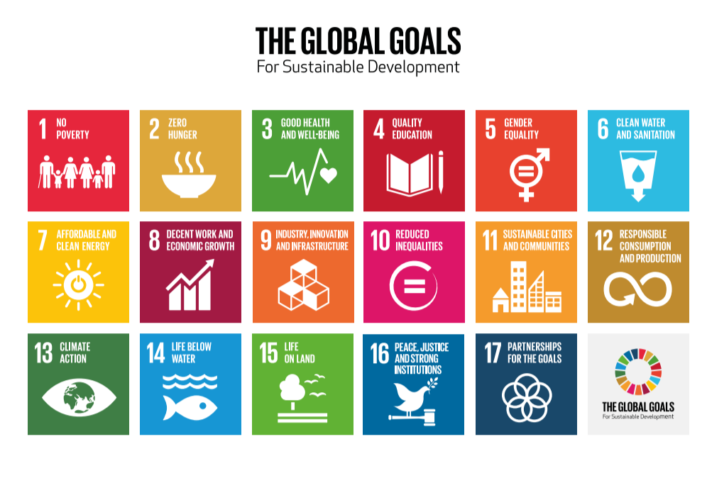
From website: https://worldslargestlesson.globalgoals.org/resource/plate-pioneerz-every-plate-tells-a-story/

Slide 8
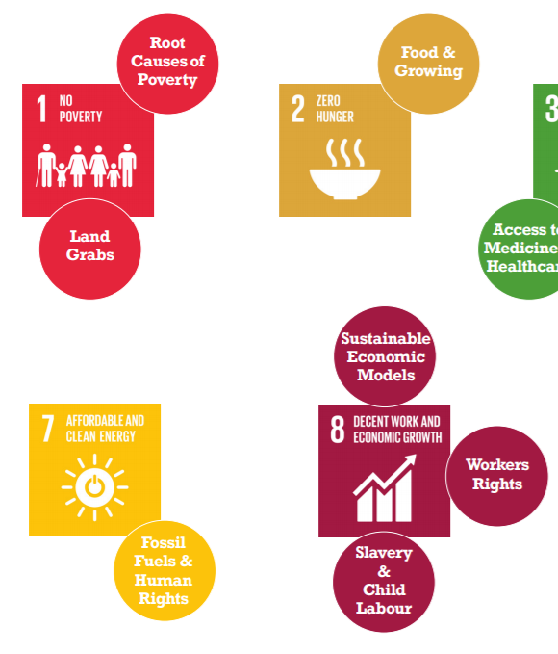

Slide 9
#3 Explore our theme
Zero Hunger: Food + Growing
Gain knowledge on the subject through
Powerpoints
Videos + worksheets
Expert inputs; growers + farmers
A range of other activities like artwork, role-play, case-studies, energisers, outdoor learning
Practical tasks like seed saving, seed growing, composting, tree planting, habitat surveys, biodiversity surveys, citizen science

Slide 10
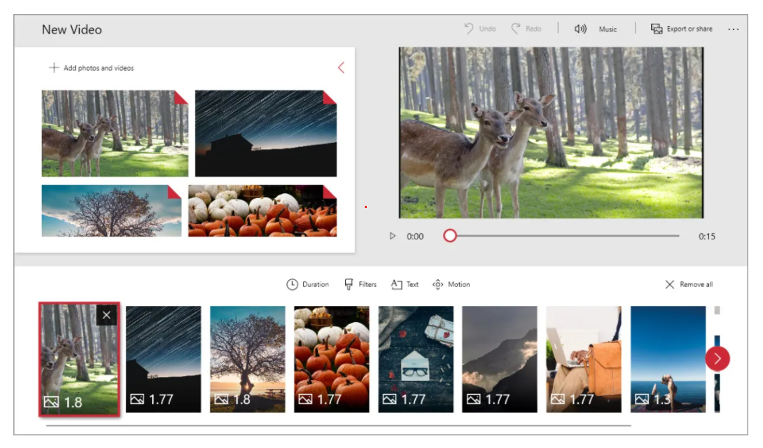
#4 Raise Awareness
Film: using video editor + weekly phone footage

Slide 11
#3 Explore our theme + assessment / checkpoint 1
#4 Raise Awareness = video + other student ideas + interests
#5 Create change = group actions, sub-themes to be decided by students
#6 Reflect = questions and reflection journal

Slide 12
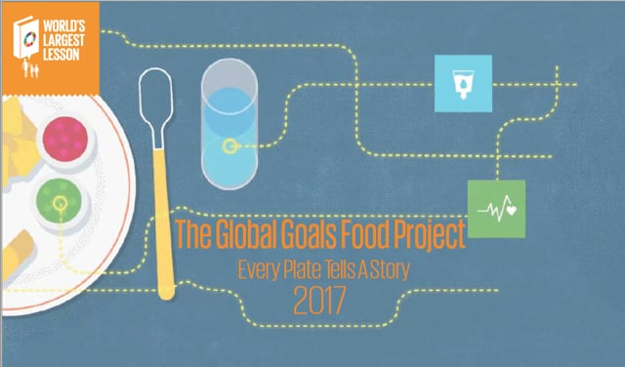
Global Garden – Food Miles
Watch this short video (see next slide) and write down 5 topics they mention under the Global Goal:
Zero Hunger – Food + growing
1.
2.
3.
4.
5.
From website: https://worldslargestlesson.globalgoals.org/resource/plate-pioneerz-every-plate-tells-a-story/

Slide 14
5 topics Zero Hunger – Food + growing
Food growers (eg farmers)
Food processors (eg meat factory workers)
Food packaging (eg plastics factory workers) + Human Rights
Food miles
Food security
Food nutrition
From website: https://worldslargestlesson.globalgoals.org/resource/plate-pioneerz-every-plate-tells-a-story/

Slide 15
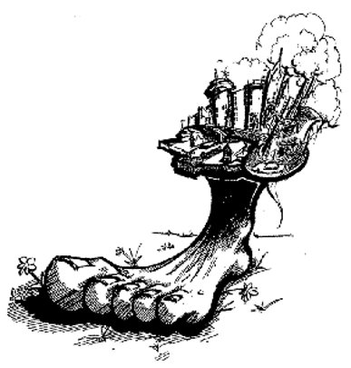
Answer the following questions:
1. What is a carbon footprint?
Notes:
Carbon Footprint activity – markers paper draw around your shoe

Slide 16
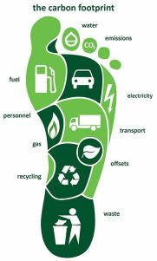
2. Use this poster to help you think about and list as many activities you are involved in your daily life that create your carbon footprint.
This Photo by Unknown author is licensed under CC BY.
Notes:
Carbon Footprint activity – markers paper draw around your shoe

Slide 17
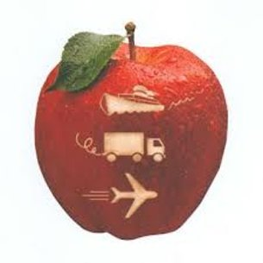
3. What are food miles?
4. Choose any 1 meal you had recently and write out the ingredients as a list
5. Imagine the people who grew/fished/reared these and
where in the world this person lives and works.
Notes:
Carbon Footprint activity – markers paper draw around your shoe

Slide 18
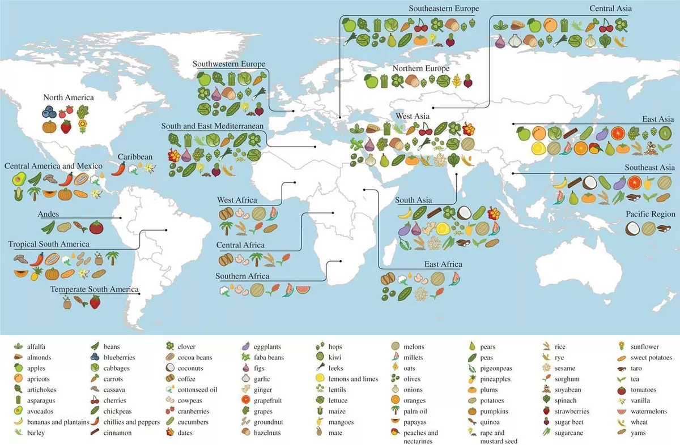
6.
Using the map-
Find the original origin of one ingredient.​
​
Colour print from here:
https://blog.ciat.cgiar.org/origin-of-crops/

Slide 20
Brainstorm –
inputs / outputs
of one food item eg. butter
Notes:
Carbon Footprint individual brainstorm

Slide 21

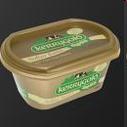



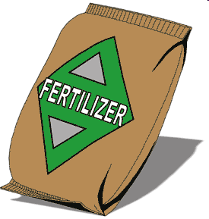
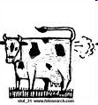

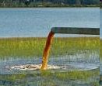
Butter
INPUTS: what you need to produce this ingredient​
OUTPUTS: waste as a result of producing this ingredient
Notes:
Teacher Notes:
Activity- Carbon Footprint
Each student one brainstorm of one item in copy
Follow Carbon footprint activity from Session 3 P/P

Slide 22
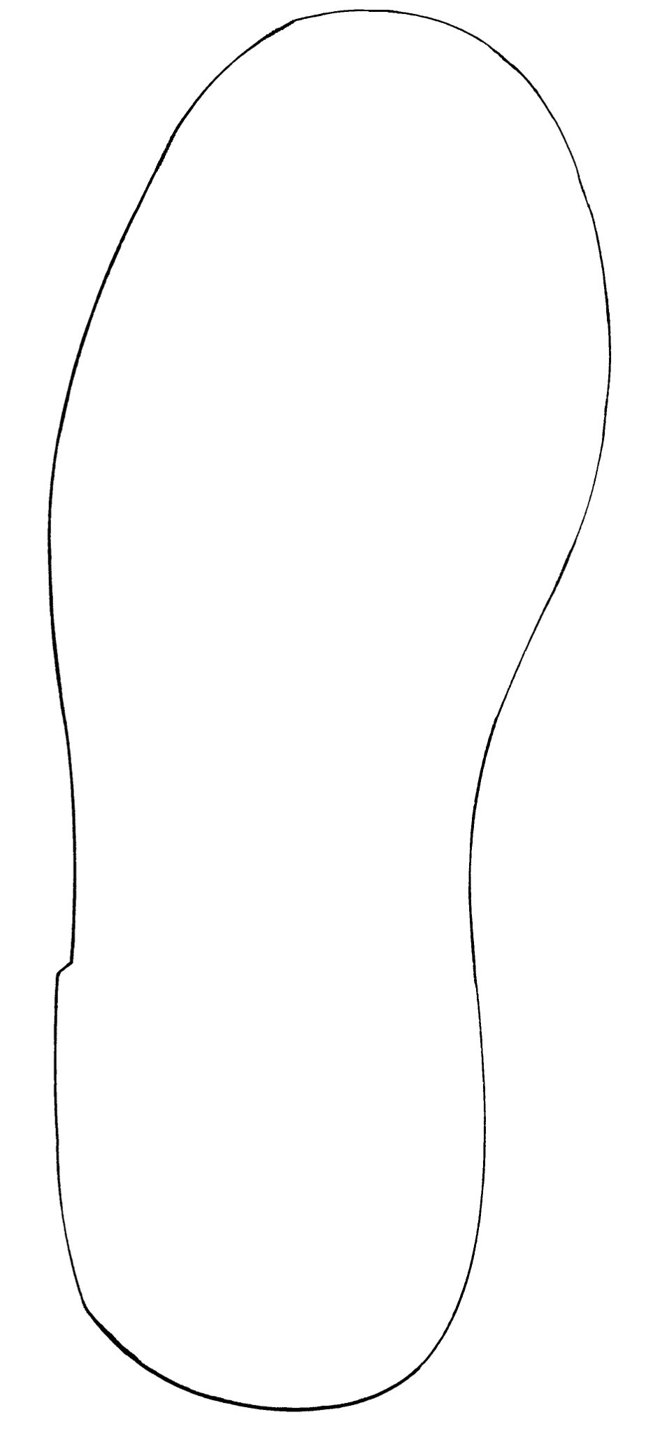
Understanding your carbon footprint

Slide 23
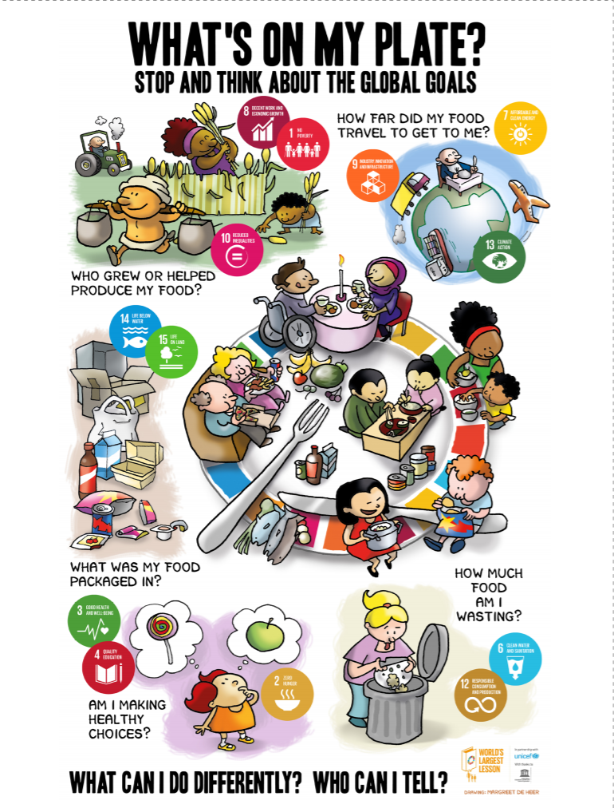
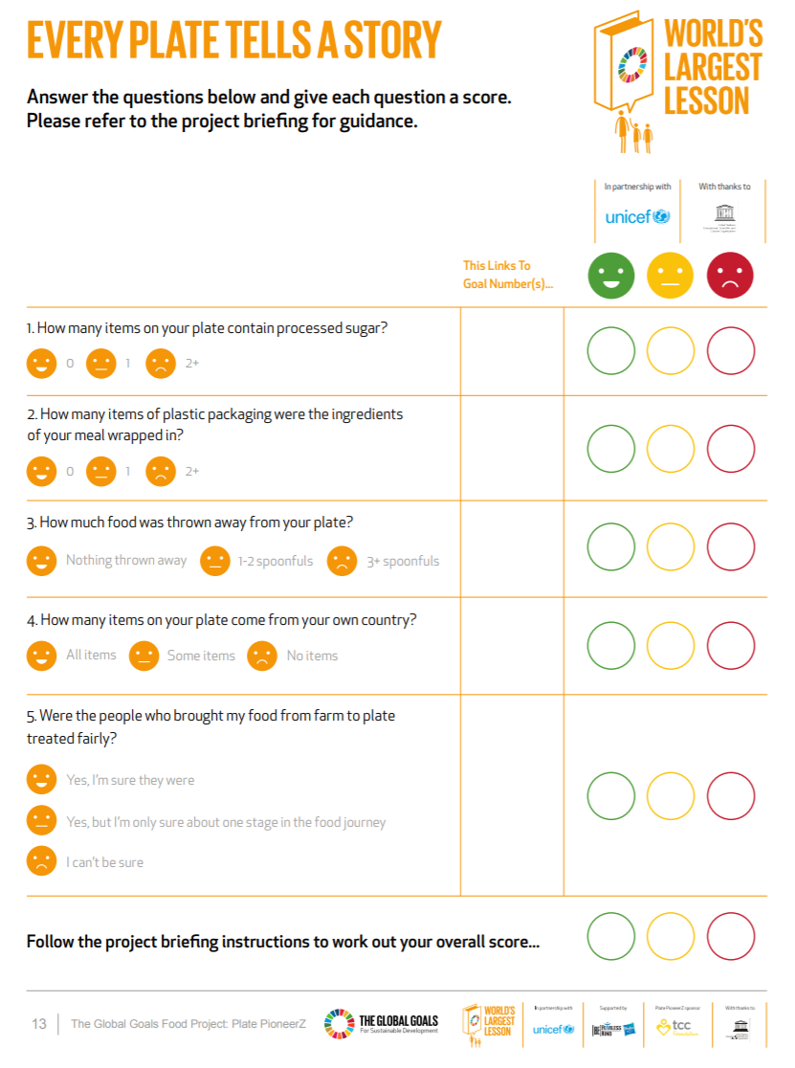

Slide 25
Junior Cycle Short Course: Sustainability Unit of Learning Global Garden: 3rd Years
Glossary – Key definitions
Summary Activity (tbc on Teams – printed notes for Assessment revision)
(Revisit students answers in their copies 1st.
Create as a quiz, use WWGS or other for exact definitions) and to do:
Match the Key words to the correct definition
Biodiversity =
Human Rights =
Global Goals =
Carbon Footprint =
Food Miles =
Global South =

